Slide 1
World War II

Slide 2
Background to WWII
No one was satisfied with Treaty of Versailles. France was still obsessed with security from neighbour Germany. Germany and Italy became obsessed with revenge.
While North America had boomed through the 1920’s and suffered depression in the 1930’s, much of Europe had struggled through both decades.
Japan was ruled by warlords who wanted to use conquest to create an empire.

Slide 3
Mussolini and Italian Fascism
Italian people were angry with results of Paris Peace Conference.
Italian economy was weak and unstable following WWI.
People were willing to sacrifice democracy if they though that it would bring a more stable economy.
Benito Mussolini formed the Fascist Party. When he was unable to gain political power through elections he organized a ‘March on Rome’ (October 1922). He formed an army of 26,000 men on the outskirts of Rome. King Emmanuel did not want to risk civil war and handed the government over to Mussolini.

Slide 4
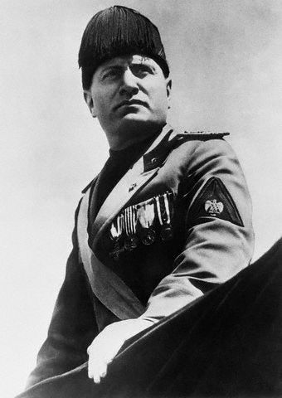
Mussolini and Italian Fascism
Mussolini said that the ultimate goal of a Fascist government was to lead the country into a war of imperial conquest (Italy invaded Ethiopia in 1935).
Italy was not strong enough to be a major player in Europe, so Mussolini eventually formed an alliance with Hitler.

Slide 5
Failure of Democracy in Germany
When the German government fell at the end of WWI democracy was forced upon them.
Democratic government known as the Weimar Republic was formed in 1919.
Most Germans hated Treaty of Versailles and blamed Weimer Republic for signing the treaty.
Many Germans did not think that democracy was a strong enough form of government.

Slide 6
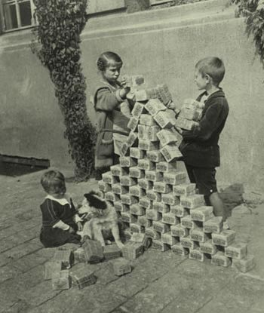
Economic Issues that Undermined Weimar Republic
Inflation – money becomes less and less valuable and goods cost more and more.
Suddenly hyper-inflation became a problem in Germany (1923-1924).
Money became worthless (at one point 12 billion German Marks = 1 Canadian Dollar).

Slide 7
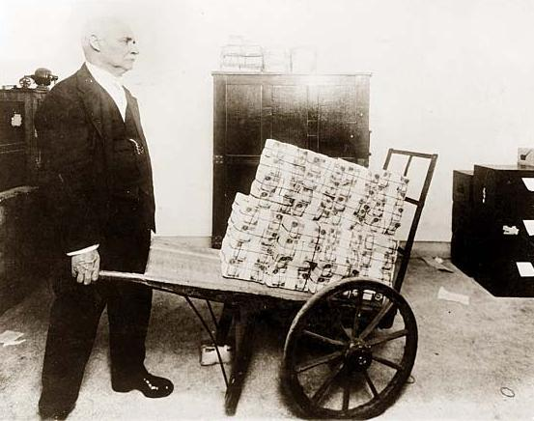
Economic Issues that Undermined Weimar Republic
The price of food rose so quickly that people stopped work at lunch time, got paid wheelbarrows full of cash and ran out to buy food while the money that they had earned in the morning still had value.
Everyone’s savings became valueless.

Slide 8
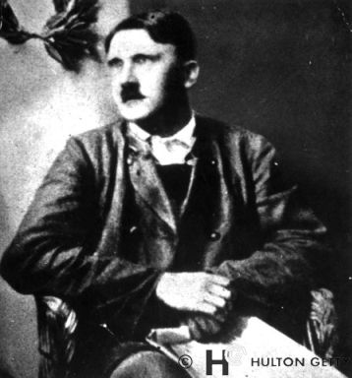
Hitler’s Rise
People blamed the democratic German government for allowing this economic crisis and for allowing French and Belgian troops onto German land.
All of these events caused some people to begin following Adolf Hitler and his new NAZI party.

Slide 9
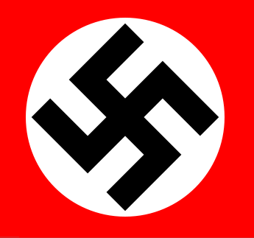
Adolf Hitler and the NAZI Party
Hitler rose to power because of losing WWI, because of the Treaty of Versailles, and because of democracy in Germany. Hitler took over German Socialist Workers’ Party (in German GSWP is NAZI).
The NAZIs had the following beliefs:
1. Extreme Nationalism – sole purpose of a citizens life was to serve the state.
2. Anti-Democratic – Hitler promised that he would get rid of democracy in Germany.
3. Anti-Semitism – the hatred of Jewish people. Hitler used the Jewish people as a scapegoat for Germany’s problems.
4. Restore Germany’s Military Might – Germany historically had a strong military. While Treaty of Versailles limited their military power, Hitler’s promise to restore the German Military was popular with the people.

Slide 10
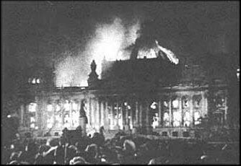
How Hitler Came to Power
In 1932 NAZIs won the most seats in the German Parliament.
Hitler became the German Chancellor.
Without a majority Hitler could not pass anything to German parliament. He called another election in 1933. During the election campaign a Dutch communist burned down the Reichstag (German Parliament Building). Hitler used this event to convince the German people that there was about to be a communist revolution.

Slide 11
How Hitler Came to Power
When 1933 election votes were counted NAZIs were just short of a majority.
He banned communists from parliament and had a majority.
He bullied parliament into passing the ‘Enabling Act’ which basically made him all powerful. He brought an end to democracy and began his own totalitarian government (dictatorship).

Slide 12
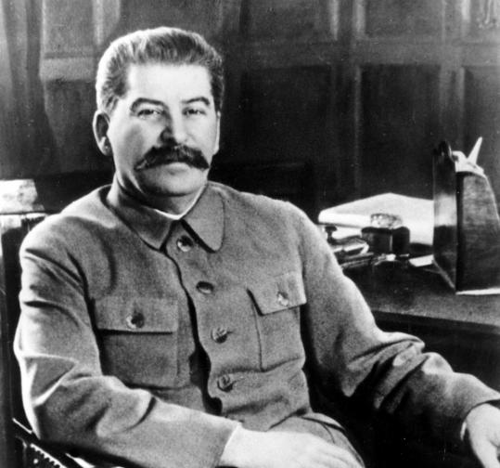
Soviet Union under Stalin
Joseph Stalin gained complete control of Soviet Union (Russia) in 1928.
Stalin wanted to modernize Soviet economy (Russia was industrially behind ‘modern’ countries) and protect Russia from foreign invasion.
Stalin introduced ‘Five Year’ plans to modernize economy.

Slide 13
Soviet Union under Stalin
Under ‘Five Year Plans’ the state took over all farms and ended private land ownership. Government made profit and everyone became an ‘equal’ employee.
Stalin invested in heavy industry. Built roads, airports, sea ports, mines, and factories. Most of this was to help the military. Virtually nothing was done for the common people (no one could make consumer goods because the government controlled all of the factories).
Anyone who stood in that way of Stalin’s goals was executed. Millions of Russian people were killed by their own government. This was known as the Great Terror.
Stalin’s main goal was to protect the Soviet Union. Joined the League of Nations in 1934. A fear of German invasion caused Stalin to sign a pact with the NAZIs in 1939.

Slide 14
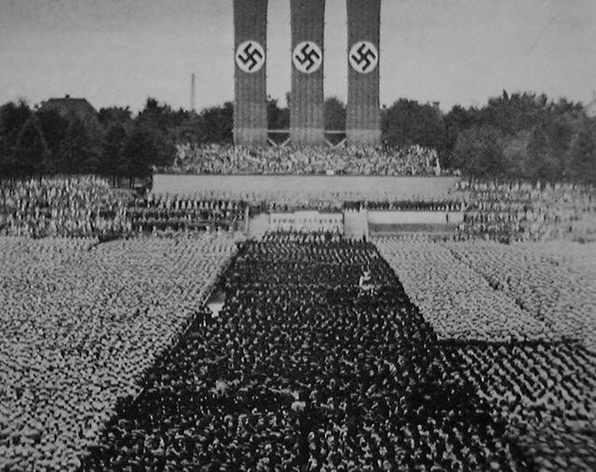
Fundamental (long-term) Causes of WWII
Treaty of Versailles
Great Depression
rise of Hitler and NAZI Party
failure of League of Nations
extreme nationalism
unwillingness of democratic governments to intervene in places like Germany

Slide 15
Immediate (short-term) Causes of WWII
Re-militarization of the Rhineland – Treaty of Versailles said that Germany could have no military presence in this region. When Hitler brought military into Rhineland France and Britain did nothing.
Annexation of Austria – to annex something means to make it part of something bigger. In 1938 German troops moved into Austria to make it part of Germany. Went against the Treaty of Versailles.
Appeasement in Czechoslovakia – Treaty of Versailles had created country of Czechoslovakia. Three million Germans lived near the Czech/German border in an area known as Sudetenland. In 1938 Hitler threatened to invade Czechoslovakia. France and Britain panicked. France and Britain met with Hitler (Czechoslovakian PM Edvard Benes was not even allowed to sit in on the meeting) and gave Germany Sudetenland in exchange for a promise that Germany would not invade Czechoslovakia. Just six months later Hitler broke his promise and his troops invaded and took over Czechoslovakia.

Slide 16
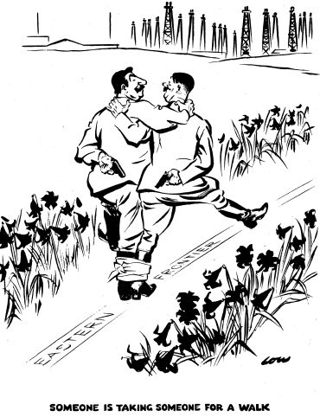
The NAZI-Soviet Pact and the Coming of WWII
Stalin had approached Britain and France to form another alliance to control Germany (Hitler), but was immediately turned down because Russia was a communist nation. Out of fear of Germany, Stalin signed an agreement that the two countries would not attack each other in August 1939. The two countries remained enemies, but Hitler wanted to avoid a two front war and Stalin wanted time to prepare if he ever had to go to war with Germany.

Slide 17
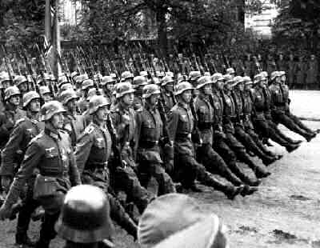
WWII in Europe
On September 1, 1939 Germany invaded Poland.
NAZI’s used blitzkrieg tactic. Airplanes led the attack and dropped bombs. Tanks and soldiers followed. Attacks would go right past enemy line, and then turn around and trap them.

Slide 18
Phoney War
Britain and France immediately declared war on Germany.
Canada did not enter the war immediately as it had with the British Empire in WWI. A week later Canada also declared war on Germany. Most Canadians thought that they had to stop Germany. PM Mackenzie King promised Quebec that conscription (forced military service) would never be an issue.
Allied troops were waiting for Germany to attack Western Europe. This did not happen from October 1939 to April 1940.
War was a reality in Czechoslovakia, Poland, and Finland.

Slide 19
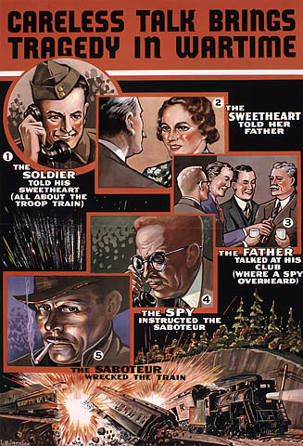
Propaganda
Canadian government continued to use many forms of propaganda including films and posters to encourage Canadians to support the war effort, create an evil image of the enemy, and discourage Canadians from talking carelessly about war related matters.

Slide 20
