Slide 1
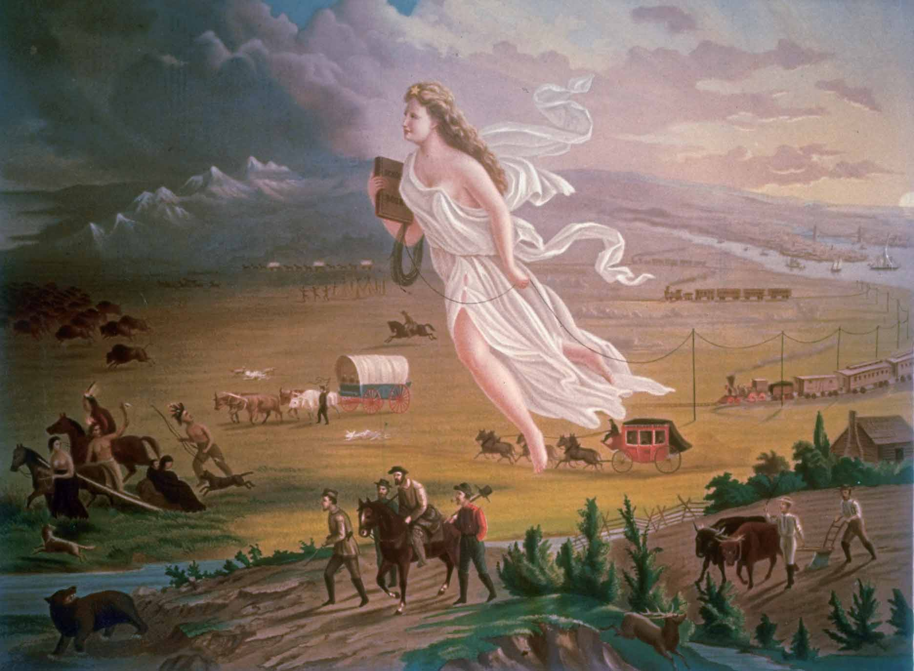
The wilderness flees before the advance of civilization – note the group of tradition Native Americans who are depicted as just another wilderness obstacle – a typical 19th century Euro-American attitude.
The Oregon Trail

Slide 2
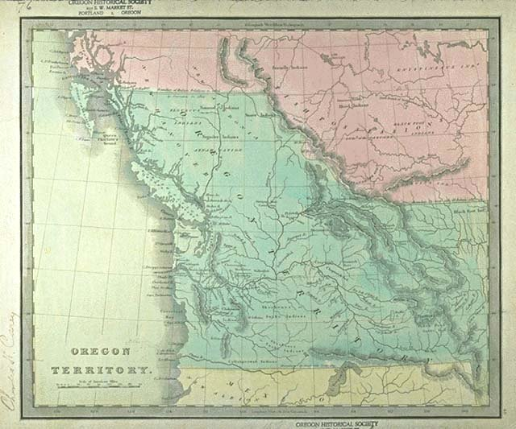

Slide 3
Trends in BNA: 1810-1860
New intellectual and religious movements.
Social reforms.
Beginnings of the Industrial Revolution in America.
Re-emergence of a second party system and more political democratization.
Increase in federal power .
Increase in American nationalism.
Further westward expansion.

Slide 4
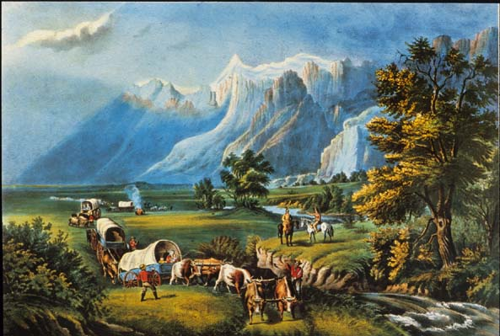
A Period of Expansion
A myth of the West as a land of romance and adventure emerged.
Expansion Fever hits [again] in 1840’s
Americans were moving west, energized by a belief in the rightful expansion of the US from coast to coast

Slide 5
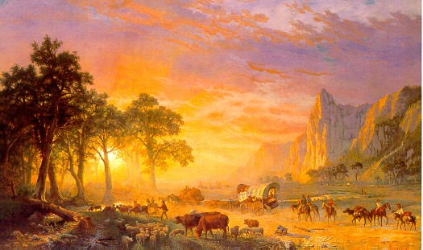
Overland Immigration to the West
Between 1840 and 1860, more than 250,000 people made the trek westward.
Between 1840-1860, 53,000 went across the Prairies to
the Oregon Territory.
The Oregon Trail remained the major highway to the Pacific Northwest until the railroad was built in 1884.

Slide 6
Trails Westward

Slide 7
Horse, Mule, or Oxen?
Horses were quickly rejected because they could not live off prairie grass along the way.
Most of the emigrants decided on the oxen because they were strong, could live off grass or sage and were less expensive.
“The oxen is a most noble animal, patient, thrifty, durable,
gentile and does not run off… The ox will plunge through mud,
swim over streams, and eat almost anything.” wrote on
emigrant.

Slide 8
Hardships Along the Way
Rivers were a constant source of distress for the pioneers. Hundreds of people were drowned as they crossed the Rivers.
Ferrymen charged exorbitant rates to take people across the rivers.
Because most people grossly overloaded their wagons, they were forced to walk the 2000 miles to Oregon.
The wagons did not have any safety features. If someone fell
under the massive wheels they were killed instantly.
“A little boy fell over the front end of the wagon during our
journey. The wheels rolled over the child’s head crushing it”
wrote Edward Lenox.

Slide 9
Hardships Along the Way cont.
Thunderstorms, flash floods, and hail storms were also a problem.
The biggest problem for the emigrants was cholera for which there was no cure. Often the emigrant would go from healthy to dead in a matter of hours. Sometimes they received the proper burial but often they were left in their beds along the trail to die. In a bad year some wagon trains lost 2/3 of their people.
“We camped at a place where a women had been buried and the
wolves dug her up. Her hair was their with the comb still in it.
She had been buried to shallow.”

Slide 10
The First Year
For many the first year in the Oregon Territory proved nearly as difficult as life on the trail.
The HBC allowed the immigrants to purchase goods on credit.
For some settlers only cold, damp campsites were available.
The first order of business was to build a cabin and then clear the land for farming.
REMEMBER THE SIZE OF THE TREES IN THIS AREA
5. A good poor mans crop was wheat especially when demand and prices increased because of the California gold rush.

Slide 11
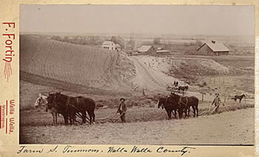
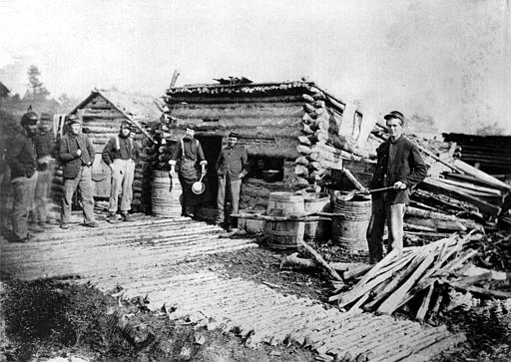

Slide 12
The Oregon Dispute: 54’ 40º or Fight!
By the mid-1840s, “Oregon Fever” was spurred on by the promise of free land.
The joint British-U. S. occupation ended in 1846.

Slide 13
The Oregon Territory
The fight for land
Russia claimed the coast as far south as northern Vancouver Island
Americans claimed the Oregon territory
HBC saw the area as n extension of Rupert’s Land (which had been granted to them by King Charles II in 1670)

Slide 14
America’s Plan for the Land
Rapidly growing population
Americans pursued an aggressive policy towards Oregon Territory – encouraged settlers to move into the area
“Manifest Destiny”
- Believed it was America’s destiny to control all of North America
".... the right of our manifest destiny to over spread and to possess the whole of the continent which Providence has given us for the development of the great experiment of liberty and federaltive development of self-government entrusted to us. It is right such as that of the tree to the space of air and the earth suitable for the full expansion of its principle and destiny of growth."
(First coined by newspaper editor, John O’Sullivan in 1845)

Slide 15
HBC Plan for the Land
No interest in encouraging settlement
- Afraid settlement might undermine their trade monopoly
HBC Governor Simpson – toured the area in 1828 & decided that the HBC was not making the best use of area resources
Simpson created a new post and put it under the direction of John McLoughlin

Slide 16
John McLoughlin
Hired by HBC to run “Fort Vancouver”
Known for his fairness & rewarding his employees
Recognized that the Americans were going to settle in the southern Oregon Territory
Encouraged Americans to go there and stay out of HBC territory
Offered money and supplies to Americans arriving overland

Slide 17
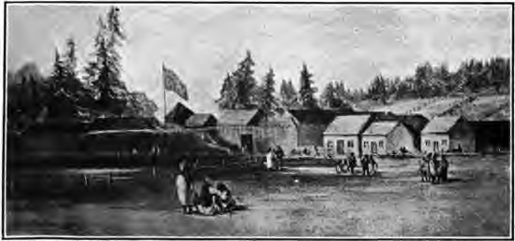
Result
McLoughlin’s actions resulted in a strong American presence after a few years
Went unnoticed as McLoughlin managed the trade effectively

Slide 18
Russian Trading Posts
A number of posts in Alaska
Extending their influence south along the Northwest Coast
1839 → Russia agreed to cease operations south of 54*40’N in exchange for food supplied by HBC

Slide 19
Rising population of American settlers in the Oregon Territory – British feared they would lose control
Simpson ordered James Douglas to establish a new depot on Vancouver Island
Fort Victoria established in 1843

Slide 20
James Polk
11th American President
Came up with the slogan “54 40 or fight”
1844 campaign, he made 5 promises:
to acquire California from Mexico
to settle the Oregon dispute
to lower the tariffs
to establish a sub-treasury
to retire from the office after 4 years.
He fulfilled all his campaign promises

Slide 21
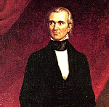
James Polk cont.
1845 – Polk tried to negotiate with the British government for the Oregon Territory
Polk did not want to go to war with the British (despite his aggressive stance in the 1844 election)

Slide 22
Oregon Boundary Treaty 1846
Britain refused to give up its claim - the old boundary of 1818 was finally extended along the 49th parallel to the Pacific Ocean
Vancouver Island remained in British hands
Fort Vancouver became US territory

Slide 23
So, Why go West?
Colonists hit the trails to:
Escape religious persecution
Find new markets for commerce
Claim land for farming, ranching, and mining
Locate new harbours on the Pacific for trade
Seek employment
Spread the virtues of democracy
Prevent America’s “Manifest Destiny”

