Slide 1
Social Studies 9 Review
Social Studies 10 WGSS Mr. Salter

Slide 2
The Social Study of Revolutions
English Revolution
French Revolution
Industrial Revolution
The Fight for North America
American Revolution

Slide 3
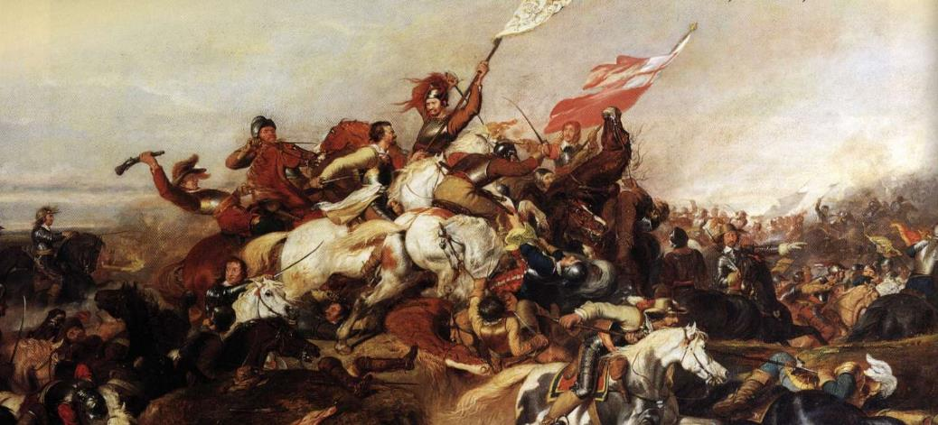
English Revolution 1640-1660

Slide 4
English Revolution 1640-1660
English Civil War (1642 – 1651)
Commonwealth (1640 – 1660)
Charles II (1660)

Slide 5
English Revolution: Civil War
series of armed conflicts and political plots between Parliamentarians ("Roundheads") and Royalists ("Cavaliers") over England's government.
First conflict (1642 – 46) & Second conflict (1648 – 49) were King Charles I’s supporters against supporters of the Long Parliament
Third conflict (1649 – 51) was between King Charles II’s supporters and supporters of the Rump Parliament
Ended with a victory for the Parliamentarians at the Battle of Worcester on September 3rd, 1651

Slide 6
English Revolution: Civil War cont.
Resulted in:
Trial and execution of Charles I
Exile of Charles II, his son
Replacement of the monarchy (under Oliver Cromwell)

Slide 7
Oliver Cromwell
Born: April 25th, 1599
Died: September 3rd, 1658
In charge of England from 1653 – 58
Signed the death warrant of Charles I
Put in new laws (blue laws)
Did not follow the rules himself
People hated him and his rules

Slide 8
French Revolution

Slide 9
French Revolution 1789 – 1799
Social and political upheaval
Abolition of the French monarchy
Establishment of a secular and democratic republic that became authoritarian and militaristic (dictatorship)
Radical social change based on liberalism and Enlightenment
Rise of Napoleon Bonaparte
Armed conflicts with other European countries

Slide 10
French Revolution cont.
Execution of Louis XVI
Lead to the spread of liberalism, radicalism, nationalism, socialism, feminism, and secularism throughout the world

Slide 11
Napoleon Bonaparte
Born: August 15th, 1769
Died: May 5th, 1821
Emperor of France from 1804 – 1814
Built a large empire during his Napoleonic Wars
Depicted as a short little man, but was actually 5’6”, which was taller than the average French citizen at the time
Propaganda by the English to make him seem less threatening and more of a joke

Slide 12
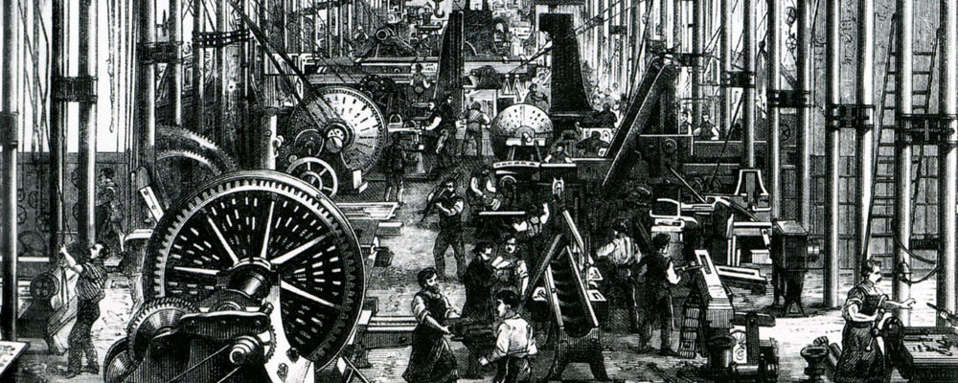
Industrial Revolution

Slide 13
Industrial Revolution 1760 – 1820
Transition to new manufacturing processes
Hand production methods -> machines
Chemical manufacturing
Iron production manufacturing
Steam power
Machine tools
Factories

Slide 14
Industrial Revolution cont.
Began in Great Britain
Resulted in an increase in average income, and the population began to exhibit sustained growth
Standard of living increased
Second Industrial Revolution (1840 – 1870)

Slide 15
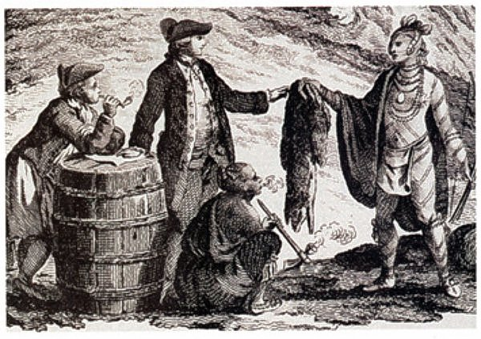
Fight for North America

Slide 16
Fight for North America
Fur trade and the desire to control North America
Main groups associated in the fight:
Great Britain
United States colonies
France
Spain
All of the groups wanted part of North America for their own reasons, mostly for profit of some sort (Empires)

Slide 17
American Revolution

Slide 18
American Revolution 1765 – 1783
Thirteen American Colonies rejected the British monarchy and founded the United States of America
Thirteen Colonies: Delaware, Pennsylvania, New Jersey, Georgia, Connecticut, Massachusetts Bay, Maryland, South Carolina, New Hampshire, Virginia, New York, North Carolina, and Rhode Island and the Providence Plantations
Colonists (Patriots) fought against the British Rule, such as during the Boston Tea Party
Some Colonists remained loyal to Great Britain (Loyalists)

Slide 19
American Revolutionary War (1775 – 1783)
Patriots (with French, Spanish and Dutch allies) went to war against the British and the Loyalists
Patriots were lead by George Washington (the future 1st President)
Eventually resulted in the abolition of slavery

