Slide 1
War is On!

Slide 2
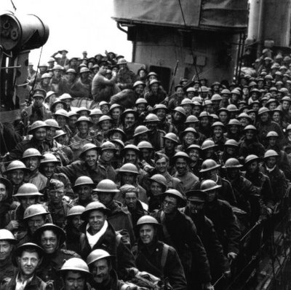
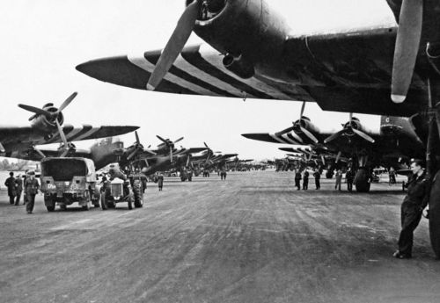
War on the Western Front (May 1940)
German troops quickly took Holland, Denmark, Belgium, and Norway.
French and British troops were trapped when they retreated to the French beaches of Dunkirk. About 900 ships came across the English Channel to rescue 340,000 soldiers form Dunkirk (May 27 – June 4 1940).
A few weeks later France surrendered to Germany.

Slide 3
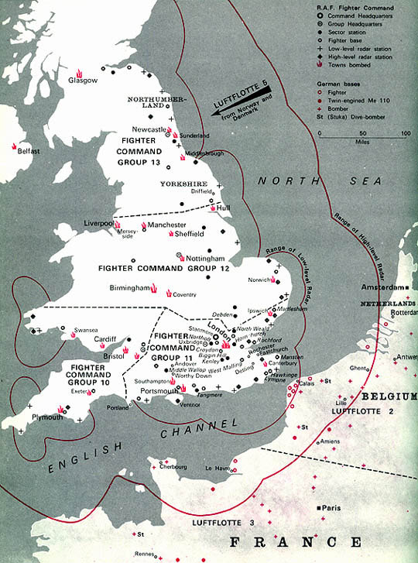
Battle of Britain - 1940
Hitler planned to use air attacks to ruin Britain’s factories and demoralize the people.
He also thought that air attacks would make Britain’s strong navy which patrolled the English Channel ineffective.

Slide 4
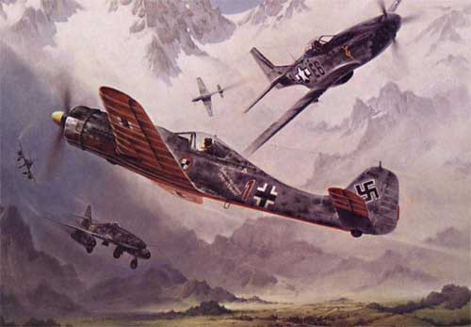
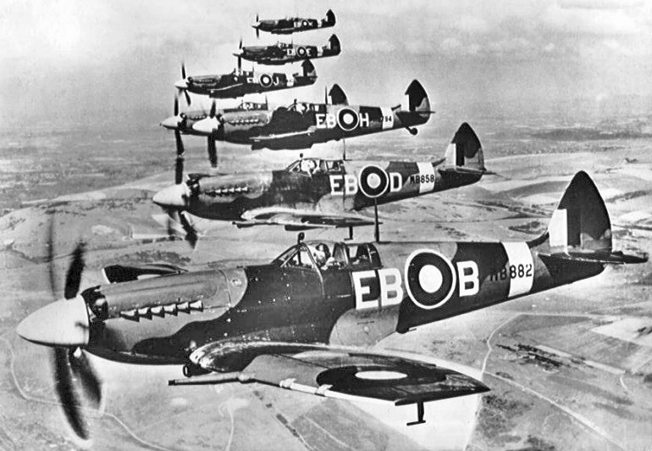
Battle of Britain - 1940
During summer of 1940 the British Royal Air Force (RAF) and German Luftwaffe (German air force) fought in the air above Britain.

Slide 5
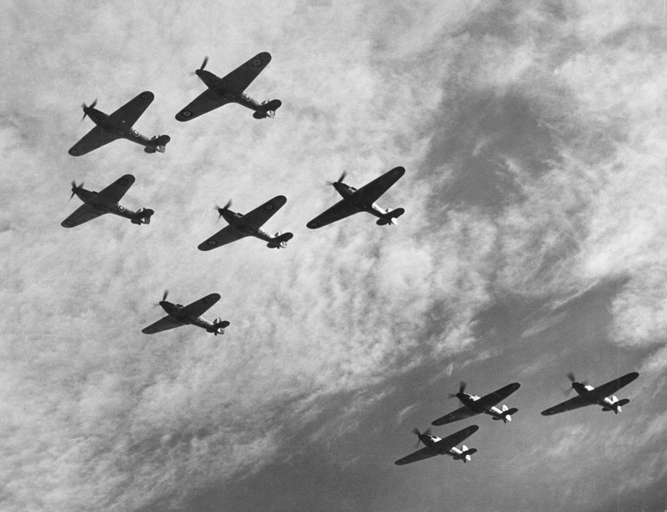
Battle of Britain - 1940
British were outnumbered 3:1, but they had better planes, radar to detect coming attacks, and the Enigma (German cipher machine) which allowed them to intercept and decode German messages.
Imitation Game: Alan Turing

Slide 6
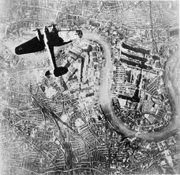
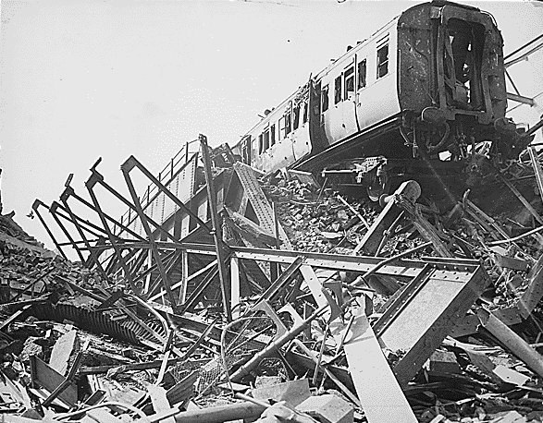
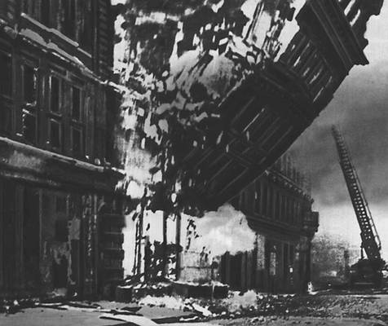
Battle of Britain - 1940
Most German air attacks had been on British military targets (military airports and military factories).
In August 1940 a lost German pilot accidently bombed London.
British PM Winston Churchill ordered the British to bomb Berlin, Germany.
Hitler then ordered a daylight bombing of London.

Slide 7
Battle of Britain - 1940
While British did not like bombing of London, it did distract German planes from bombing military airports in Britain. Safe airports allowed the British to train more pilots and rebuild their strength.
Many say that letting the British rebuild their air force was the mistake that cost Hitler the Battle of Britain.
Britain RAF (Royal Air Force) was able to regroup and win Battle of Britain.
The Battle of Britain was the first time that Hitler had been stopped.

Slide 8
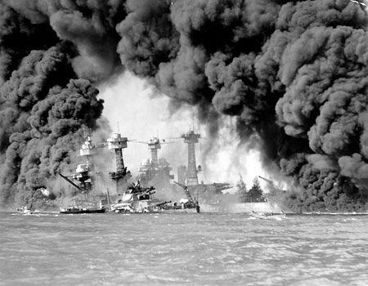
Pearl Harbour – December 7,1941
At the start of WWII the United States once again remained neutral.
They supplied the Allied forces for resources and supplies.
On December 7, 1941 Japan attacked Pearl Harbour (Hawaii).
This attack brought the United States into WWII.

Slide 9
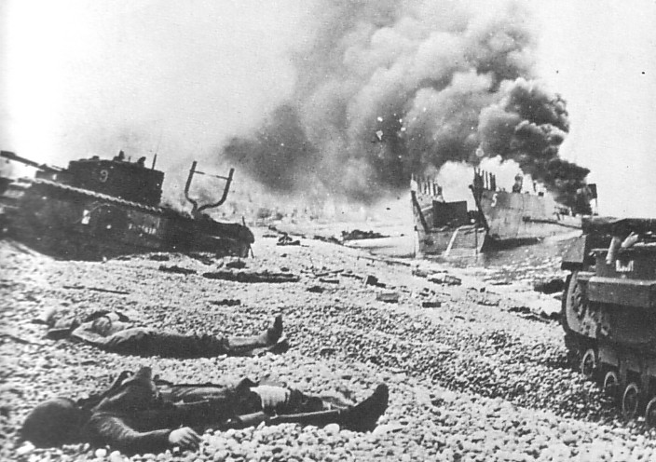
Canadians at Dieppe (1942)
Five thousand Canadian soldiers were assigned to attack and capture Dieppe (north coast of France).
Canada lost the battle badly - they had been spotted coming across the English Channel and British Air Force did not bomb ahead of them like they were supposed to.
Lessons learned (that heavy air and naval support would be needed to take France back) helped the Allies to prepare for later attacks.

Slide 10
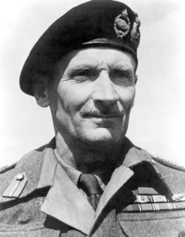
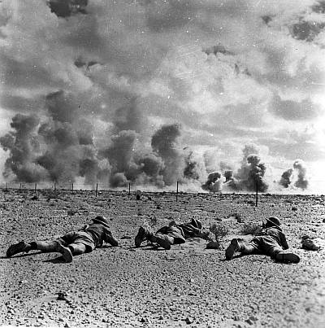
War in Northern Africa
Mussolini’s Italy attacked Egypt in September 1940. British forces defended Egypt. Germany backed Italy.
War between the Axis (Germany/Italy) and Allied (Britain/France) forces raged in Egypt for two years. It ended in October 1942 with Battle of El Alamein (for control of Egypt). Decisive victory for the British was led by General Bernard Montgomery. First major victory off British soil for the Allied forces.
Turning point in the war because Allied victory ensured that Hitler would not seize the Suez Canal and oil resources in the Middle East.

Slide 11
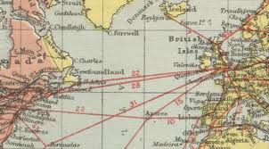
Battle of the Atlantic
Battle of the Atlantic was the longest campaign in WWII.
Like in WWI, Germany wanted to cut off supplies to Britain (high population and small land mass with limited resources means that Britain is an importing nation).
Germany’s goal was literally to starve the British people into surrender.

Slide 12
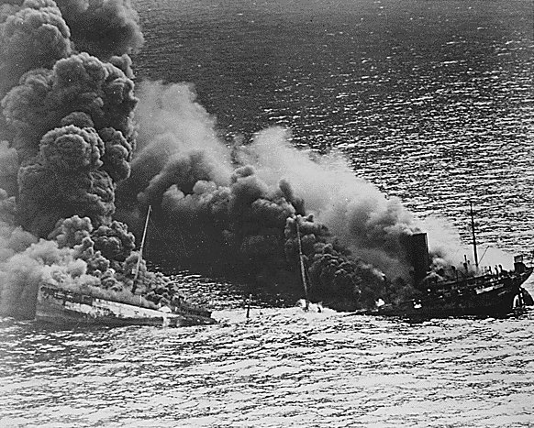
Battle of the Atlantic
German submarines (U-boats) travelled in packs all over the Atlantic.
They even sunk 21 ships in Canada’s St. Lawrence River.
By 1941 the U-boats were sinking ships faster than the Allied nations could build them (not to mention lost lives and supplies).
Allied ships sailed in convoys.
Royal Canadian Navy often protected convoys of supply ships. Small Canadian warships were called ‘corvettes’.

Slide 13
Battle of the Atlantic
Convey system quite successful in protecting ships.
Royal Canadian Air Force also sent bombers to protect convoys.
New technology of sonar (underwater radar) also alerted convoys of coming attacks.
Bombs dropped by planes and depth charges (explosives) dropped by escort ships helped the Allies win the Battle of the Atlantic.

Slide 14
Battle of the Atlantic
At the beginning of the war Canada’s Navy had 13 ships and 3,000 sailors.
By the end of the war they had 370 ships and over 100,000 sailors.
Over 2,000 members of the Royal Canadian Navy lost their lives on the Atlantic.
This was one of Canada’s biggest contributions to the war effort.

Slide 15
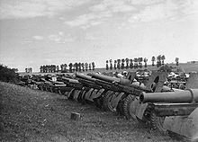
War on the Eastern Front
Hitler broke the NAZI-Soviet Pact and invaded Russia.
His hope was to win more land and resources and to do away with communism forever.
Operation Barbarossa was Hitler’s invasion of Russia which began June 22, 1941.
The Eastern front was approximately 3,000 km long.

Slide 16
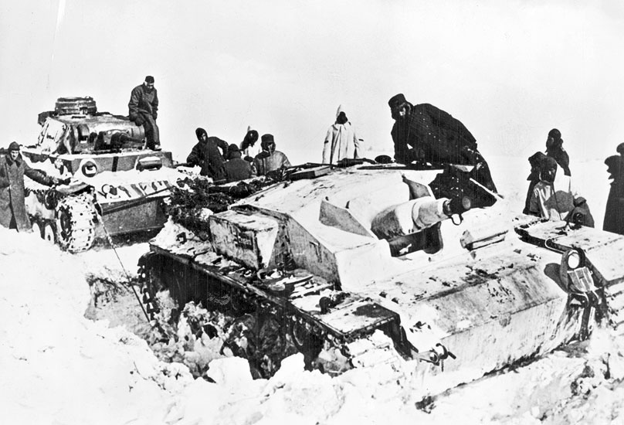
War on the Eastern Front
By December 1941 the German advance had been slowed just outside of Moscow.
Harsh winter caused huge losses for the Germans.
Soviets used the harsh winter as a chance to attack the stalled German advance. Soviets win long battle.

Slide 17
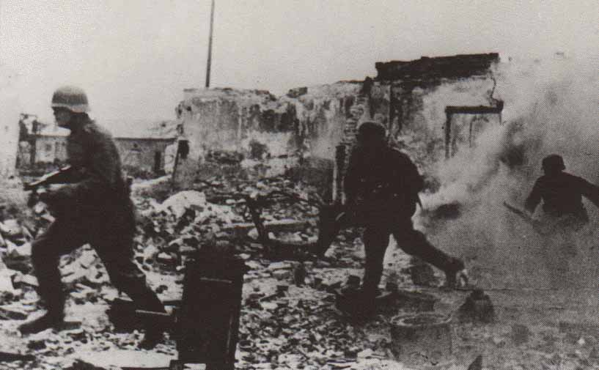
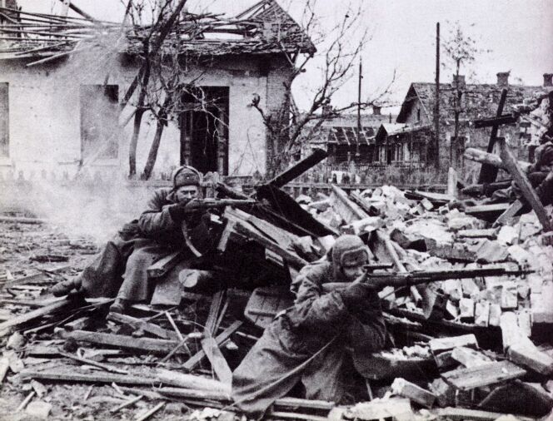
War on the Eastern Front
Turning point – Battle of Stalingrad (September 1942 – January 1943).
Hitler needed to get to the oil fields in southern Russia (oil was obviously a needed resource).
Hitler could have gone around Stalingrad to get to the oil fields, but because he hated the name ‘Stalingrad’ he decided to attack the city.
This long, bloody battle ended with a sure Russian victory.
After the Battle of Stalingrad Germany suffered defeat after defeat on the Eastern front.

Slide 18
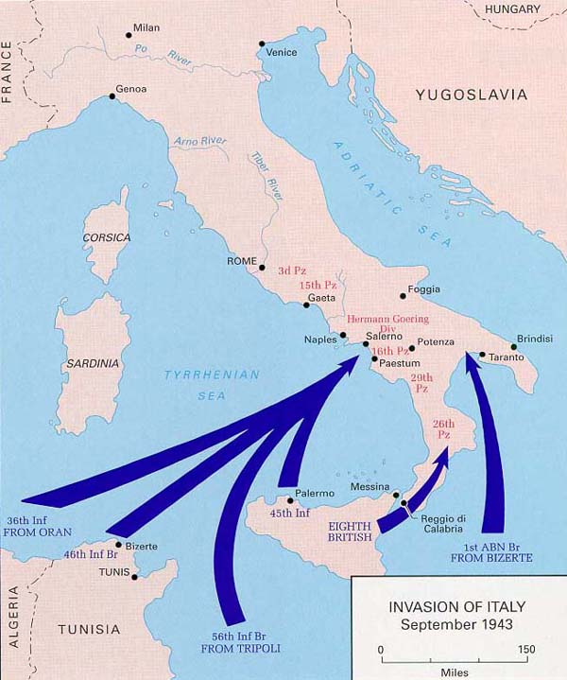
The Italian Campaign
By mid-1943 the German had been defeated in North Africa and were retreating on the Eastern Front.
Allies decided to attack Italy with the hope of surrounding Germany.

Slide 19
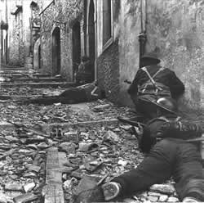
The Italian Campaign
It took the Allies one month (July 1943) to capture Sicily.
Next the Allied forces attacked Italy from the southern side of the country. Canadian forces pushed north until the Germans stopped them at Ortona (south of Rome) in December 1943.

Slide 20
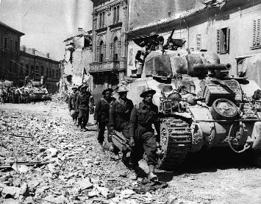
The Italian Campaign
French Canadian unit (Vandoos) broke through the last line of German defense before Rome and continued to free northern Italy in 1944.

Slide 21
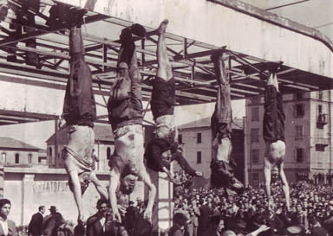
The Italian Campaign
Fight through Italy was one of the bloodiest of the war. At some points ground soldiers literally had to fight from street to street.
In April 1945 Mussolini was captured by Italian soldiers who no longer supported him.
The fighting in Italy (which lasted for almost two years) was a key to surrounding Germany. It also helped to take German soldiers away from defense in northern France.

Slide 22
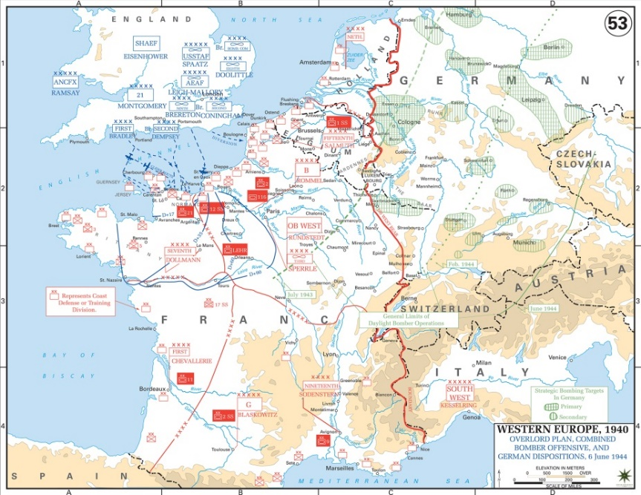
Allies re-capture France
By mid-1944 the Allies were ready to attack the German fortresses in northern France. Germans were expecting this attack and were ready.
The Normandy Landing – June 6, 1944 – Operation Overlord or D-Day
Operation Overlord was the Allied invasion of German-held Europe (Normandy is an area of Northern France). Allies planned to use Air Force, Navy, and bring in ground soldiers.

Slide 23
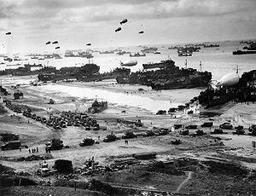
Allies re-capture France
Largest Canadian military operation of WWII.
Over 14,000 Canadian soldiers were involved (5,000 Canadians were killed) along with 100 Canadian ships and 36 planes.
The Allied forces used over two millions men. In total 37,000 Allied soldiers were killed, 154,000 were wounded, and almost 20,000 went missing (presumed dead).

Slide 24
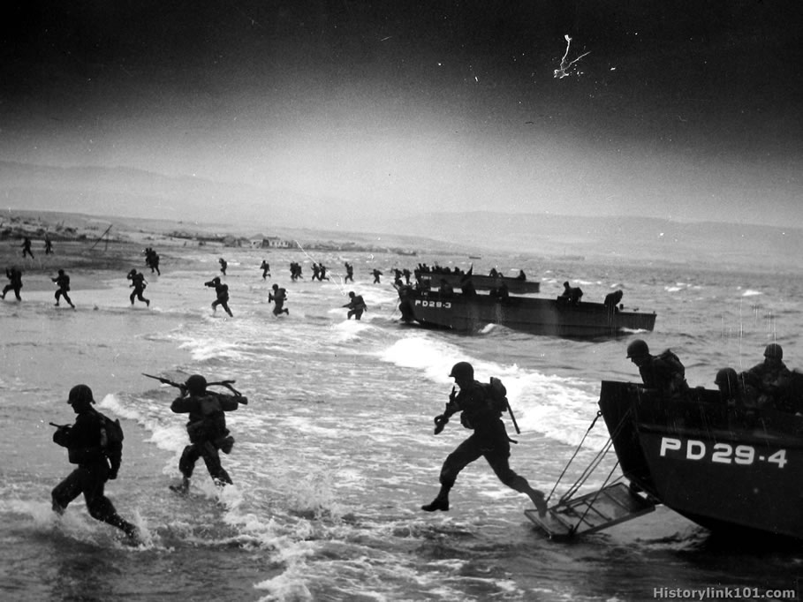
Allies re-capture France
Canadian forces were assigned to capture ‘Juno’ beach. This was a code name for an 8km stretch of coastline in Normandy.
Fighting was gruesome.
Within a week the Allies had landed 300,000 soldiers. Within a month the Allies had landed over a million soldiers and 200,000 military vehicles.
Capturing Normandy gave the Allies a spot where they could work from to push the German troops back.

Slide 25
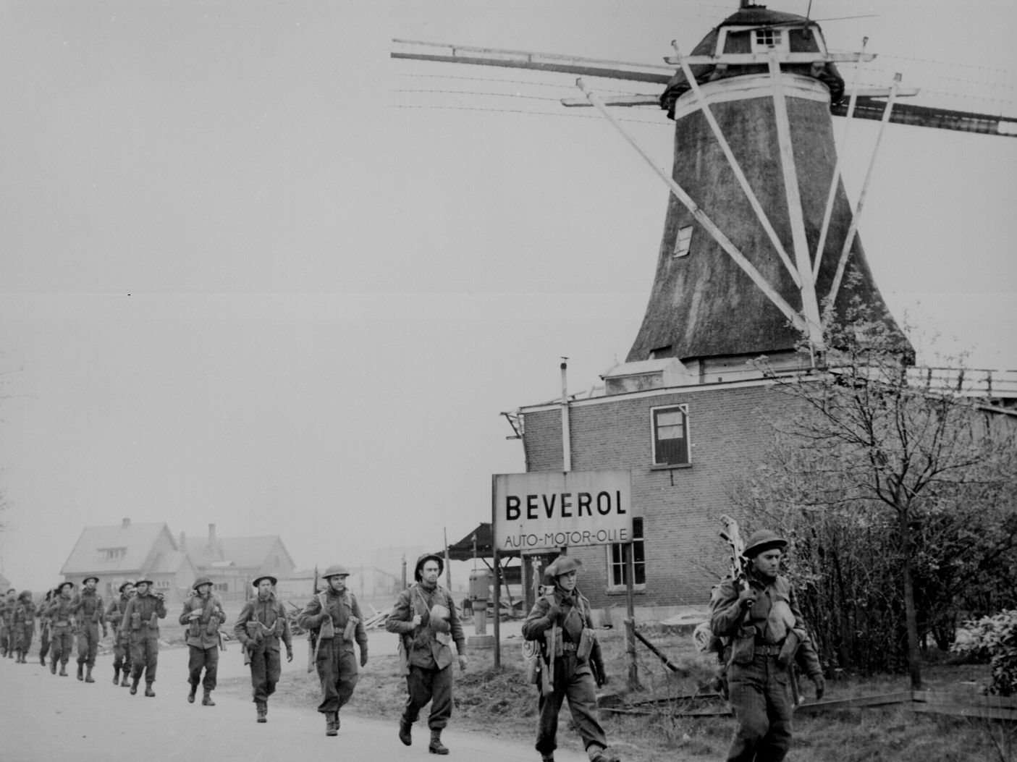
Liberation of Holland
It took Allied forces almost a year to push the Germans out of France and Western Europe.
Canadian soldiers played a key role in the fighting.
On May 5, 1945 Canadian forces drove the NAZIs from Holland.

Slide 26
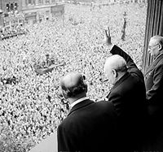
End of the War in Europe
In late April 1945 American and Soviet troops met in Germany south of Berlin. Soviet troops turned their attention to overtaking Berlin.
April 30, 1945 – Hitler committed suicide.
May 8, 1945 – V-E Day (Victory in Europe) announced when the last German troops surrendered.

