Slide 1
War in the pacific
In come the americans

Slide 2
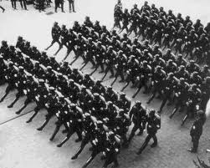
What caused the War in the Pacific?
Militarism in Japan
In the 1920’s Japanese culture was caught between tradition and modern world.
Radicals wanted to reject ‘Western’ ways and create a military based government (similar beliefs to NAZIs).
Japan had a very strong military.

Slide 3
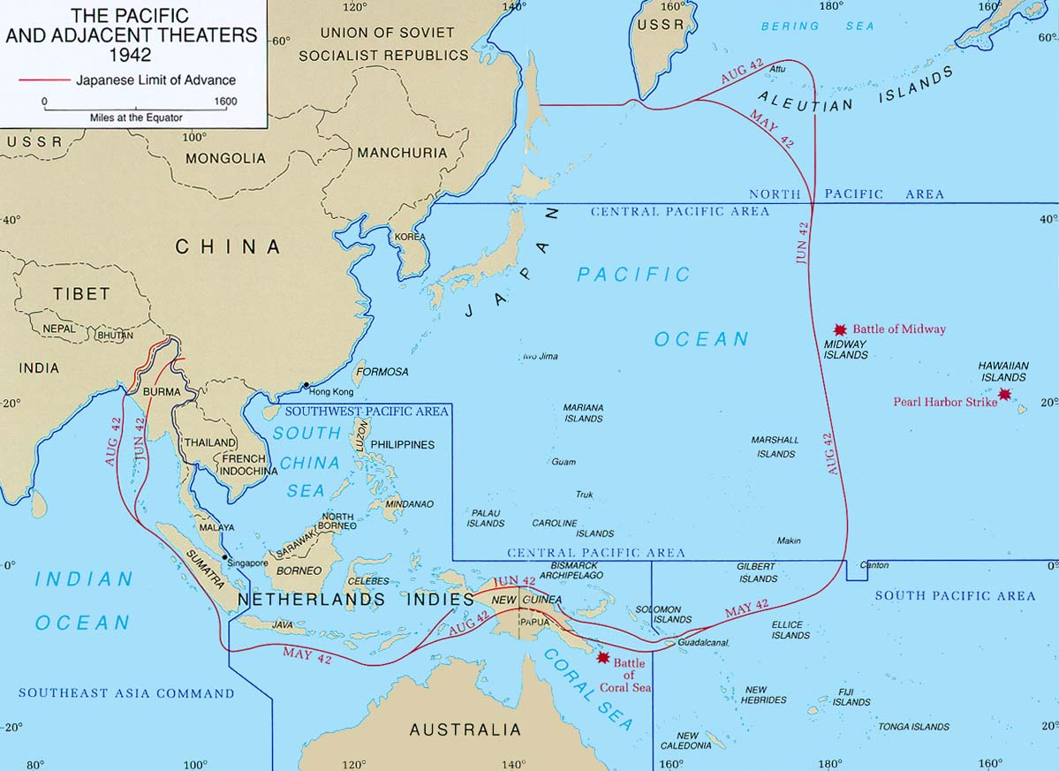
What caused the War in the Pacific?
Japanese Imperialist Expansion
Japan wanted to acquire new territories.
Economic depression of 1930’s, lack of resources, and need for resources drove this desire for more territories.
The army and government (which was somewhat weak) in Japan were not getting along.
Army began taking military actions which the government did not approve of. The government had no power to stop the military commanders.

Slide 4
Events Leading to Pearl Harbour
In 1931 the Japanese Army invaded Manchuria (part of northeastern China) without the consent of the Japanese government.
Military forced Japan to accept martial law (military law/rule).
Prime Minister and other politicians were assassinated.
When France fell in 1940 the Japanese Army occupied most of French Indo-China (French colonies in Southeast Asia).
American President Roosevelt immediately froze all Japanese assets in American banks and refused to sell Japan any more oil or metal (resources the Japanese needed).
Without needed resources, Japanese military insisted that war to overtake the United States was the only solution.

Slide 5
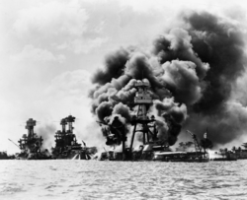
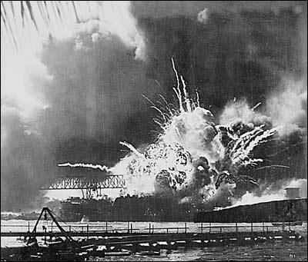
Pearl Harbour
Japan surprized US with an attack on American Navy Base at Pearl Harbour, Hawaii on December 7, 1941.
Japan wanted to control Hawaii and use it as a base for future attacks.

Slide 6
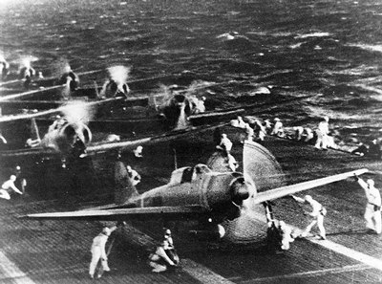
Pearl Harbour
The next day America declared war on Japan. To support the Japanese, Hitler declared war on US. US declared war on Germany. Britain now had another huge ally in Europe.

Slide 7
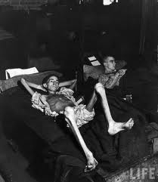
Japanese Aggression in the Pacific
Canada declared war on Japan after Pearl Harbour. Canadian troops (along with British and Indian troops) fought Japanese in British colony of Hong Kong (first time Canadian troops had actually been in a battle in WWII).
Japan attacked Hong Kong only eight hours after attacking Pearl Harbour.
Allies were undermanned in Hong Kong and did not have the necessary supplies.
Forced to surrender after 17 days of fighting. In the fighting 290 Canadian soldiers were killed.
Captured Canadians were put in Japanese POW (prisoner of war) camps.
A total of 267 Canadian POWs died in Japanese camps.

Slide 8
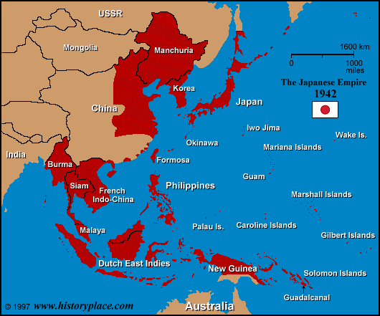
Japanese Aggression in the Pacific
It took several months for America to prepare for what everyone knew would be a tough war to control the Pacific.
While Americans prepared for war in the Pacific, the Japanese continued with a rapid conquest.
Even Australia felt threatened.

Slide 9
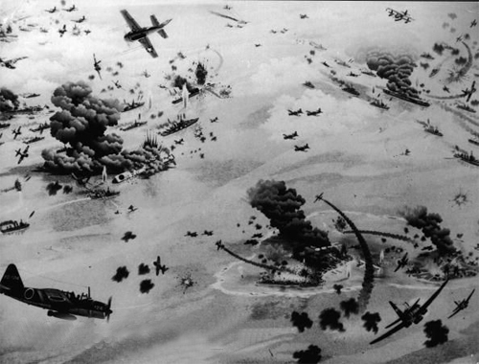
Battle of Midway
Battle of Midway – June 1942
Midway is an island in the middle of the Pacific Ocean.
Key military point, especially in WWII when planes could only fly a limited distance without refueling.
Japan was preparing to capture the islands. American’s intercepted Japanese Navy in the Pacific Ocean and defeated them.
Turning point as it ended a string of Japanese victories and some of Japan’s best soldiers/equipment were lost.

Slide 10
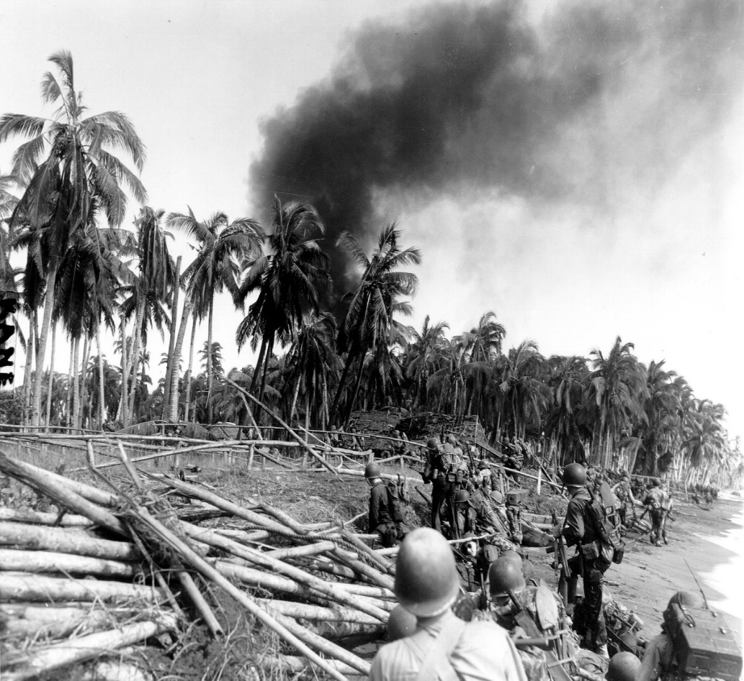
Island Hoping
American troops did not capture every Japanese controlled island in the Pacific.
Their plan was to capture islands about every 400 miles (600km) as they moved closer to Japan and simply cut off the supply line to the other islands.
Every battle for an island was bloody.
Japanese were already set up in key military points (ridges, hidden in jungles, etc.) on each island.

Slide 11
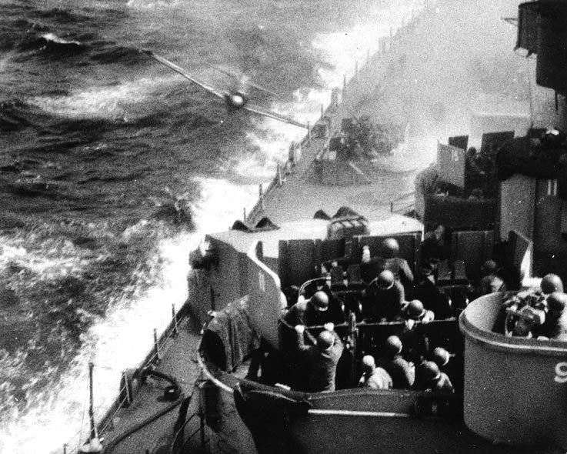
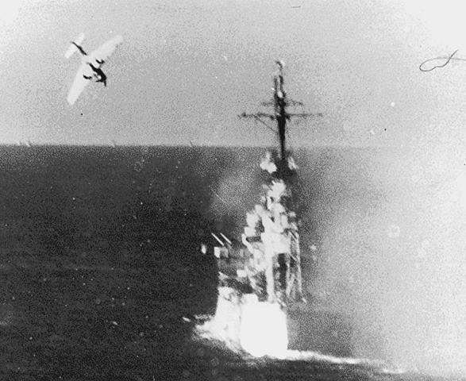
Battle of Leyte Gulf
Leyte Gulf is in the Philippines.
Americans had to take on the entire Japanese fleet in a long, hard, bloody battle.
Japanese suffered heavy losses (four aircraft carriers – remember the Japanese were short on metal and other resources).
First time that the Japanese resorted to using a kamikaze suicide bombing method (planes full of explosive deliberately crashed into American ships – Japanese pilots gave up their lives to hurt the Americans).

Slide 12
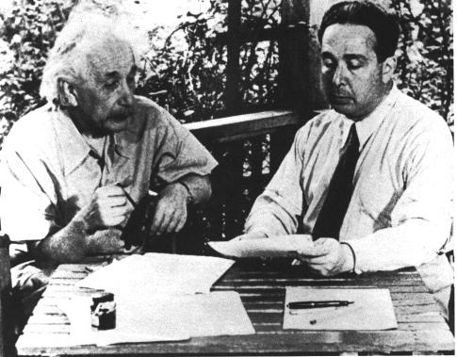
End of the War in the Pacific
In the spring of 1945 US captured Iwo Jima and Okinawa (two key islands just south of Japanese mainland).
In March 1945 the Americans began bombing Tokyo (much death and damage in the city). Japan did not surrender.
The Manhattan Project – atomic/nuclear bombs built in the US.

Slide 13
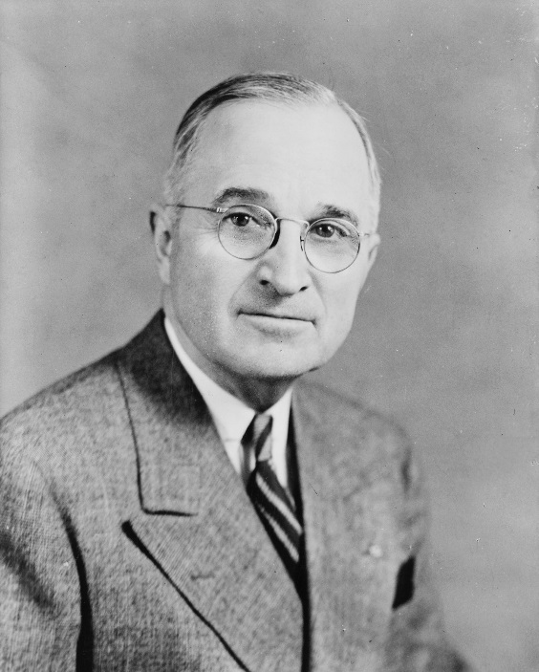
End of the War in the Pacific
US Secretary of War recommended dropping the nuclear bombs without warning to end the war quickly.
Scientists recommended dropping one over an isolated area to show Japanese how powerful they were.
Truman decided to ‘make a military decision’ and drop the bombs on a populated area to shorten the war and ‘save American lives’.
American military planners thought that using conventional warfare it would take more than a year to end the war and cost America over a million soldier’s lives.

Slide 14
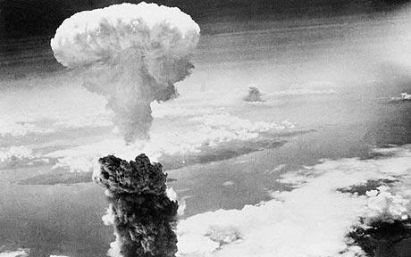
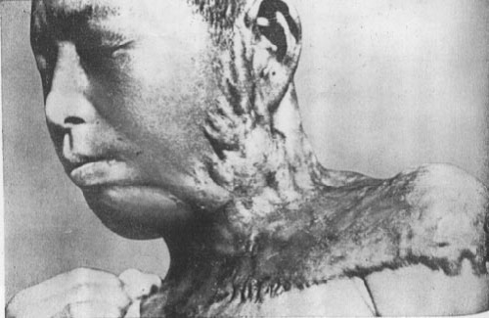
End of the War in the Pacific
Hiroshima – August 6, 1945
Truman directed that an atomic bomb be dropped on Hiroshima.
Japan did not immediately surrender like the Americans had hoped.
Three days later, August 9, 1945, another atomic bomb was dropped on Nagasaki.

Slide 15
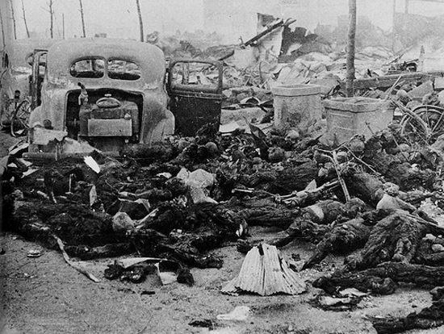
End of the War in the Pacific
Total of 170,000 people died because of the two bombs.
Japanese did not know that US only had two atomic bombs.
Japan asked for peace on August 14, 1945.
WWII was over.

Slide 16
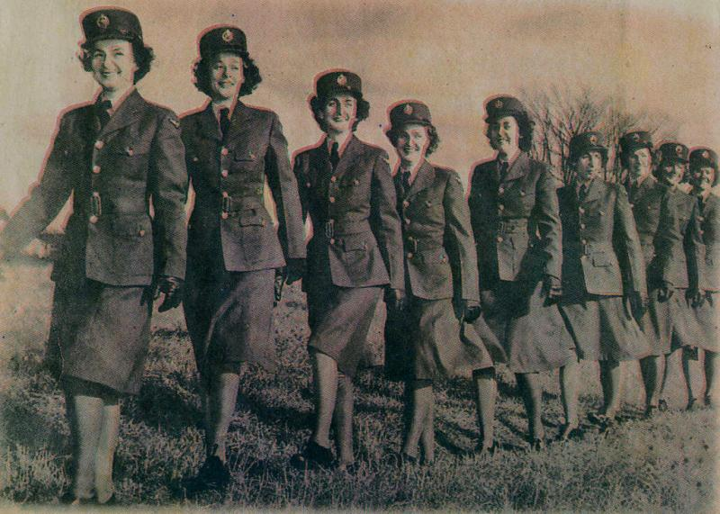
The Canadian Home Front
Role of Women (Overseas)
Women had divisions in the Army, Air Force, and Navy.
In total more than 46,000 Canadian women served overseas.
Two very important and dangerous roles that women served were as Special Operations Executives (secret spies on enemy soil) and radar station operators to alert Allies of incoming planes.

Slide 17
The Canadian Home Front
Role of Women (Home Front)
As soon as WWII started there were more jobs than Canadians could handle.
Factories were running 7 days a week/12 hours a day (total war) and often relied on an almost entirely female workforce.
By 1944 there were 1 million women in the Canadian work force.

Slide 18
Canadian Training Facilities
British Commonwealth Air Training Plan – facility developed in 1939 to train pilots and flight crews for the entire British Commonwealth. Huge demand for pilots, especially when bombing of Germany began in 1942. Through war 130,000 air personnel were trained at 230 training sites across Canada.
Camp X – secret training center for Canadian, British, and American spies. Of the 500 secret agents trained here, many served ‘behind enemy lines’. At Camp X the Hydra radio was also used to intercept and translate enemy signals.

Slide 19
Conscription
In 1939 PM King had promised no conscription. In 1940 he implemented the National Resource Mobilization Act (all men had to help with war effort, but not necessarily serve overseas).
In 1942 there was a need for more troops overseas. PM King held a plebiscite (vote on one issue) on conscription. Majority of Canadians voted ‘Yes’ for conscription, but again majority of French Canadians voted ‘no’. Controversy caused between French and English Canada, but not as bad as during WWI.
This time men who were of fighting age but were conscientious objectors were put in jail for not supporting the war effort

