Slide 1
Holocaust and Internment

Slide 2
Internment
Internment is “the state of being confined as a prisoner, especially for political or military reasons” (Dictionary.com)
Internment camps are areas where a group is forced to be confined in it after being removed/relocated from their homes

Slide 3
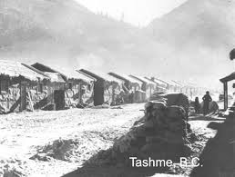
‘Enemy Aliens’ in Canada
People whose ancestry was from an enemy nation (mostly German Canadians) were considered enemy aliens.
The government forced these people to officially register.
Over 100,000 Canadians had to register and 650 were sent to internment camps.

Slide 4
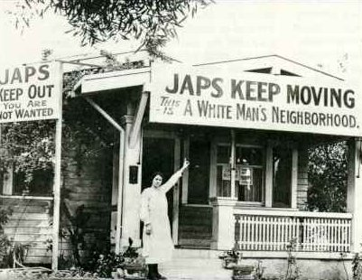
Japanese Internment in Canada
After the attack of Pearl Harbour, people in Canada were worried that Japanese Canadians would supply information to the enemy (spy) and maybe even help Japan invade Canada.
Japanese Canadians had to choose between being deported or being relocated away from the West Coast.

Slide 5
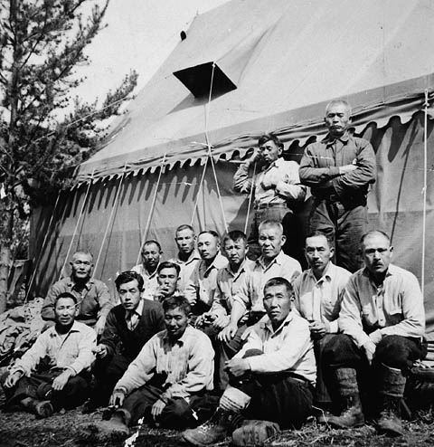
Japanese Internment in Canada
In total, 22,000 Japanese Canadians were sent to internment camps (work camps under police security). Over 14,000 of these were people who had been born in Canada.
Custodian of Aliens Act (1943) – all of the possessions of Japanese Canadians were auctioned off.

Slide 6
The Holocaust
Holocaust comes from two Greek words – ‘holos’ (whole) and ‘kaustos’ (burnt).
Holocaust is the word used to describe Hitler’s attempt to eliminate the Jewish race.
Anti-Semitism – the hatred of Jewish people.
Before WWII there were 600,000 Jewish people living in Germany.
Nazi party spread propaganda to promote hatred of Jewish people. Hitler believed that having ‘common enemies’ would bring the German people closer together and build patriotic pride.
Many Jewish people left Germany because of the persecution they faced before WWII started

Slide 7
The Holocaust - The St. Louis Incident
After many Jewish people were persecuted in 1938 many tried to leave Germany, but many other countries had strict immigration policies against Jews. A ship known as the ‘St. Louis’ left Germany for Cuba with the plan of waiting there until refugees could enter US.
Cuba refused to allow the refugees to come into the country. Nazi Minister of Propaganda, Joseph Goebbels, had sent the Cuban government propaganda to make Jewish refugees seem like a threat (including false criminal records).
St. Louis left Cuba. Was not allowed to land in Florida. Tried to land in Canada, but the government said no because ‘Jewish refugees would not make good settlers’. When asked how many Jewish refugees Canada would accept one government official said “none is too many.”
Ship returned to Europe. Most of the 907 on board died in concentration camps.

Slide 8
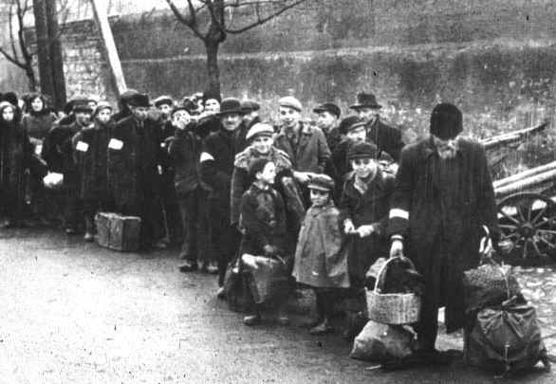
Ghettos
At the beginning of WWII many Jewish people were forced from their homes to live in ‘ghettos’ (small, crowded, fenced in communities that Jewish people were not allowed to leave).

Slide 9
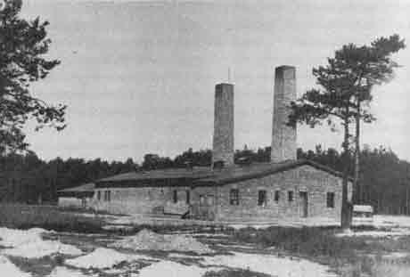
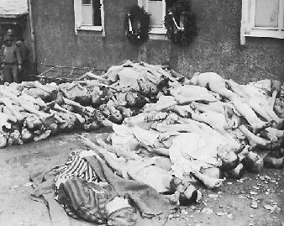
The Final Solution
Hitler’s plot to end the Jewish race.
He ordered that all Jews be rounded up and shipped to concentration camps where they would wait to be killed in gas chambers because Germans thought that gas was cheaper than bullets (genocide).

Slide 10
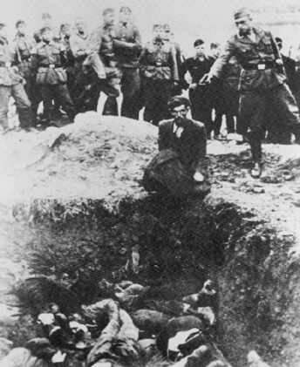
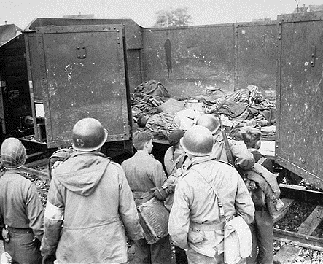
The Holocaust - The Final Solution
Many Jewish people died on trains going to the concentration camps because of a lack of food, water, and air.
Those who refused to get on the trains were shot immediately.

Slide 11
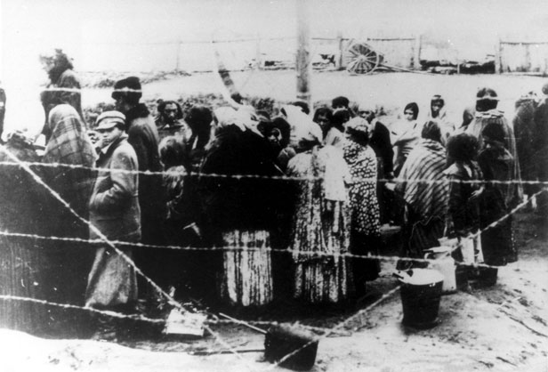
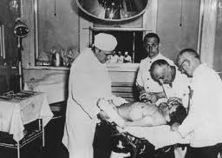
The Holocaust - The Final Solution
At the concentration camps many Jewish people were used for scientific testing (effects of medicine and poisonous injections, thrown into boiling or freezing water to see the effects, burned to see how the body recovered, operated on without freezing to see how body would react, weird obsession with experimenting with twins).

Slide 12
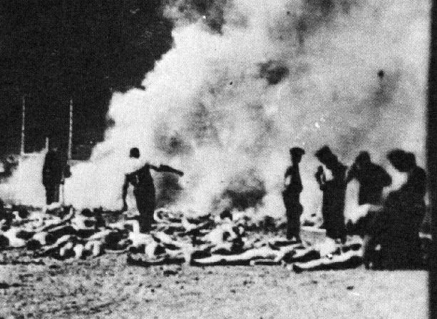
The Holocaust - The Final Solution
After being poisoned to death Nazis removed gold fillings from teeth, and then used skin (gloves, etc.) and bones (fertilizer) for different purposes. Many Jewish people had their heads shaved when they arrived at the camps (hair was used to stuff mattresses and pillows).

Slide 13
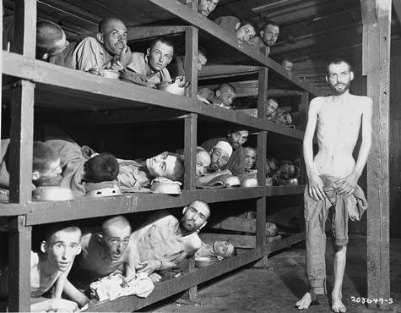
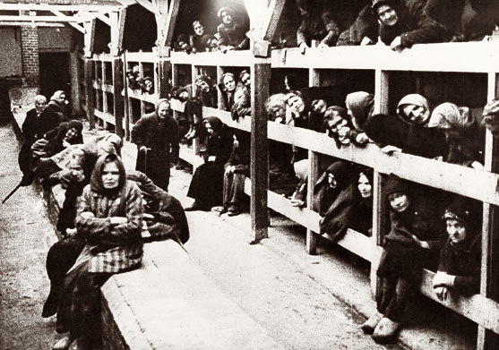
The Holocaust - The Final Solution
Auschwitz was the largest Nazi Death Camp where over one million people were killed.

Slide 14
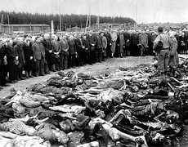
The Holocaust - The Final Solution
Jews not the only ones persecuted. Millions of others were killed by the Nazis (physically or mentally disabled, black people, gypsies, other minority groups, homosexuals, Catholics, Jehovah’s Witnesses).
Estimated 10 million people died in Concentration Camps (6 million Jews).

Slide 15
Technology and Communication in WWII
airplanes and tanks advance quickly through war (larger, faster, longer range without refueling, more powerful weapons).
radar and sonar (underwater radar).
Germans invented to rocket and jet engine (as opposed to propeller driven planes) during WWII. The war ended before they had time to use these to their advantage.
radio communications.
nuclear bomb.

Slide 16
War Criminals and Crimes Against Humanity
A ‘war crimes court’ was set up in Nuremburg, Germany.
While punishments against a country (Treaty of Versailles) had been common after a war for centuries, this was the first time that individual leaders of nation had been charged for crimes during a war.
At the Nuremburg Trials, 177 Nazi leaders were charged for crimes related to starting the war and the Holocaust.
Three of these were acquitted, the rest were hung or sentenced to long prison terms.

Slide 17
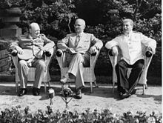
Potsdam Conference - July 1945
War in Europe was over, but the war in the Pacific continued.
Allied leaders met to discuss the future of Germany and Europe.
Supposed to be planning session for a peace conference. Instead of planning for peace, democratic and communist leaders began to show distrust for each other (now that they had won the war together and were done being Allies).
Conflicts between political ideologies (democratic/communist) would eventually lead to the Cold War.

Slide 18
Canada after WWII
Economic Effects
despite federal debt of $10B, Canada’s economy was booming after WWII.
Industrial and manufacturing production had grown to overtake agriculture (farming) as the largest part of Canada’s economy.

Slide 19
Canada after WWII
Political Effects
during WWII Canada established itself as a ‘middle power’.
Canadian troops were recognized for some of their key contributions to WWII (Dieppe, Hong Kong, Italy, Battle in the Atlantic, Normandy, Liberation of Holland).
PM King handled conscription crisis well. French/English relations were strained but not broken.
despite difficulties faced by some (Japanese) the contribution of minority groups in WWII helped the push for civil rights.

Slide 20
Canada after WWII
Social Effects
once again, women played a key role in the war effort.
many returning soldiers started families soon after returning from war. Baby boom.
over 42,000 Canadians died in WWII.
Immigration After WWII
guilt of St. Louis incident (and immigration policy which restricted minorities) played a key role in changing immigration policy.
In 1947 ‘Pier 21’ in Halifax officially reopened. Over half a millions immigrants came soon after the war. Canada was changing from ‘British’ to multicultural.

Slide 21
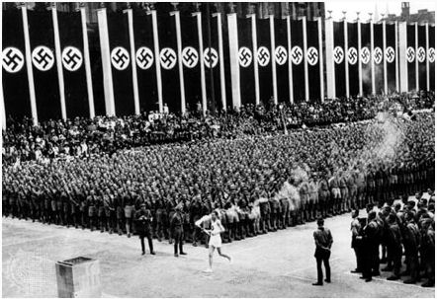
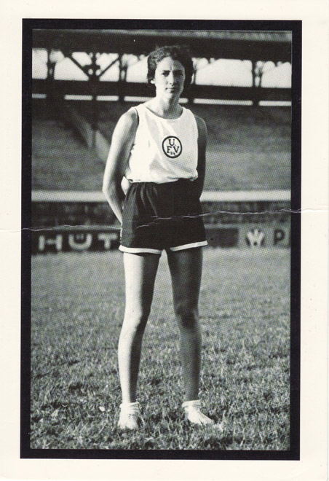
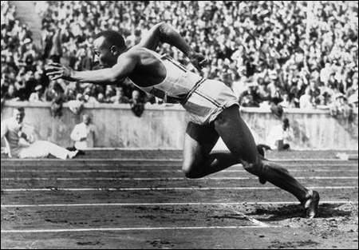
Berlin Olympics - 1936
Hitler declared that Jews and blacks were not allowed to participate
Hitler used the games as an avenue to promote his antisemitism ideals and racial supremacy
While the stance on Jewish people and blacks were eventually lifted, many of Jewish ancestry decided to sit out the games for their own safety.

Slide 22
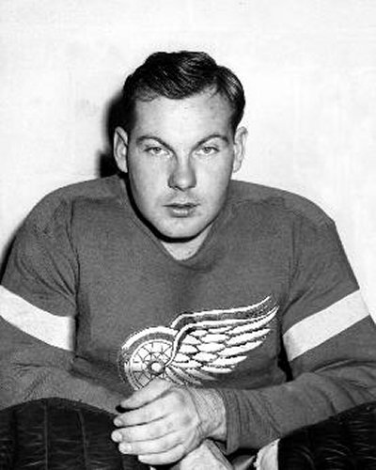
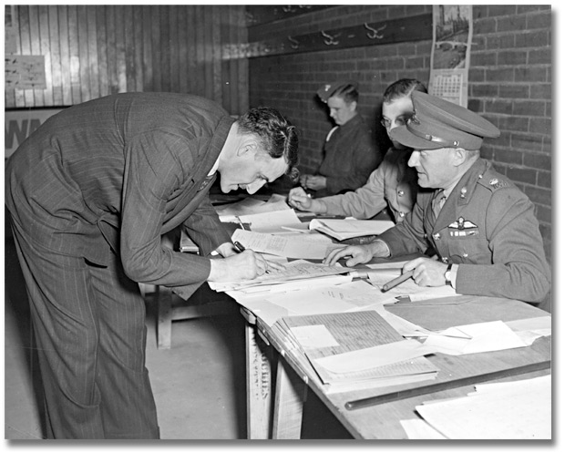
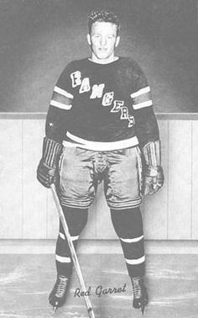
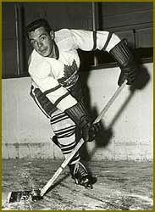
Hockey Players in WWII

Slide 23
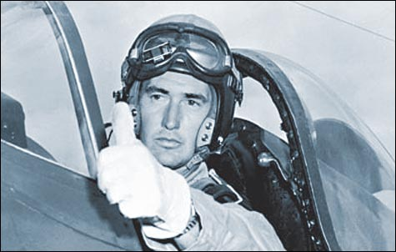
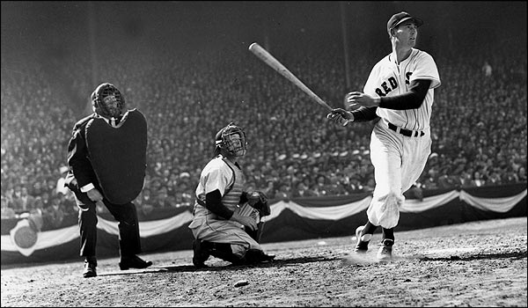
Ted Williams

