Slide 1
Trench Warfare and Modern Technology
World War I

Slide 2
Map of The Western Front

Slide 3
Trench Warfare

Slide 6
Duck boards and firing shelf

Slide 7
going over the top

Slide 8
Parapets

Slide 9
“No Man’s land”

Slide 10
The battlefield of Passchendaele (Pits left from Heavy Artillery Shells)

Slide 11
Constant threat of Mustard gas and Chlorine Gas

Slide 13
Survivor of chemical weapons

Slide 14
Hospital: No Antibiotics

Slide 15
New weapon: Machine gun

Slide 16
Battles of Attrition: no decisive victories – grind other side down and try to outlast them

Slide 17
Trench Warfare: Simulation
1. Select a Major General – in charge of the mission
Select a Gunman – in charge of the Machine Gun
Everyone else is a private / infantry soldier
Strategize for your mission

Slide 18
Video: Trench Warfare
https://www.youtube.com/watch?v=_G4ZY66BG38

Slide 19
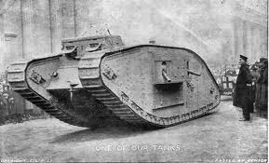
New Weapon to fight the Machine Gun: THE TANK
Tank makes its debut in the Battle of the Somme

Slide 20
War in the air
Roy Brown
and the Red Baron

Slide 21
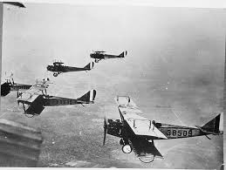
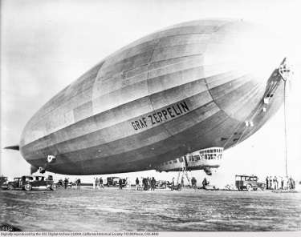
New Technology in the Air
Zeppelin / plane: for Reconnaissance missions
Canadians Pilots Work for British Army Corps
Germany has advantage – more planes

Slide 22
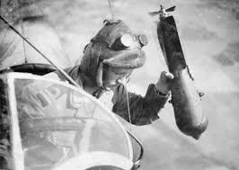
New Technology in the Air
Aerial battles: “Dogfights” – fire at enemy from behind
Parachutes not invented
hold bombs in lap & throw overboard
Many deaths due to mechanical failure

Slide 23
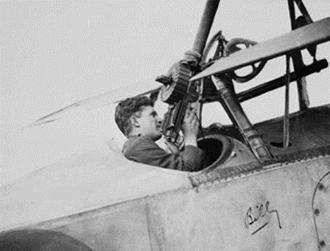
New Technology in the Air
1917 – average life of pilot = 3 weeks
Then machine guns were added (pilot had to fire it while flying the plane)
Pilot shoot 5 planes down = “ace” – a hero
Aces may be taken off duty for fundraising and recruitment at home

Slide 24
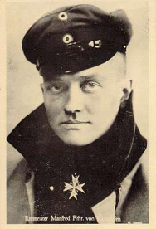
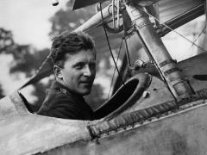
New Technology in the Air
Who are famous WW1 pilots?
Famous pilots (“Ace”):
Baron von Richthofen from Germany, called “the Red Baron”
80 air combat victories
2.Roy Brown (Canadian) shot down the Red Baron, allegedly
3. Billy Bishop – Canada’s top Ace (72 enemy planes down) & given the Victoria Cross (British military honour for courage and Bravery)

Slide 25
WW1 planes (stock footage)
https://www.youtube.com/watch?v=B4T7Mrju7jc

Slide 26
War at Sea

Slide 27
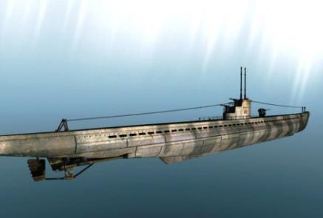
War at Sea
Germany Has a New Technology:
“U-boats”
(Submarine)
Germans advance:
develop Torpedoes

Slide 28
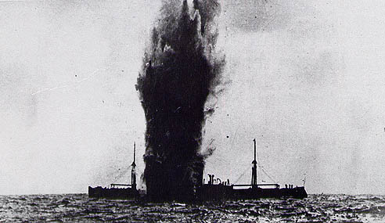
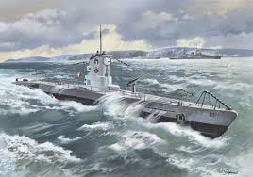
War at Sea
German plan: end supply line to Britain and win war
by 1917 have policy to sink all boats & hit 1000 in 4 months
Britain needs supplies
navy will defend the seas (strongest navy – but no submarines)

Slide 29
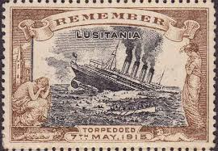
War at Sea
1915: Germany sinks “Lusitania” British Passenger ship (128 rich Americans on board) – 1198 drown
Result – USA enters war in 1917

Slide 30
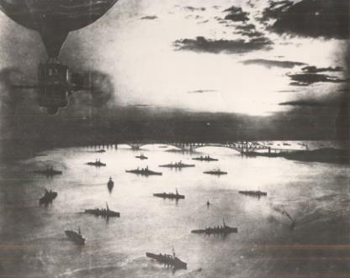
War at Sea
Allies defense:
“Convoy system’: Canada’s Merchant Marine (civilian sailors) help ferry munitions and food to Britain
and underwater listening devices to hear U-Boats
Canada has 2 warships:
“Rainbow” on west coast
“Niobe” in Halifax
Halifax harbour:
refuelling and repair port for Allies

