Slide 1
The War to End all Wars
Last 100 days and the Treaty of Versailles

Slide 2

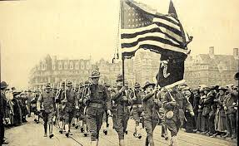
Last 100 Days of War: Why Did the War End?
April 1917: USA enters the War
  Germany sunk Lusitania
  Zimmerman Telegram (Germany and Mexico allies?)
  Fresh troops
  are coming for Allies

Slide 3
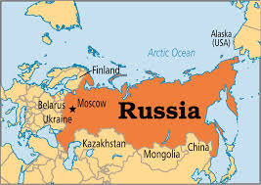


Last 100 Days of War: Why did the War End?
2. October 1917: Russia withdraws from the War
    March: Russians overthrow Tsar
    October: Bolsheviks (Communists) take over and withdraw from the war
    Treaty of Brest-Litovsk
      Russia surrenders Poland, Lithuania, and the Ukraine to Germany to be let out to the war

Slide 4
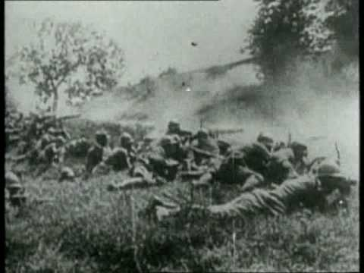
Last 100 Days of War: Why did the War End?
Germany only has Western front now
Germany in crisis: Austria and Turkey near collapse and fresh US troops are coming
Solution: Germany pushes a Hard attack before US arrives
  Last 100 days of war, Germany almost takes Paris, then is pushed back to German boarder

Slide 5
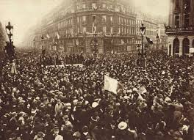


Germany Surrenders
War ends: Nov. 11, 1918

Slide 6

November 11, 1918 in London

Slide 7
COST of WW1:
Canada: $3 billion, 60,000 lives
International effect:
10 million dead, 20 million wounded in battle
$200 billion = Europe in bankruptcy
Movement of people (refugees)

Slide 8
What is an Armistice?
What is the Paris Peace Conference?
Armistice signed Nov. 11,1918
(Germany surrenders and all agree to stop fighting and have a peace conference)
Paris Peace Conference:
delegates from major countries involved
Borden fought successfully for a seat for Canada (rather than being represented by Britain)
Canada signed the Treaty of Versailles

Slide 9
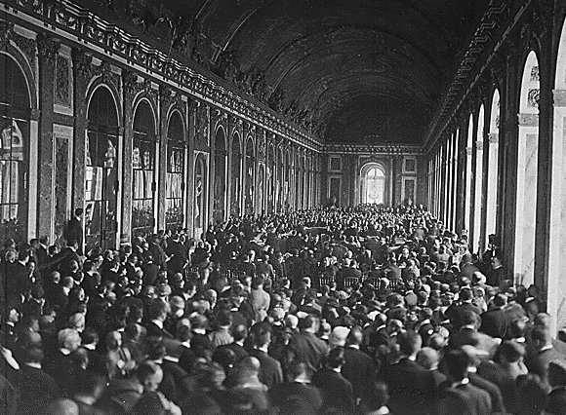
French Palace of Versailles:
Peace Treaty 1919

Slide 10
What is the debate about the treaty?
What is the 14 points?
Need to write the Treaty of Versailles (1919)
To decide what happens to Central powers
Should Germany be punished or given an honourable peace? Should they pay Reparations for damage done in war? Should Germany be crippled?
The Fourteen Points
Woodrow Wilson (USA president) had a plan for forgiveness and peace after the war
“internationalism” and all ethnic groups should have a homeland, given in a fair process

Slide 11
The Treaty of Versailles:
What do you think?
What should be the Conditions of Germany’s Surrender?

Slide 12
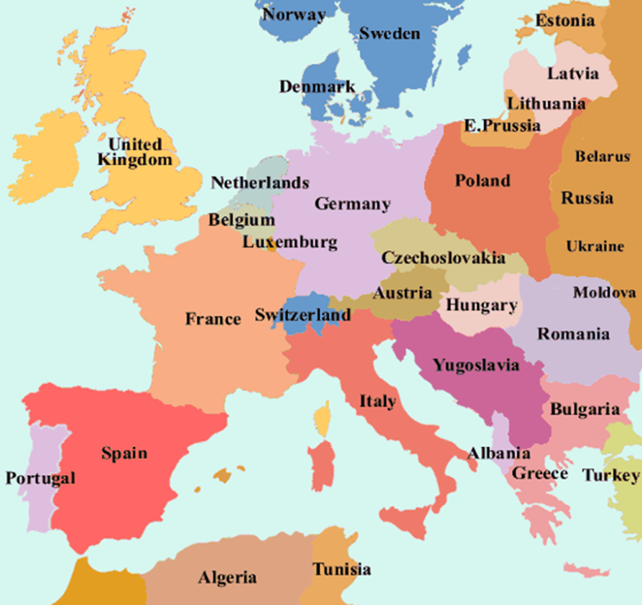
What is the Treaty of Versailles?
New Map of Europe
1919
Treaty of Versailles
1. Change map of Europe:
Alsace-Lorraine returned to France
Poland given “Polish corridor” – access to sea from German land
Austria-Hungary collapsed and Yugoslavia and Czechoslovakia created

Slide 13
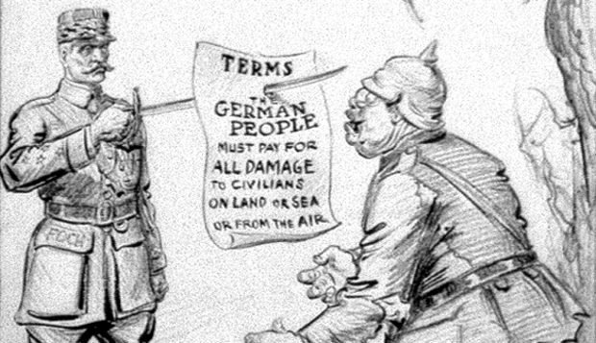
What is the Treaty of Versailles?
2. War Guilt Clause
Germany had to accept full responsibility for causing the war
3. German army limited to 100 000 men, no u-boats, no air force

Slide 14
Germany surrender Merchant fleet to allies
Rhine River valley in Germany, by France, be de-militarized as a buffer zone
Unification of Austria and Germany is forbidden

Slide 15
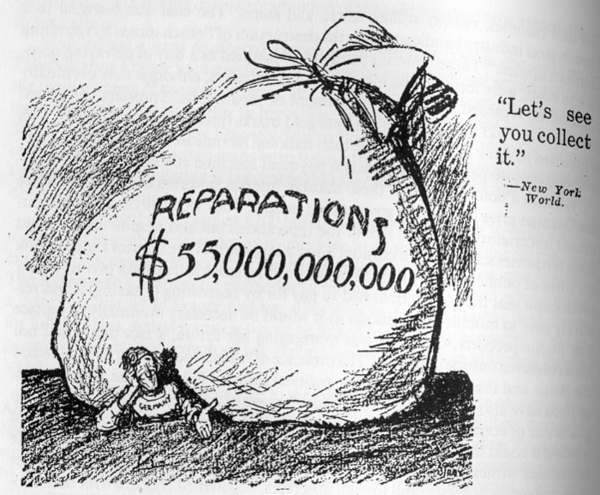
7. Germany to Pay reparations of $30 billion to Allies

Slide 16
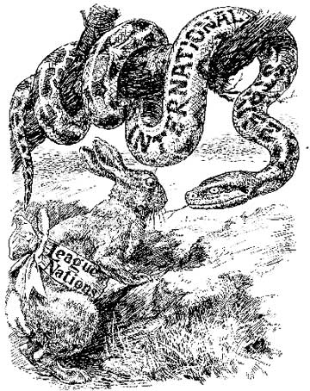
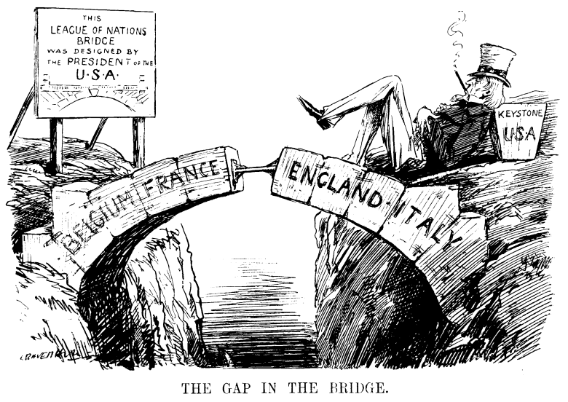
8. League of Nations
International League created in Treaty - Woodrow Wilson’s idea
  For Collective Security of the World
Requires nations of the world to cooperate
  has no military force
Canada gets its own seat
USA doesn’t join (even though was their president’s idea)

Slide 17
Prediction:
What will be the impact of the Treaty of Versailles? The Impact of WW1?
  Socially? Economically? Politically?
  on Germany? Europe? Canada? The World?
What will happen next? WHY?

