Slide 1
CANADA
Before WWI

Slide 2


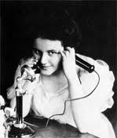

1900 – a time for optimism
1. Science can fix everything and change the world!
  Electricity in homes and work
  Steel hulled ships with steam power cross the Atlantic
  Automobile industry soon to boom
  Medicine: anaesthetics allow major surgery
  Telephone and telegraph allow communication in seconds

Slide 3
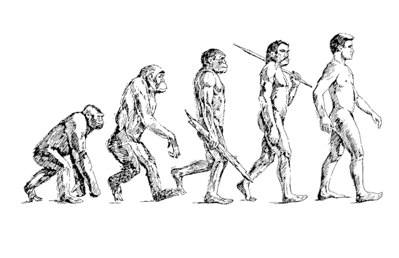
2. New ideas change the view of the world!
  Charles Darwin
    theory of evolution (religion in question)
  Trade Unions
    protect workers rights, gain benefits, higher wages
  Socialism spreading
    opposite of capitalism
    the idea that the government should run major elements of the economy for the overall benefit of the people

Slide 4
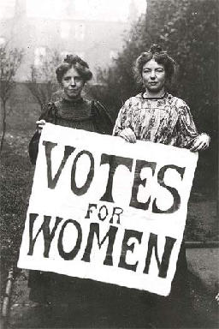
2. New ideas change the view of the world!
  Women’s Movement – improve rights! Give women the vote! (suffragists)
    Nellie McClung: “Never retract, never explain, never apologize, just get the job done and let them howl!”
    Women get vote:
            1916 in Manitoba,
            Saskatchewan, Alberta
            1917 in BC and Ontario
            1918 Federal Government,
            Nova Scotia
            1922 PEI
            1925 Nfld
            1940 Quebec

Slide 5
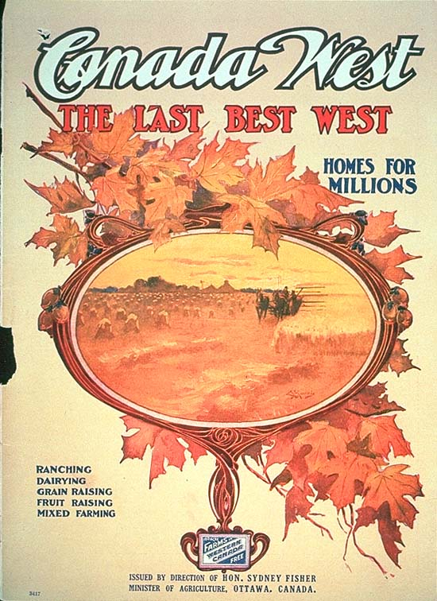
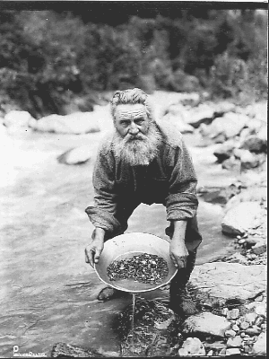
Klondike gold rush

Slide 6

RCMP and Klondike Goldrush

Slide 7
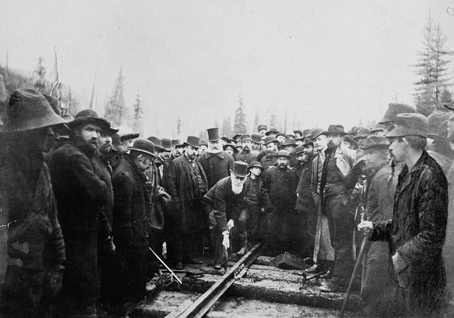
The last spike in the CPR

Slide 8
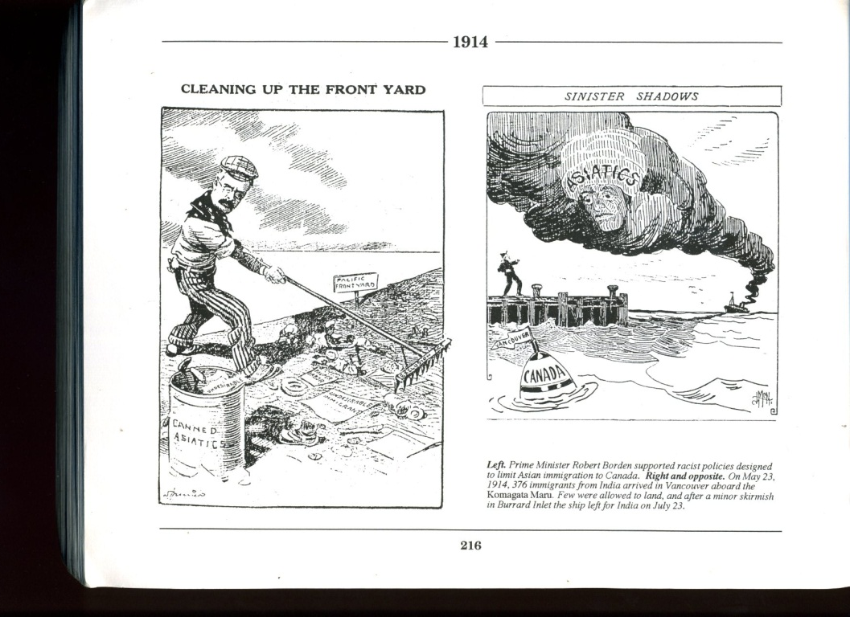
Chinese Head Tax

Slide 9
Chinese Head Tax
What happened
Chinese came to BC due to CPR and gold rush, and to find a better life
BC (and Canada) wanted to keep Canada “British” and put in place discriminatory immigration policies
Goal of Head tax: keep Chinese out of Canada
Head Tax on Chinese Immigration
1885: $50
1900: $100
1903: $500
Reaction in Canada
BC residents form the “Asiatic Exclusion League” and riots will occur (1907) over Asian immigration
Laurier will apologize for the riots, but restrict Japanese immigration to 400 per year as a result

Slide 10
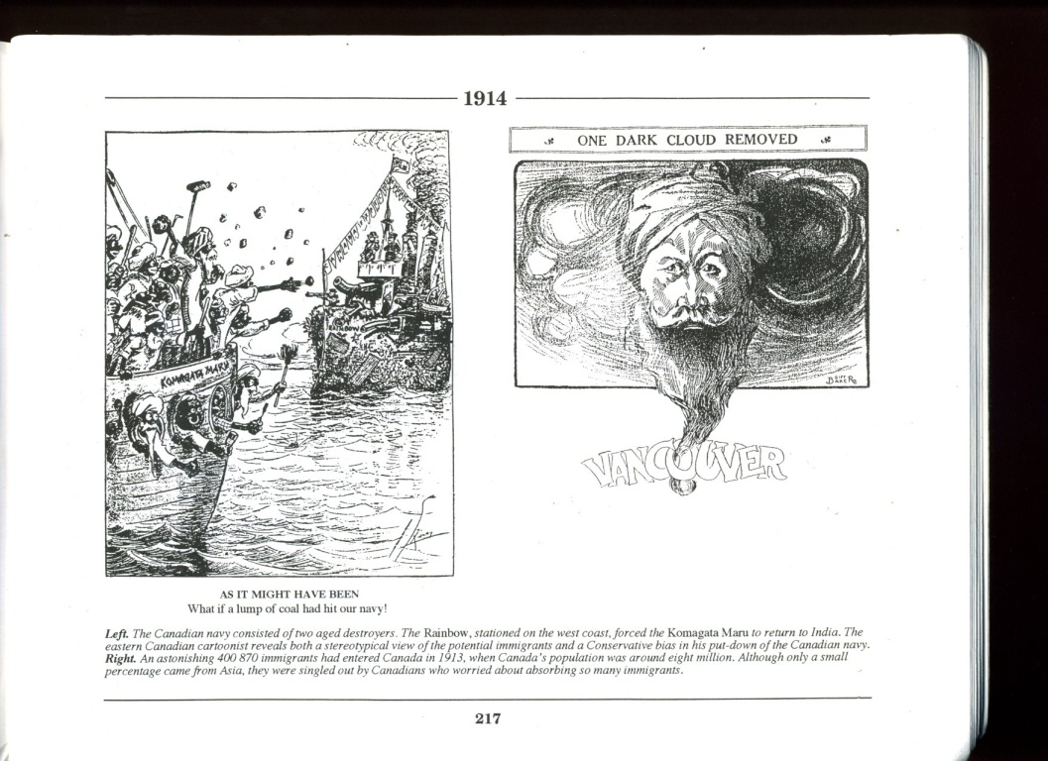
Komagata Maru (1914)

Slide 11
Komagata Maru
What happened
India was a colony of Britain, and therefore could immigrate to Canada
The Continuous Passage Act was passed stating only those who came directly could immigrate to Canada (impossible from India)
1914: Ship named Komagata Maru, carrying 354 Sikh immigrants arrives in Vancouver.
  BC places them in quarantine – not allowing them ashore
  Many nearly starve to death
  Ship is escorted out of Vancouver by the HMCS Rainbow
  Result in Canada
  May 23, 2008 –British Columbia Government issued an apology

Slide 12
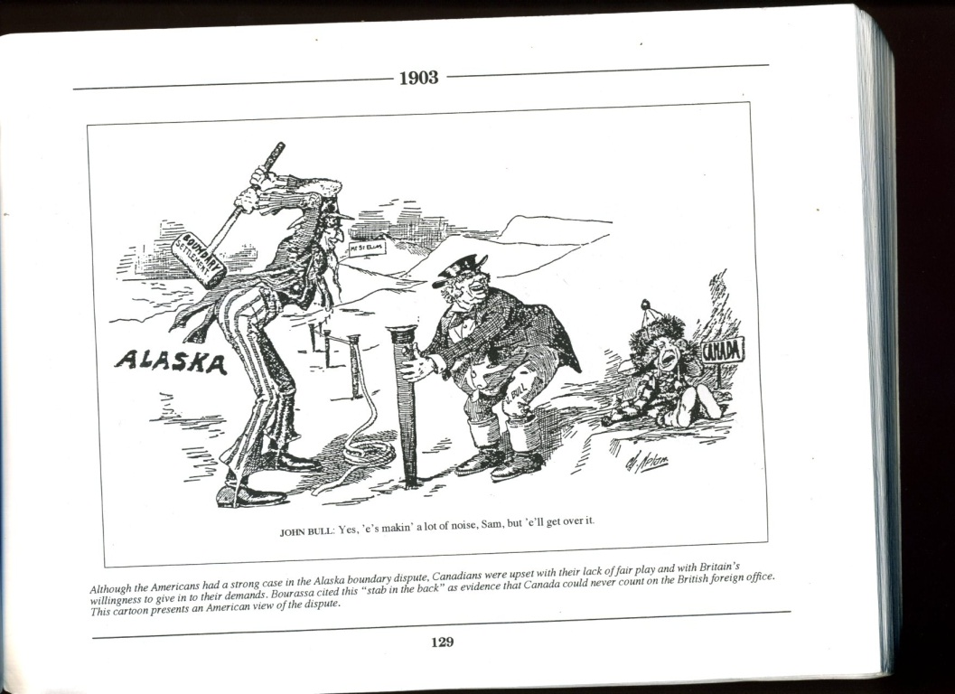
Alaskan Boundary Dispute
  “Canada seemed alone in the world,
  bullied by the United States, abandoned
  by Great Britain.”
  - Historians Norman Hillmer and J. L. Granastein

Slide 13
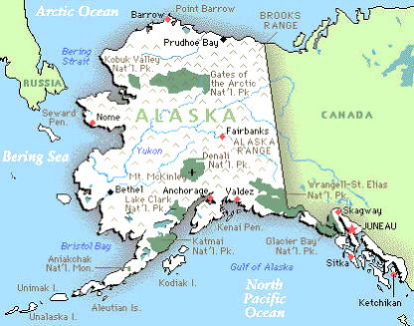
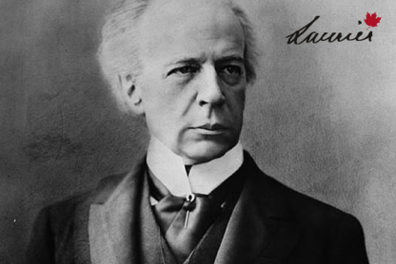
Canada: a British Nation?
Boer War – 1899-1902
  Britain goes to war in South Africa
  English Canadians want to send support
  French Canadiens disagree
  Laurier’s compromise: Volunteers only
Naval Crisis, 1910
  Britain asks Canada to build naval ships
  to give to Britain.
  English Canada agrees
  French Canada disagrees
  Laurier compromises: build a Canadian Navy that would serve Britain in times of war: Naval Services Bill

Slide 14


Canada: French – English conflict
Manitoba Schools Dispute
1890-1896
  After influx of English to Manitoba - prov. Gov. passes Manitoba School Act:
    Guarantee of French catholic education taken away (betrayal to founders of Manitoba).
  Laurier compromises :
    French teachers and ½ hour of religious instruction, in an otherwise English=speaking public school system.
  victory for a Western English Canada (and for Provincial Power)

Slide 15

Canada: a British Nation?
In 1900 . . . .
National Anthem: “God save the King”
Flag: Union Jack
Governor General: Duke of Connaught (British)
Foreign Affairs controlled by Britain
Nationality: ???

Slide 16

Overall Summary
What was Canada like in 1914? What words would you use to describe our National Identity at that time?
What was Canada like in 1914 . . .
Economically? Politically? Socially?
Wilfred Laurier stated:
”. . . the 19th century had been the century of the United States, so the twentieth century would be the century of Canada."
Do you agree or disagree?

Slide 17
Overall Summary
optimism about scientific progress
Canadian identity forms as Nation is geographically united
Multiculturalism begins
Ethnocentric - discriminates against Asian immigration
French- English conflicts continue/ worsen
Canada hits a recession in 1914
Canada begins to want autonomy from Britain (and distinction from USA)
Canada is ready to be seen as a separate and unique country by the world

