Slide 1
Causes of WWI
What do you know about World War 1?
Notes:
Austria, Serbia, Russia, Germany, France, Great Britain, Canada, Italy, USA, Ottoman Empire, Bulgaria

Slide 2
All’s Quiet on the Western Front
https://www.youtube.com/watch?v=AI7m8TDBH2I

Slide 3
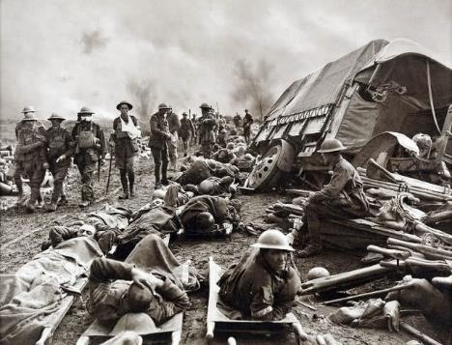
The Second Battle of Ypres 1915

Slide 4
The Battle of the Somme 1916

Slide 5
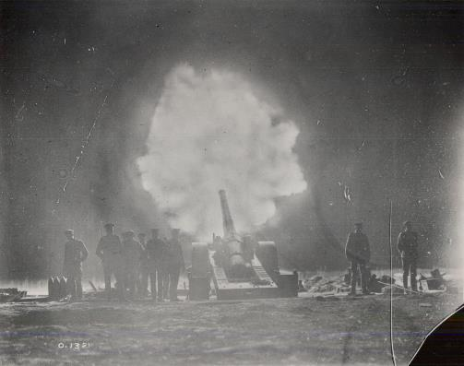
Vimy Ridge 1916

Slide 7
Passchendaele 1917

Slide 8
WWI: War at Sea
Notes:
The British Navy blockaded the German fleet from entering any battles. The Germans then used their U-boats to disrupt supply boats belonging to the Allies.

Slide 9
1918 airplane : reconnaissance

Slide 10
Europe Today

Slide 12
Alliances in 1914

Slide 13
Countries involved (for our simulation)
Austria
Serbia
Russia
Germany
France
Great Britain
Canada

Slide 14
Situation 1
The Heir to the Austrian throne – Arch Duke Francis Ferdinand – has been assassinated by a terrorist in the Bosnian city of Sarajevo. Austria suspects (but has no proof) that the Serbians may have been behind the murder.
Austria: What are 3 courses of Action that you, as the leader of your country, would take and the rationale for each.

Slide 15
Situation 2
The Black Hand takes responsibility for assassinating the heir to the Austrian throne. The Black Hand has been receiving unofficial aid ($) from Serbia for years. The Austrian government has demanded they be allowed to investigate the murder within Serbian borders. They have issued Serbia an ultimatum. If Serbia does not comply with Austrian demands they will attack Serbia.
Serbia: What are 3 courses of Action that you, as the leader of your country, would take and the rationale for each.

Slide 16
Situation 3
Serbia asks Russia for unconditional military support in her conflict with Austria. These are in fact the terms of the Russian alliance with Serbia.
Russia: What are 3 courses of Action that you, as the leader of your country, would take and the rationale for each.

Slide 17
Situation 4
Germany has an alliance with Austria and has promised unconditional support. In response, the Russian army has begun its cumbersome mobilization against both Austria and Germany
Germany: What are 3 courses of Action that you, as the leader of your country, would take and the rationale for each.

Slide 18
Situation 5
Germany invades Belgium to the North and mobilizes its whole army in the West. Germany declares war on France.
France: What are 3 courses of Action that you, as the leader of your country, would take and the rationale for each.

Slide 19
Situation 6
Germany invaded Belgium in an attempt to outflank the French army, and plan to continue with an attack on France. Belgium, France and Russia have all asked Britain for assistance, as per their individual alliances with Britain.
Britain: What are 3 courses of Action that you, as the leader of your country, would take and the rationale for each.

Slide 20
Situation 7
Great Britain declares war on Germany, Aug. 4, 1914. The moment this happens, Canada was also at war. The inclusion of the British Empire makes this officially a world war.
It is up to Canada to determine exactly how much they will contribute to the British war effort – military, economic, financial, or some combination thereof. Also, it is up to Canada to decide the size of the contribution.
Canada: What should Canada do? From Canada’s perspective? From your countries perspective?

Slide 21
Causes of WW1 Notes
What was the view of War in 1914?
What caused WW1?
(MAIN)
Seen as romantic, a glorious adventure
Modern weapons not considered
Militarism
Alliances
Imperialism
Nationalism

Slide 22
Causes of WW1 Notes
Militarism
Alliances
Imperialism
Nationalism
“making a countries armed forces very strong, and military interests dominate government policy”
“nations uniting for a purpose, like joint military protection”
“extending rule of authority of one country over another country or territory”
“pride in one’s country, or ethnicity”

Slide 23
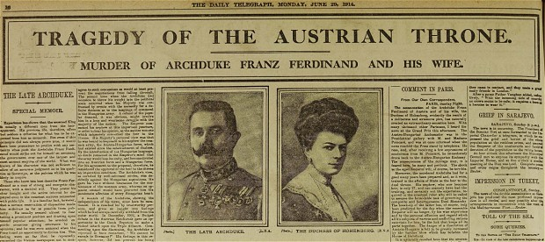
The Start of it All
What event triggered the war?
Archduke Ferdinand, heir to the Austrian throne, is assassinated
When: June 28, 1914
Who: the “Black Hand” - Serbian nationalistic terrorist (Gavrilo Princip)
Where: Sarajevo, Serbia

Slide 24
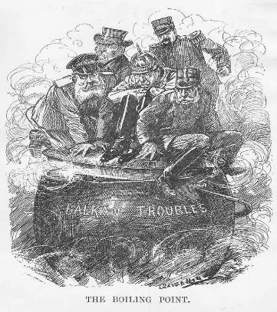
War is Declared
What is the Blank Cheque?
When/ why was war first declared
Germany gives Austria-Hungary the “Blank Cheque” – support Austria-Hungary completely
Austria-Hungary sends Serbia an ultimatum: hand over “Black Hand” or will declare war
Serbia asks to clarify a few points
Austria declares War July 28, 1914

Slide 25
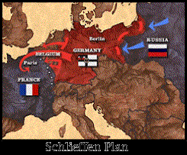
Schlieffen Plan
How did the war escalate?
What is the Schlieffen Plan?
Major powers enter conflict:
Russia fears losing Balkan Port – Supports Serbia
Germany declares war on Russia
“Schlieffen Plan”
Germany wants to avoid a war on 2 fronts
Go through Belgium to enter France, take them out.

Slide 26
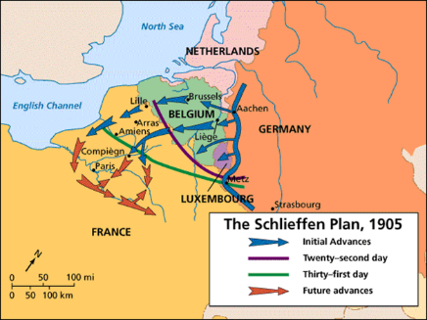
The Schlieffen Plan
Altered Plan
The original plan

Slide 27
Assumptions of the Schlieffen Plan
Why?
Germany is afraid they cannot win a war on 2 fronts
Assumptions:
Russia would be slow to mobilize, giving Germany time to take France (in the West )first
Britain would stay Neutral (out of it)
Austria would take Serbia quickly
France would offer little resistance, and Germany would defeat them in 6 weeks

Slide 28
Schleiffen Plan in Action
Germany attacks through Belgium (slightly modified plan)
Britain sends 100 000 men to Belgium (whole army) to hold off Germans
French troops defeat the Germans at the Battle of Marne
Russians mobilize quickly and attack; Germany divides its force to face 2 fronts
Why doesn’t the plan work?

Slide 29
Here Come the Brits
Why did Britain enter the war?
Why does trench warfare develop?
When Germany Entered Belgium, Britain followed through on their alliance with Belgium and declared War on Germany (Aug 4, 1914)
Both sides dig in – trenches from Switzerland to The English Channel – Western front (and an Eastern Front)
WW1 had officially begun

Slide 30
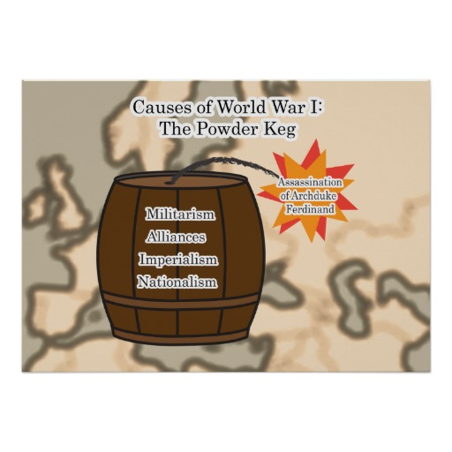
In a nutshell…

Slide 31
Militarism: “making a country’s armed forces very strong, and military interests dominate government policy”
Germany, France, Britain, Russia and Italy have all men between 18-60 required to go to war if called
Britain's Two-Power Standard: Navy must be equal or better than any 2 other navies combined
Germany trying to build a powerful navy = arms race
Germany trying to build a powerful army = arms race with Russia and France
What is Militarism and how did it contribute to the start of WW1?

Slide 32
What are Alliances and how did they contribute to the start of WW1?
Alliances: nations uniting for a purpose, like joint military protection
Triple Alliance: Germany, Austria-Hungary, Italy (the Central Powers)
Triple Entente: France, Russia and Britain (the Allies)
Serbia and Russia have strong connections
Britain has agreed to protect Belgium’s Neutrality

Slide 33
Imperialism: “extending rule of authority of one country over another country or territory”
Goal in Europe: colonies, empires, influence (industrialization needs raw materials and market to sell goods)
Britain: “sun never set on British empire”
France: trouble with territories - rival
Russia: wants a warm water port and supports slav-nationalism (control Balkans)
Austria-Hungary: wants to control Balkans (fear many ethnic groups will revolt)
Germany: has colonies, but few and not rich – desires empire (like Britain)
What is Imperialism and how did it contribute to the start of WW1?

Slide 34
Nationalism: “pride in one’s country, or ethnicity”
At this time, nationalism in Europe was extreme, even in groups in the Balkans without a country
Countries want to assert power and national identity
Austria-Hungary: took over Bosnia - had 11 different Slav groups that wanted independence, and Serbia wanted the same land for a “greater Serbia”
Black Hand was a terrorist group that wanted to create a greater Serbia
What is Nationalism and how did it contribute to the start of WW1?

