Slide 1
Canada Enters the War

Slide 2
“Ready, Aye, Ready”
Why did Canada declare war?
Britain declares war, and controls Canada’s foreign policy, so Canada was at war (not Prime Minister Borden’s decision)
English speaking Canada was eager to support the motherland
Laurier stated Canadians were “ready, aye, ready” to follow Britain
30, 000 Canadians volunteer in the first month

Slide 3
Why did Canadians volunteer?
How did Canada mobilize?
Volunteers believe war will be over by Christmas
See war as an adventure (underestimate new weapons)
Patriotic connection to Britain
Sam Hughes : in charge of training and supplying troops
Training center in Valcartier Quebec
Minimal basic training, then sent to England
Newfoundland troops under own unit

Slide 4
How did war affect Canadian identity?
What is the Ministry of Militia?
What problems occurred?
Soldiers in a unit develop a Canadian National identity, instead of regional identities
Canadian Expeditionary Force (CEF) was not integrated into British forces as expected - increased Canadian national identity
Shell committee – under Sam Hughes “Ministry of Militia” – supply to Britain
Miss-managed: way behind in production, poor quality shells (kill gun crews), gave contracts to friends
Shoes that fell apart in rain
Ross Rifle: Jammed in rapid fire
Sam Hughs will be dismissed in 1916

Slide 5
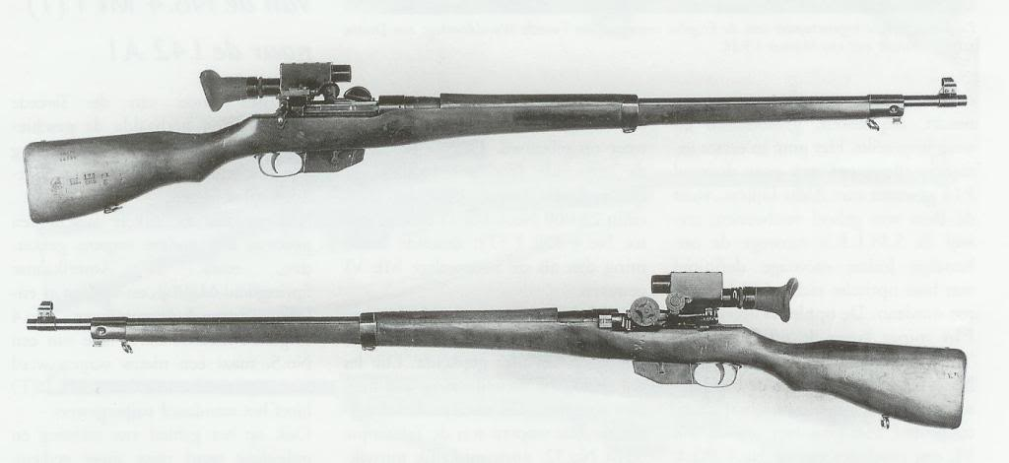
The Ross Rifle

Slide 6
What is the War Measures Act?
PM Borden introduces “War Measures Act”
Gave Government authority to do anything necessary “for the security, defence, peace, order ,and welfare of Canada”
Meaning: gov. controls transportation, trade, manufacturing, agriculture, etc.
Gov. could strip civil liberties (ex. Censor mail, detained without charges, imprisoned if suspected, German immigrants given identity cards, 8579 held in internment camps)

Slide 7
Canadian battles in WWI

Slide 8
Battle of the Somme
http://www.britishpathe.com/video/battle-of-the-somme

Slide 9
The Second Battle of Ypres
https://www.youtube.com/watch?v=EKgHtYBr7lE

Slide 10
Vimy Ridge – 1916 (Heritage Minute)
https://www.youtube.com/watch?v=rH0Gx3OFFyk

Slide 11
Passchendaele – clip from movie
https://www.youtube.com/watch?v=kUox_hQAih8

