Slide 1
Why Come to the Canadian colonies?
WGSS SS10 Mr. Salter

Slide 2
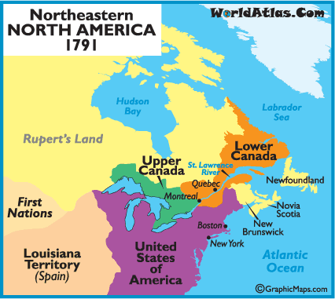
Groups coming to Canada 1765-1867
Americans
Escaped Slaves
European Settlers

Slide 3
American immigrants
Many of the Loyalists (American colonists still loyal to Great Britain) decided to immigrate up into parts of British North America (BNA)
Now that the United States was its own country, these Loyalists wanted to go where they were still a part of Great Britain’s empire
They flocked in the thousands to various areas of British North America

Slide 4
Loyalist groupings
The immigrating Loyalists can be divided into three separate groups:
Refugees: fled the Thirteen Colonies on their own during the American Revolutionary War
Under British Military protection: sailed from ports in Boston and New York
Soldiers: fought for the British during the war and were released from duty after the war

Slide 5
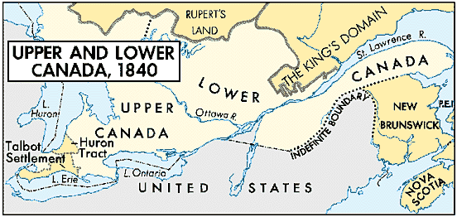
Where did they go?
The Loyalists settled throughout British North America but the majority settled in two main areas:
Nova Scotia: approximately 35,000 Loyalists went to Nova Scotia to settle. Helped create New Brunswick due to high population in the area. Another approximately 1000 Loyalists settled on St. John’s Island (Prince Edward Island).
Quebec: most that came to Quebec were farmers. Settled in almost unoccupied areas of Quebec. Many settled in what is now south-east Ontario. Eventually asked the British government to separate from Quebec, which was approved, leading to the creation of Upper Canada and Lower Canada.

Slide 6
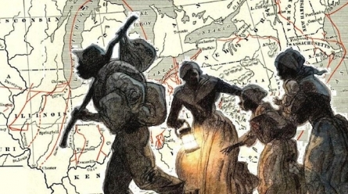
Underground Railroad
enslaved Africans followed the North Star on the Underground Railroad to find freedom in Canada
It was not an actual railroad but a secret network of routes and safe houses that helped people escape slavery and reach free states or Canada
The "railroad" actually began operating in the 1780s, but became known as the Underground Railroad in the 1830s
The organization used railroad terms as code words
“conductors”: helped people move from place to place
“passengers” or “cargo”: fleeing refugees
“stations”: safe places to stop to rest

Slide 7
Underground Railroad
Refugees arrived all over Canada: from Nova Scotia to British Columbia
Most ended up in southwestern Ontario, in cities such as Windsor, Fort Erie, Chatham and Owen Sound
The actual number of escaped slaves is not known, but it is believed to be around 30,000

Slide 8
Europeans coming to BNA
Great Britain
England
Ireland
Scotland
Wales
France
Other European countries

Slide 9
England
England was beginning to get overcrowded for many of the middle to lower class citizens
Population outpaced economic opportunity
Land and jobs were harder to come by
On top of becoming too crowded many families were suffering from the depression after the Napoleonic Wars, which resulted in mass unemployment and a crashed economy
Industrial revolution improved life expectancy of people, resulting in more people needing space and food
Many families were forced to live in slums
Families decided to move to BNA for a chance at a better life

Slide 10
England
British government was eager to try and increase population in BNA, so they offered their citizens some opportunities
1. Immigrants were offered free passage into Canada
2. Many immigrants were offered free land to come to Canada
3. Many soldiers were offered incentives such as food for a year, tools, etc.
Made the decision for many to leave England, and Great Britain in general, much easier

Slide 11
Scotland
Many Scottish farmers were evicted from their homes in a process called clearances (also called the Highland Clearances)
Landlords would claim back land from the farmers to use it to create huge sheep farms to provide wool for the textile industry in England
Selling the wool was much more profitable for the landlords than renting to the farmers
Over 50,000 Scots moved to Nova Scotia (hence the name, “New Scotland”)

Slide 12
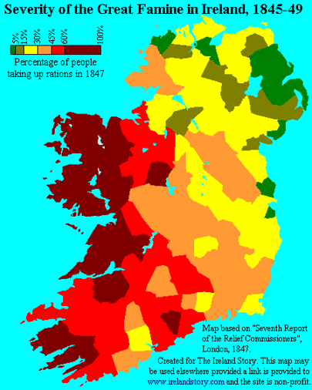
Ireland
Potatoes were the staple of the Irish diet as well as their main export crop
In the 1840s there was a “potato famine” where a blight destroyed the vast majority of potatoes in Ireland
Famine set in killing between 1 – 2 million Irish between 1847 – 51
In 1849 over 90,000 Irish emigrated to BNA

Slide 13
Ireland
By 1860, the majority of English speaking people in Canada were of Irish descent
Emigrated from Ireland
Immigrated from the United States
Mostly Catholic (Northern Ireland was mainly Protestant)
Not necessarily loyal to England
Many preferred cities over farming
By 1871, there were 846,000 Irish in Canada, out of 3.5 million
Only the French outnumbered the Irish

Slide 14
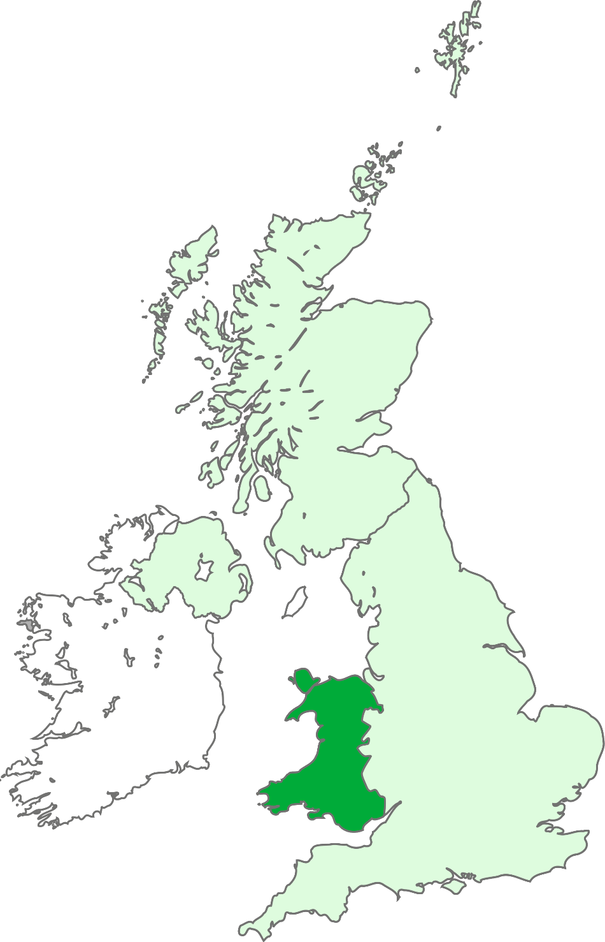
Wales
No great travesties occurred in Wales, outside of the same ones happening throughout Europe
Many Welsh made the trek for a chance at a new life, or for some, to get away from their pasts
Wales did suffer from over population and the depression, but not to the same extent as England

Slide 15
France
Much like England, France was overcrowded in the hubs, causing many citizens to live in slums
With the Napoleonic Wars being over, many French soldiers were now out of work
The Industrial revolution and the machines that came with it took the jobs of many more people
People sought out new lives in BNA, mainly in the French speaking area of Lower Canada (or New France before)

Slide 16
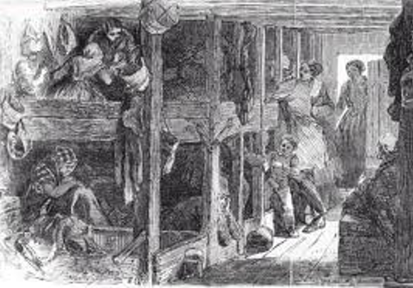
The Voyage
Immigrants often arrived at Halifax, St. John, and Quebec by boat
Cargo ships (meant for carrying lumber) were used to bring the immigrants from Great Britain to BNA to earn extra profits
Families were to take as little with them as possible, as the space was very limited
The conditions on these ships were deplorable: cramped, diseases, rats, little food, sea sickness, death
The ships got the name of “coffin ships”

Slide 17
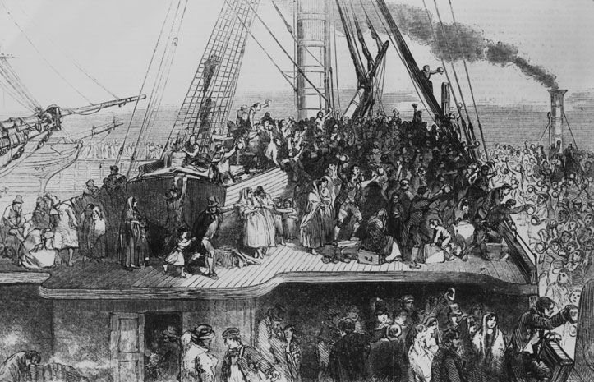
Coffin ships
Voyages would last 20 – 60 days
3000 mile journey
When a ship sank, everyone would go down with it, hence the name of “coffin ship”
Approximately 30% of those on board died before reaching BNA, and some died shortly after
The bodies of those that died on the ship were often thrown overboard during the voyage, which lead to the myth that sharks constantly followed these “coffin ships”

Slide 18
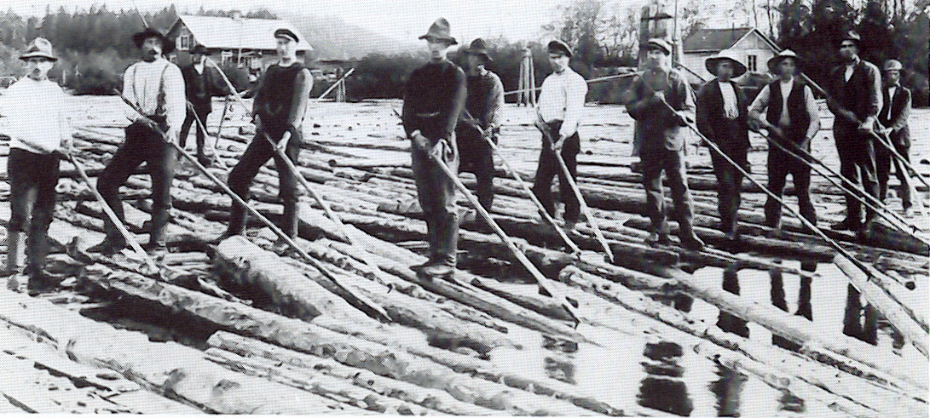
Canada: Poor Man’s Country
Seasonal work due to harsh winters in many areas
Many immigrants relied on charities for food and shelter
Jobs available to immigrants included road building, canal construction, logging, farming, labourers, servants, and more

Slide 19
Log Driver Waltz
https://www.youtube.com/watch?v=upsZZ2s3xv8
P.S. I’m sorry.

