Slide 1
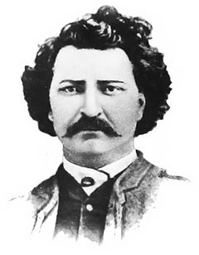
Louis Riel
Hero or traitor?

Slide 2
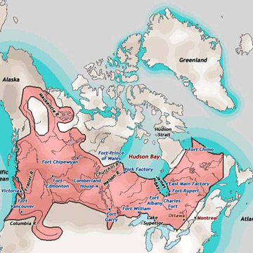
Did the HBC have the right to sell Rupert’s Land?
John A. Macdonald wanted to create a dominion of Canada from coast to coast
In 1867 Macdonald and HBC began negotiating for the sale of Rupert’s Land
The rights of the people living at the Red River Settlement were not considered
Surveyors assumed that Métis did not own the land

Slide 3
Louis Riel
A young Métis man who returned to the Red River Settlement
Educated in Montreal as a lawyer
Fluent in both English and French
Formed the National Métis Committee to fight for Métis rights

Slide 4
Provisional Government
Macdonald appointed William McDougall, who was anti-French, as lieutenant governor of the Northwest Territories (old Rupert’s Land)
Riel and the National Métis Committee told McDougall he was not welcome in their area
McDougall ignored them and the NMC occupied Upper Fort Garry, seizing weapons and ammunition
The NMC were prepared to fight for the rights, if need be
NMC was not opposed to confederation but wanted to have their rights upheld
Riel set up a provisional government, which would give the Métis a voice and would help maintain order
McDougall made a mistake and claimed himself governor before it was time then fled to the US, which allowed the NMC to exploit a loophole, giving them sovereign rights (legal government)

Slide 5
Trouble at Upper Fort Garry
Armed Métis arrested 49 men, including their leader, John Schultz, of the Canadian Party
They housed the prisoners at Upper Fort Garry
Macdonald sent Donald Smith (senior official of HBC) to negotiate with the NMC and Riel
Macdonald felt that if the NMC did not cooperate that they “must be put down”
Smith and Riel met and agreed that the provisional government should have negotiators in Ottawa
During this time, Schultz and some of his men escaped Upper Fort Garry thanks to a raiding party
The Métis caught some members of the raiding party, including a man named Thomas Scott

Slide 6
The Trial of Thomas Scott
Born in Northern Ireland, January 1st, 1842
Settled in Red River in 1869
Known to be difficult, hot headed and prone to violence
Aggressive anti-Métis, believed white people to be superior
Deep personal hatred for Riel
Spent time in captivity berating guards and threatening to kill Riel, even fellow prisoners wanted nothing to do with him
Physically assaulted one of his guards
March 3rd, 1870, Scott was put on trial for treason
Board (of Métis officials) found Scott guilty and passed the sentence of death by firing squad
March 4th, 1870, Scott was executed

Slide 7
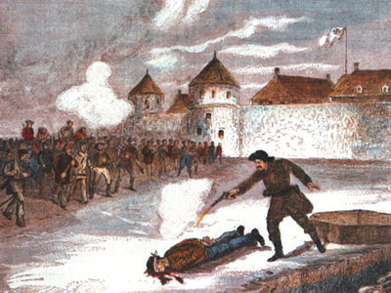
Was Riel Right to Execute Thomas Scott?

