Slide 1
The Northwest Rebellion
And the Trial of Louis Riel

Slide 2
The Metis and the First Nations people of the Northwest are going to face many challenges in the 1860s and 70s, that will lead to a North West Rebellion against the new landowner: Canada

Slide 3
Problems with the Manitoba Act
What is the Manitoba Act?
How did Canada view the Metis?
What did the military do?
The Manitoba Act (1870) created the Province of Manitoba for the Metis, and was based on the Metis list of Rights
2 official languages (French and English)
2 school systems (Catholic and protestant)
Metis need to be controlled by military until overtaken by English settlers
Commit crimes (arson, rape, assault, murder) against Metis and are not punished

Slide 4
Problems with the Manitoba Act
Who owns the land in Manitoba?
What is a Scrip?
What problems occur with the land scrip?
Metis needed a “scrip” to get ownership of the land they lived on
Scrip is paper that could be exchanged for land or money ($160 for adult/ $240 for children)
Children’s Land was surveyed and plots given out by lottery in 1875 – some land is no where near river
Many Metis sell “scrip” to Land Speculators and leave Red River going NW
Poor land
Abusive military
English Settlers
No more Buffalo

Slide 5
Problem of the Buffalo
What happened to the Buffalo?
What problems result form this?
American Gov. encouraged the Bison hunt to lower the numbers and force First Nations onto reserves
Hides and Pemmican were valuable
New transcontinental Railroads bought more hunters
In 1800s, 1000s of buffalo are killed a day and they are quickly becoming endangered
First Nations populations on the plains are facing starvation (and have no homes, or coats)
Map. P. 173

Slide 6
Canada tries to control the First Nations People
&
Take control of the land in the North West

Slide 7
North West Mounted Police
Why does Canada need to create a police force for the North West?
What was the police force called?
How were they received?
Canada owns the Northwest (Old HBC land), but can’t enforce it
Fear losing land to American Settlers
Fear American Whiskey Traders that sell to Native populations, causing alcoholism, malnutrition, disease, death
Create North West Mounted Police to enforce the law and protect the land (later renamed RCMP)
Police welcomed by Native groups

Slide 8
Treaties for the First Nations
Why does Canada want Treaties?
Why do the Natives want treaties?
What do the Treaties agree to?
Canada wants to control the North West land and be able to sell it to White Settlers
First Nations are hurt (due to buffalo) and want rights/ lands guaranteed by Canada
Treaties agree to share the land with settlers and give Natives rights to resources, heath care, education
Cree in Treaty 6 also got farm equipment/ supplies
See Map. P. 178

Slide 9
Problems after the Treaties are signed
How did the Treaties change their way of life?
How was farming a disaster?
First Nations are now Farmers, not Buffalo hunters
Failing Crops/ starvation:
Plains First Nations had never been farmers
Poor land, insects, drought
Canada doesn’t provide equipment/ mills/ seeds, or came too late or poor quality, and not allowed to use machines
Canada wants to keep the First Nations People in poverty/ sees them as children (Read p. 179)

Slide 10
The Indian Act
What is the Indian Act? Why was it created?
P. 180
Indian Act of 1876 – First Nations were made wards of the State, their lives controlled by the Canadian Government, without consulting them.
First Nations had to register with the government or else become “non-status” and lose their rights
First Nations children had to attend Residential Schools (assimilation)
Many traditional ways were banned

Slide 11
Northwest Uprising
What caused the uprisings in the Northwest?
The Métis were losing patience with the Canadian government, as they had not been part of the treaty process and their status under the Indian Act was unclear
The government already had plans for the land currently occupied by the Métis and European farmers
The land was believed to be worth $71 million, so the government was not going to pass up the opportunity to profit
Louis Riel returns

Slide 12
Louis Riel Returns
Where was Louis Riel?
Why did he come back?
Louis Riel was forced into exile to escape being charged with the murder of Thomas Scott
Settled in Montana, had a wife, two children and became a teacher
Became convinced that he was chosen by God to be the leader of the Métis
Gabriel Dumont, the leader of the Métis at the time, asked Riel to return because he was the only one that the Métis believed the government would listen to
Riel agreed and returned to Canada to become the leader of the Métis once again

Slide 13
The Lie that Started it All
What was the start of the conflicts?
The Métis sent the Canadian Government the Métis Bill of Rights in an attempt to negotiate
They never heard back from Ottawa
Lawrence Clarke, who was secretly working for the Canadian government, told Riel that the only answer the Métis would get for their petition was bullets and that a force of 500 Northwest Mounted Police were on their way to arrest Riel, which was a lie
Riel now believed that no peaceful solution was available so he told the Métis people that “justice commands us to take up arms”

Slide 14
The First Conflict
Where was the first conflict of the Northwest Uprising?
Duck Lake was the first area of conflict
Fort Carlson had minimal forces to defend against attack, so the Métis moved on the fort to seize supplies
Angry words were exchanged between both parties (the Métis and the NW Mounted Police) and two Métis negotiators were shot
Both sides opened fire
12 NWMP officers were dead and 25 were left wounded
Fort Carlton was evacuated the next day

Slide 15
Fish Creek and Batoche
What happened next?
The Canadian government mobilized over 5000 troops to combat the Métis
General Middleton was put in charge of the soldiers
On April 24th less than 300 Métis stopped the advance of 1600 militia soldiers at Fish Creek
On May 9th Batoche was attacked by Canadian troops, who had Gatling guns
After three days the Métis ran out of ammunition and had to shoot rocks and nails from their guns
Half of the Métis at Batoche were wounded, and they had to surrender or flee

Slide 16
Trial of Louis Riel
What was going to happen to Riel?
Louis Riel was taken to Regina to stand trial for treason
Riel wanted to try and show that the Métis were tricked into the uprising by the government
Only a six-man jury was required in Regina, rather than a 12-man jury in Manitoba
Manitoba jury would have consisted of both English and French, in which they may have taken a sympathetic view on the Métis
Trial began on July 28th, 1885
Riel was prevented from questioning witnesses and could not make a statement until verdict was announced

Slide 17
Trial of Louis Riel cont.
What was going to happen to Riel?
On August 1st, 1885, Louis Riel was found guilty of treason after only an hour of deliberation
Judge Richardson sentenced Riel to death, as per the law
Riel was hanged in Regina on November 16th, 1885

Slide 18
Aftermath
What happened after Riel’s execution?
The Métis moved further north and west, as they lost the titles to their land
They had to squat on public land reserved for roads, gaining them the unfortunate nickname of “the road allowance people”
First Nations people were confined to their reserves
Many of the First Nations’ ways of life became banned and stayed that way until the 20th century
Neither the Métis nor the First Nations people have fully recovered from the impacts of the Northwest Uprising

Slide 19
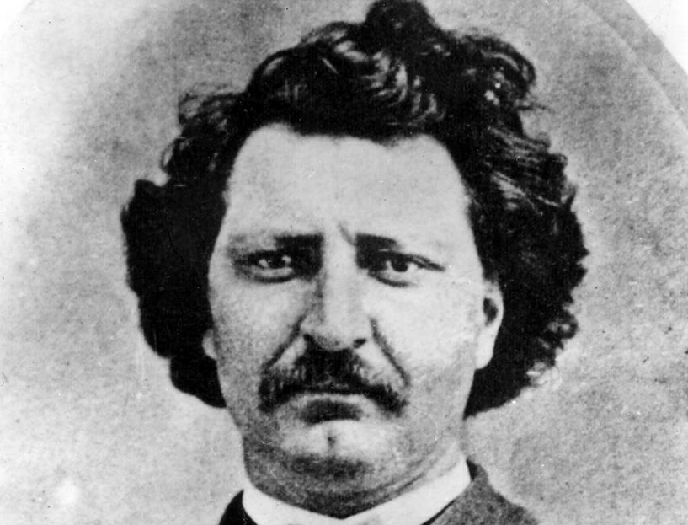
Louis Riel: Hero or Traitor?

