Slide 1
Interwar Years (1918-1939)

Slide 2
How Canada Changed in the Early 1900’s…
Technology – cars, airplanes, radio, electric oven, electric refrigerator, telephone, etc. Technology made life easier in many ways. While technology took some jobs away, it created other jobs. Technology also drove up the cost of living.
The role of women began to change dramatically. During WWI many women accepted jobs outside of the home for the first time. Women were given the right to vote and some women began running for political office. After the British court ruled on the famous ‘Persons Case’, women were guaranteed their legal recognition as people.
Canada’s population continued to grow. Immigration numbers remained high and many Canadians continued to have large families.

Slide 3
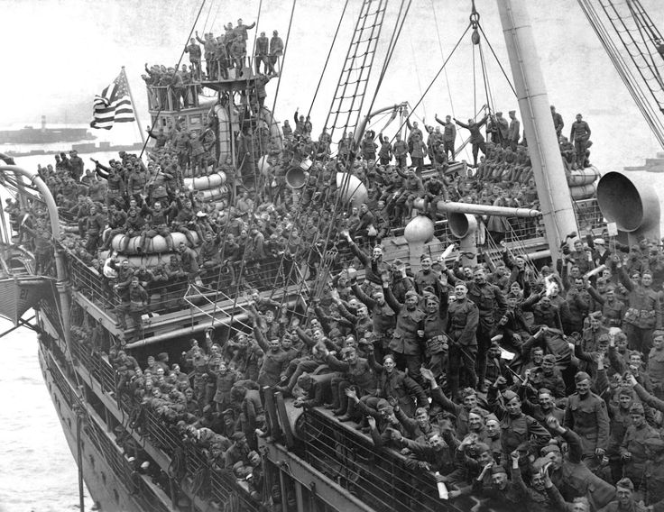
Post War Issues in Canada
1. Took years for some soldiers to get back from Europe.
2. Many returning soldiers (veterans) were not satisfied with government compensation upon their return.
3. Many soldiers struggled to return to ‘normal’ life.
Post traumatic stress syndrome
“Shellshocked”
Some said that life had lost its meaning.
Some turned to alcohol and drugs.
Gap between French Canada and English Canada was greater than ever (mainly due to the conscription issue).

Slide 4
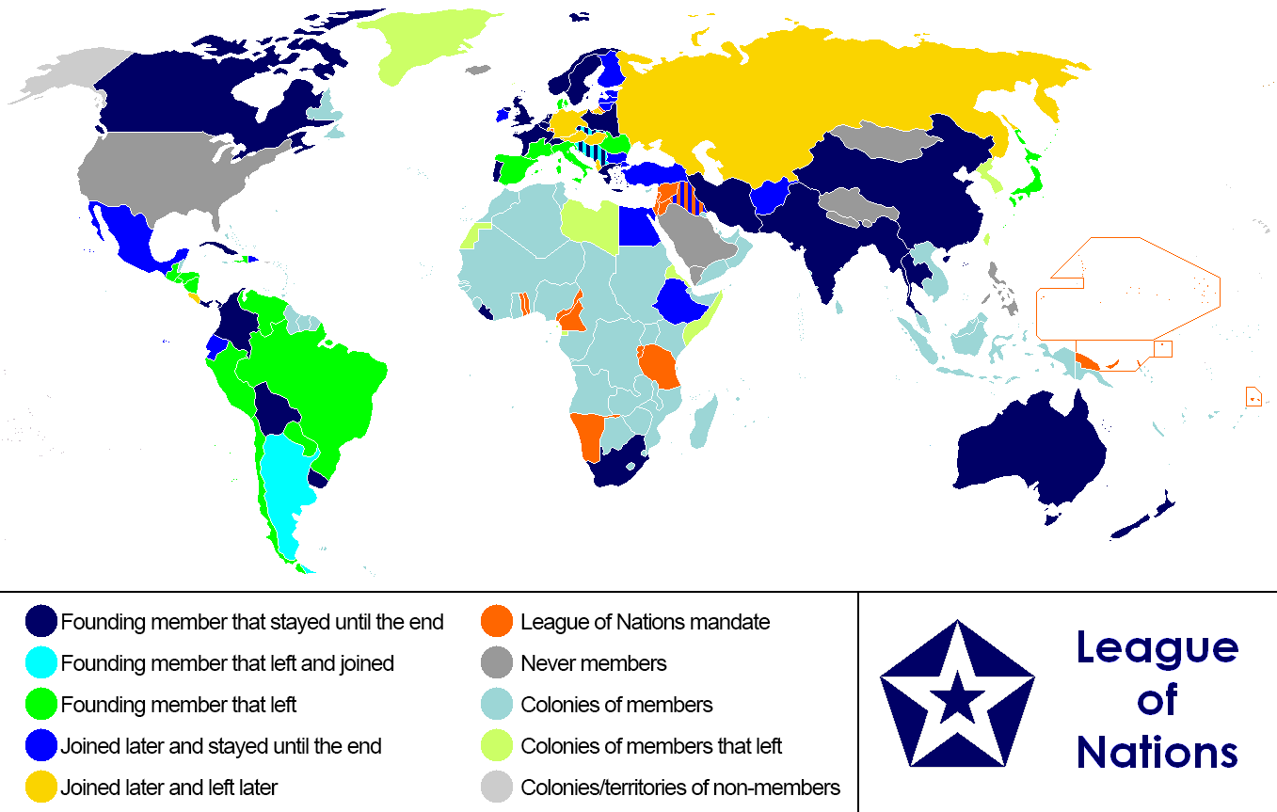
League of Nations
After the horrors of WWI, everyone wanted peace and wanted to ensure that future disputes could be solved peacefully.
Goals of the League of Nations:
International Cooperation
Arbitration (a third party helps arguing countries to solve their issues without fighting)
Collective Security (attack one member and everyone acts together in defense)
The idea of the League of Nations was presented at the Paris Peace Conference by American President Woodrow Wilson. Ironically, due to internal political disputes in the United States, the Americans did not join the League of Nations.
WWII began in 1939. Enough said about the long term success of the League of Nations…..

Slide 5
Canadian Politics after WWI
Canada continued to slowly separate itself from Britain.
Treaty of Versailles (1919) – Canada signed as an independent nation.
League of Nations (1919) – Canada represented itself as an independent country.
Chanak Crisis (1922) – for the first time Canada told Britain that they would not automatically send troops if Britain chose to go to war (Britain vs. Turkey).
Halibut Treaty (1923) – Canada signed a treaty with the US despite Britain’s disapproval.
Imperial Conference (1926) – Canada makes it clear that it is not under British authority. The Balfour Report is presented which makes Canada’s independence clear. (Commonwealth)
Statute of Westminster (1931) – legal recognition by Britain that in 1926 Canada had cleared itself of British authority.

Slide 6
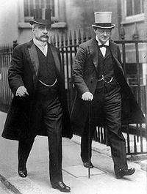
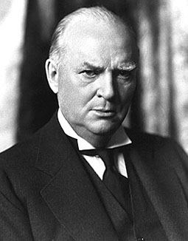
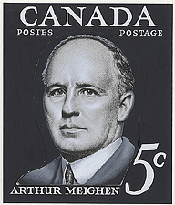
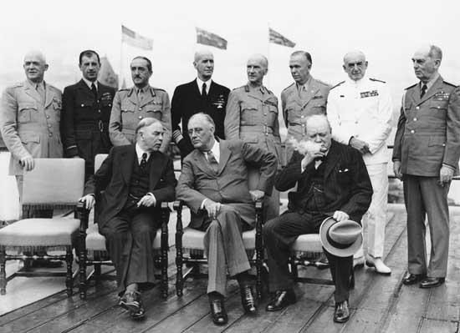
Canadian Politics after WWI
Robert Borden (Conservative PM 1911–1920) was most famous for leading Canada through WWI and his controversial conscription laws. Left the Conservative party and created the Unionist Party to bring together those of similar political beliefs during WWI.
Arthur Meighen (Conservative PM 1920-1921, 1926) had two short stints as Prime Minister
William Lyon Mackenzie King (Liberal PM 1921-1926, 1926-1930, 1935-1948) was Prime Minister for 22 years and leader of the Liberal Party for 37 years (half of his life). Helped keep Canada united through WWII.
R.B. Bennett (Conservative PM 1930-1935) lead Canada out of the Great Depression.
Canada only had four different Prime Ministers in the 37 years between 1911 and 1948. Comparatively, we have had ten different Prime Ministers in the past 37 years.

Slide 7
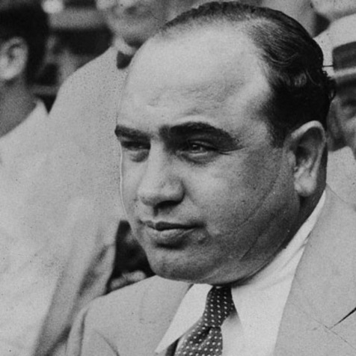
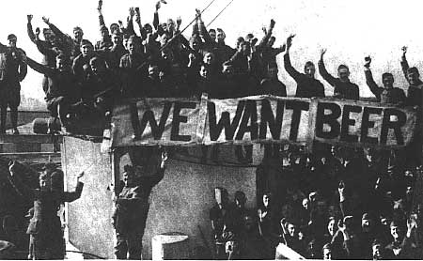
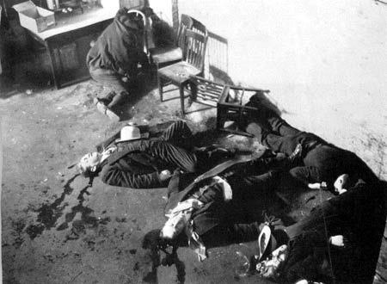
Canadian Politics after WWI
In the United States, a group called the Women’s Christian Temperance Union used their newfound political influence to have Prohibition (alcohol is illegal) put into law.
The Canadian government soon made similar laws (but not as strict).
Alcohol abuse had always been a problem. Crime, poverty, and domestic abuse became increasingly serious problems after WWI and alcohol abuse was often to blame.
Prohibition in the US lasted from 1920-1933. In Canada, the length of time that prohibition was in effect varied by province (Ontario 11 years [1916-1927], BC 4 years [1917-1921], PEI 48 years [1901-1948]).
The problem with prohibition was that mobsters began producing and selling alcohol illegally. Organized crime became big business. Mobsters such as Al Capone became extremely powerful individuals.
Many ‘rum-runners’ smuggled alcohol between Canada and the United States.

Slide 8
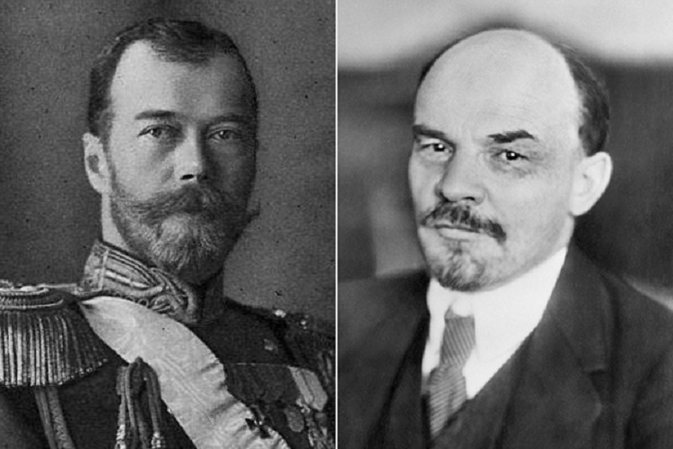
Communist Russia and Canada….
February 1917 – Russian Czar overthrown by people wanting political change in Russia.
February 1917 – October 1917 – political and social chaos across Russia.
October 1917 – Bolsheviks (communists) overtake government.
November 1917 – October 1922 – Russian Civil War. Anti-communist groups fight to retake control of the country. Communists win the war. Approximately two million die in the war. Millions of others die of disease and starvation.
https://www.youtube.com/watch?v=cV9G1QUIm7w (13 min)

Slide 9
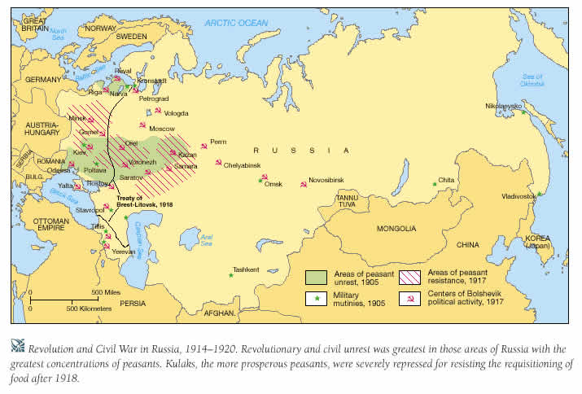

Slide 10
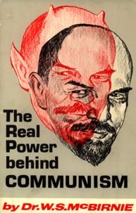
Communist Russia and Canada….
Why did Russian becoming communist matter to Canada?
What is communism?
a political theory derived from Karl Marx, advocating class war and leading to a society in which all property is publicly owned and each person works and is paid according to their abilities and needs.
The communist system (politically and economically) was the exact opposite of the democratic and capitalist system which Canadians were used to. Many people had immigrated to Canada because they wanted to have the right to vote and they wanted to work hard and prosper financially.
The revolution in Russia had been started by workers who wanted better wages and working conditions (did not want to see wealthy business owners get all the profit while the workers literally starved). These workers did not plan the communist government, politicians who had developed communists beliefs used the people’s bad situation to generate political support.

Slide 11
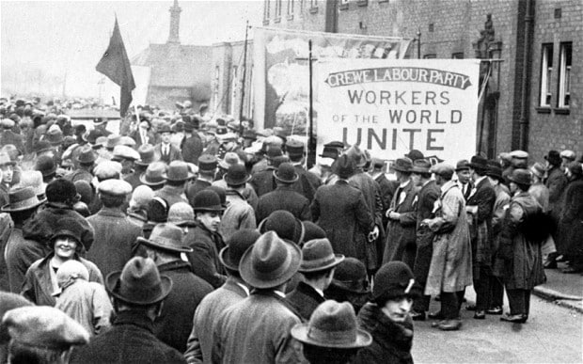
Communist Russia and Canada….
After WWI, most soldiers returned to working regular jobs (a few soldiers were sent to Russia to fight against the Communist forces in the Russian Civil War).
Canadians working regular jobs had grown sick of working extremely hard for low wages while business owners gained extraordinary wealth.
After WWI, workers began to group together and form unions. The goal of the unions was for workers to group together to stand up to employers and demand better wages and working conditions. This likely happened after the war (instead of before) because many ex-soldiers were now used to taking a firm stand for what they thought was right.
The formations of unions scared many Canadians because it reminded them of the Communist Revolution which started in Russia with employees grouping together.

Slide 12
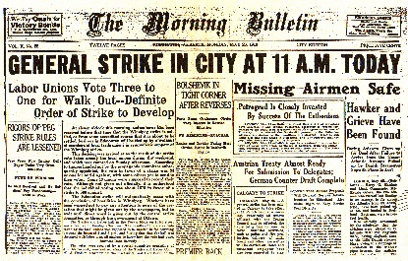
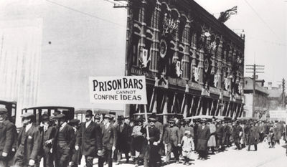
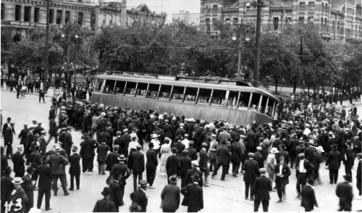
Winnipeg General Strike
In the spring of 1919, a metal workers union in Winnipeg went on strike. Workers from other unions soon joined the strike in support. Eventually most of the city’s workers were on strike. The city literally shut down when transit workers, telephone operators, and firefighters joined the strike. Over 30,000 workers protested peacefully in the streets each day (wanting at least 85cents/hour). There were soon similar (but smaller) strikes in other Canadians cities.
This reminded many of how the Russian revolution had began two years earlier.
The strike in Winnipeg became violent on Saturday June 21, 1919. Strikers overturned and burned a streetcar. The police charged the crowd and in the chaos that ensued one was killed, thirty were injured, and hundreds were arrested.
Union leaders soon told workers to return to work. Employers in Canada realized that they had to treat workers better and negotiate with unions. A new political party was also formed to represent the working class (originally the CCF, now known as the NDP).

Slide 13
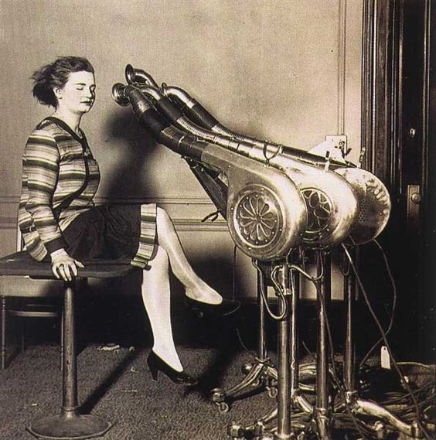
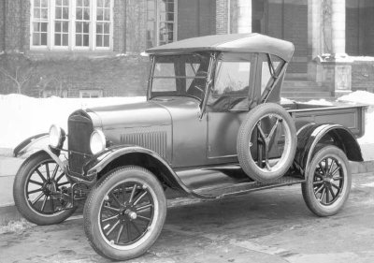
The Economy After WWI
North America prospered. World financial centre became New York City (no longer London).
Technology allowed farms to produce more food than ever before. Food costs began to drop. Less people worked on farms. Many people moved to urban areas.
Huge market for new technology (consumer goods such as cars and electric appliances).
The success of unions gave people more money to spend than ever before.
Manufacturing companies made large profits. Many new factories were built. Some companies made more products than they could sell. Extra product was stored to be sold later (overproduction).

Slide 14
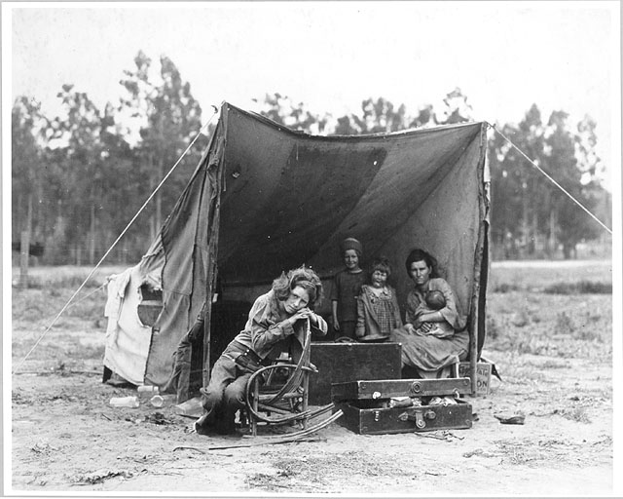
The Great Depression
What was the Great Depression?
A severe economic downturn which affected much of the world in the early 1930’s.

Slide 15
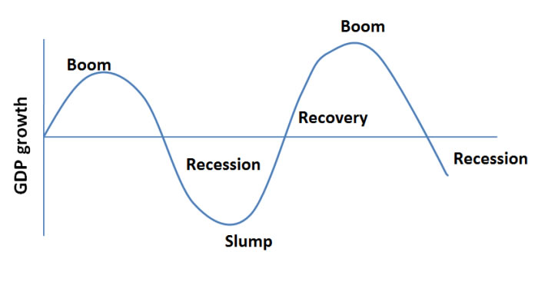
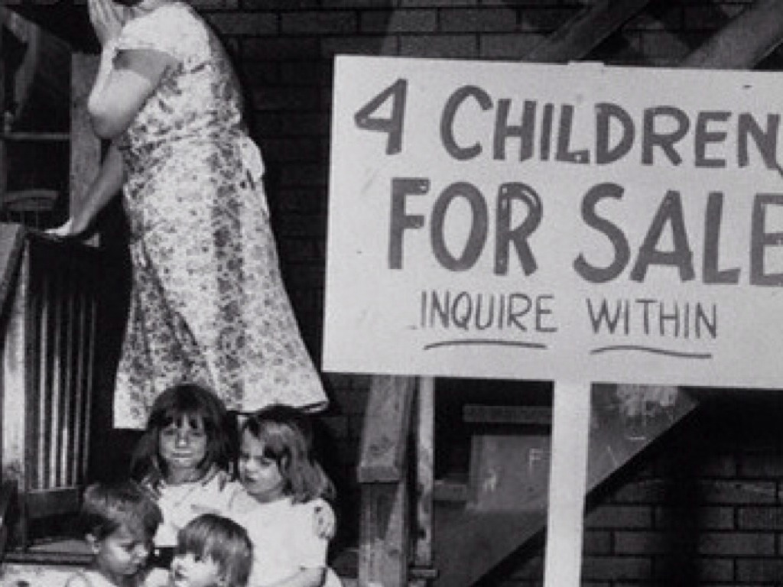
The Great Depression
What caused the Great Depression?
The economy naturally goes through up and down cycles. Throughout the 1920’s the Canadian economy was on an ‘up’ cycle. This could not last forever….
Manufacturing companies overproduced late in the 1920’s.
The Canadian economy was too dependent on selling key resources (wheat).
The Canadian economy was too dependent on the US economy.
The stock market crashed on October 29, 1929.
A severe drought hit the prairie provinces in the early 1930’s.

Slide 16
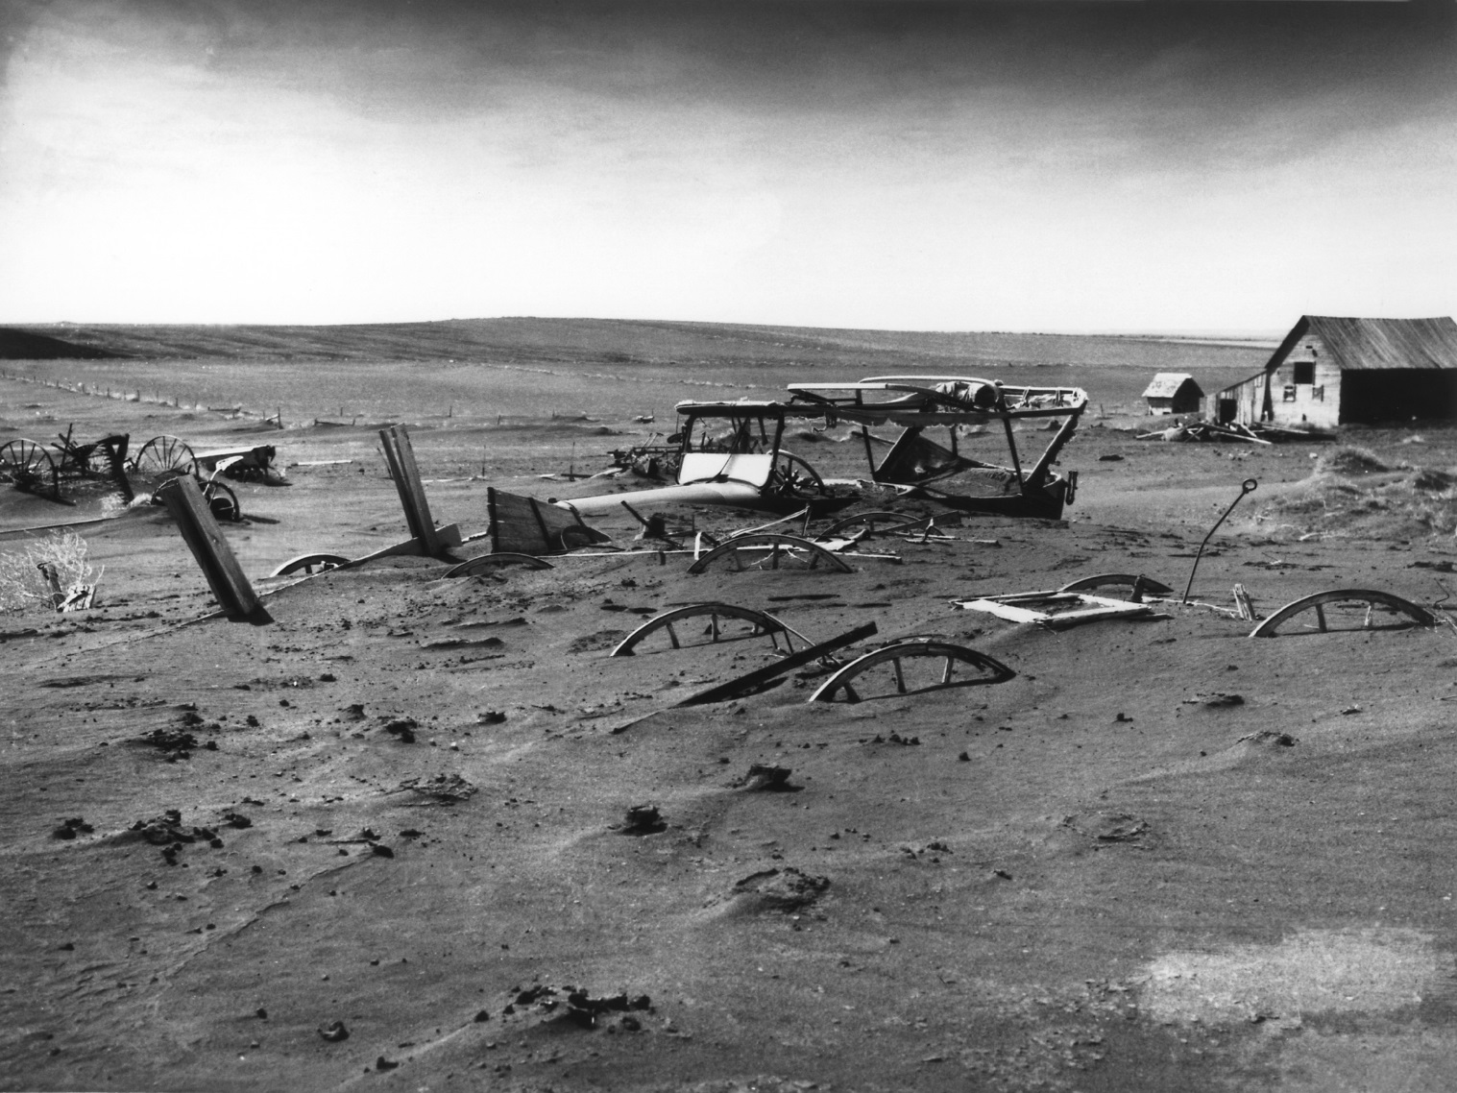
The Great Depression
When did it happen?
The depression began with the stock market crash in 1929. It lasted for most of the 1930’s. It was probably at its worst in 1933-1934.
Where did it happen?
The entire world was affected. That said, some historians think that Canada was hit harder than any other country.
Who was affected?
Poor people and the middle class. Often during a depression, the wealthy actually become wealthier. People living in cities were often affected the most.

Slide 17
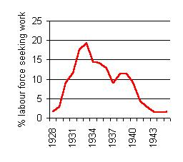
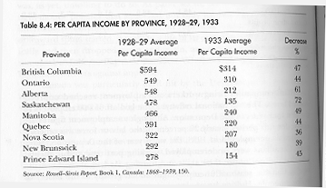
The Great Depression
Many workers could not find jobs.
Young people and uneducated people were affected the worst.
Many people had to accept very low wages to find a job.
Many families lost their homes and their life’s savings.
The economy is greatly affected by a “trickle down” effect. If people are without work and do not have money to spend, it also effects the businesses where people would normally spend their money….. especially businesses selling ‘non-essentials.
Some banks even went bankrupt during the Great Depression!

Slide 18
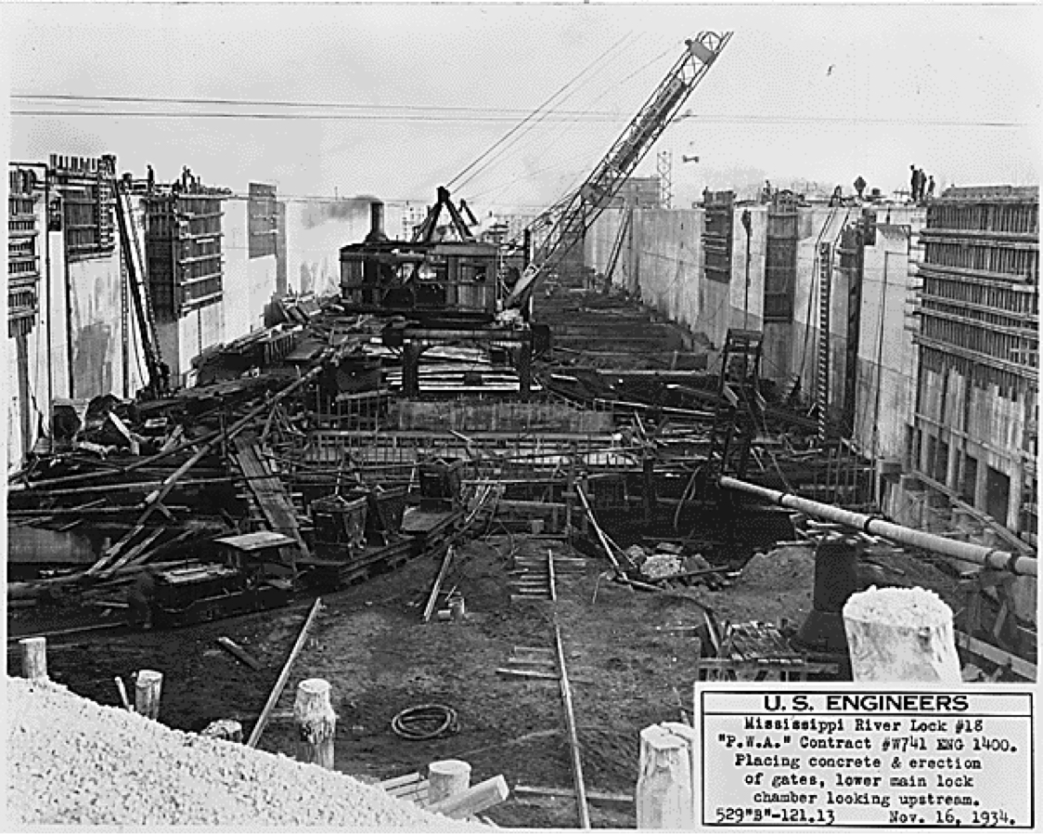
The Great Depression
What would end the depression?
Before the Great Depression, most governments had a laissez faire (let do or let it take care of itself) view of the economy. During the Great Depression, voting citizens insisted that the government take serious actions to help the economy and people who were struggling.
British economist John Meynard Keynes recommended that governments use debt financing to start large projects which would create jobs and kick start the economy.
When elected, US President Franklin Roosevelt introduced the ‘New Deal’. This included large projects to create jobs and social welfare programs.

Slide 19
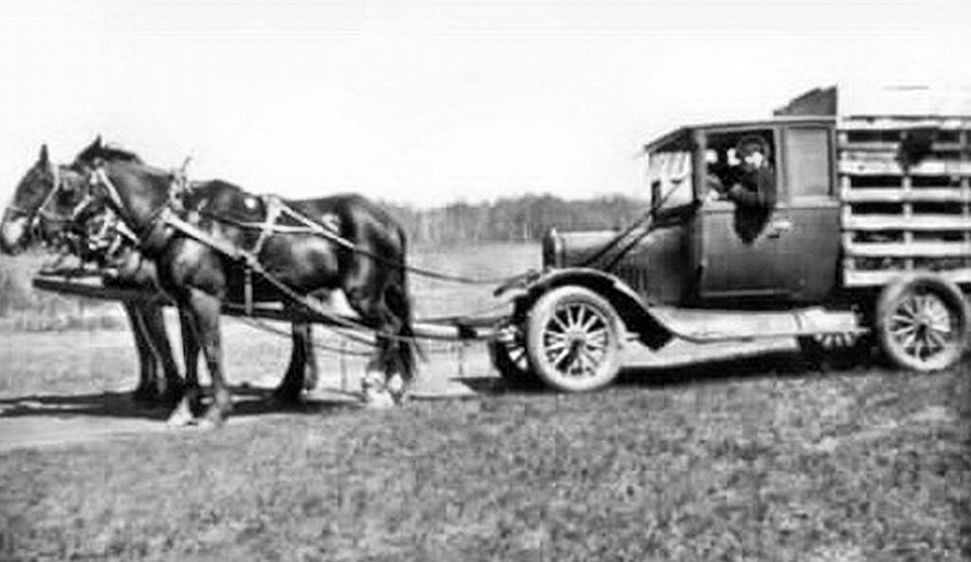
The Great Depression
What would end the depression?
In Canada, Prime Minister Mackenzie King refused to help the unemployed.
R.B. Bennett won the 1930 election and became Prime Minister.
Bennett set up a ‘Pogey’ (welfare) system and also set up Unemployment Relief Camps (workers were paid 20cents/day).
In 1935 Bennett passed new laws including progressive taxation (the more you make the more you pay), minimum wages, unemployment insurance, old age pensions, and health insurance.

Slide 20
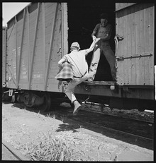
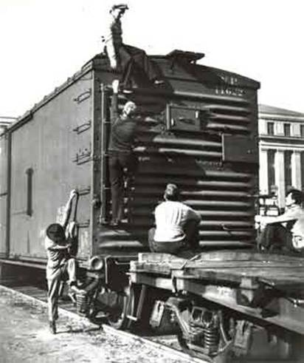
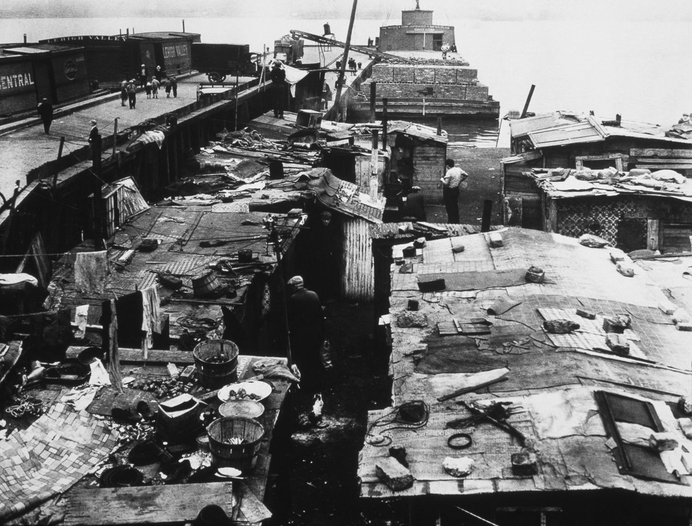
The Great Depression
Throughout the Great Depression, many unemployed workers would illegally ride freight trains from town to town looking for employment. This practice became known as ‘riding the rails’.
These workers sometimes found seasonal jobs, but were often viewed as troublemakers because they often lived in homeless camps.

Slide 21
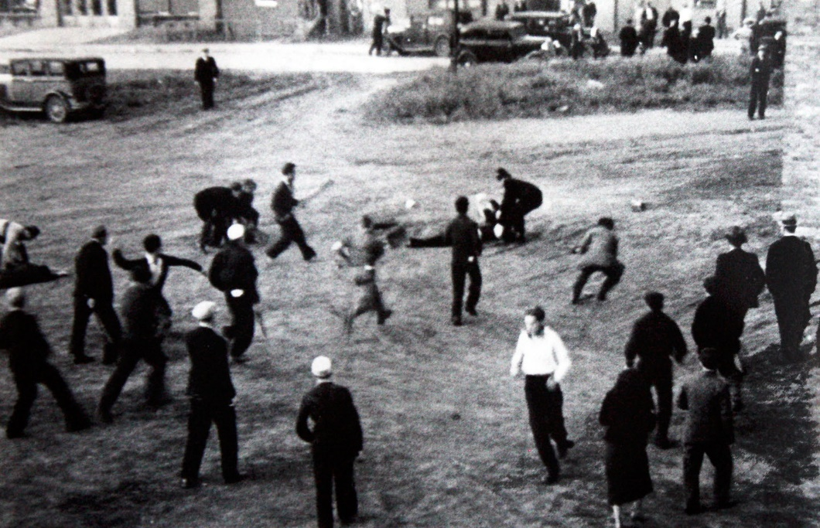
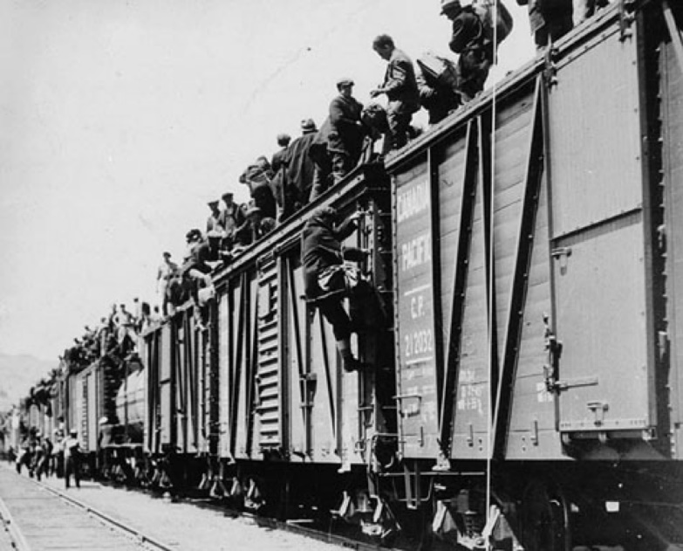
The Great Depression
In 1935, many unemployed workers were unsatisfied with how the Canadian government had been dealing with the Great Depression.
Large groups in Vancouver and other western cities planned to ‘ride the rails’ to Ottawa to protest.
In Regina, Saskatchewan the trains were stopped by the RCMP. The protesters began to riot and 300 RCMP officers tried to stop the riot. Fights began. Many rioters were injured and one RCMP officer was beaten to death. This became known as the Regina Riot.
Due to frustration with the federal government, Mackenzie King was re-elected in the 1935 election.

Slide 22
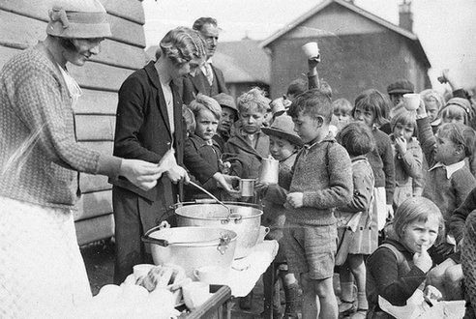
The Great Depression
No specific event ended the Great Depression.
The economy went into a downward plunge in 1929. Unemployment was at its worst in 1933-1934. Things began to get better in the mid 1930’s and by the late 1930’s the economy was improving.
The start of WWII in 1939 completely ended the Great Depression.
Why does War help the economy?
Solders are paid and other people can take their previous jobs.
Many jobs created to supply soldiers with ‘war supplies’.
By the early 1940’s almost all Canadian workers had jobs.

