Slide 1
Electoral Process
How do we choose our government? What are the problems with our system?

Slide 2
Who is allowed to vote?
Any Canadian citizen over the age of 18
Who is allowed to run in an election?
Any Canadian citizen over the age of 18
How is it decided who will run in an election?
Political party nominate a candidate per riding (or you can run as an independent)

Slide 3
How often are elections held in Canada?
Elections must be held the second Tuesday in October, every 4 years
(this is a new law as of 2011)
They can be called earlier than that by choice of the prime minister, or after a successful vote of non-confidence

Slide 4
Definitions
Dissolution
Enumeration
Nomination
Governor General ends the current government - election called
Voter list created
The Political Party choses (nominates) members to run for election in each riding.
Those who are not part of a party can run as independent candidates

Slide 5
Definitions
Campaigning
Vote (balloting)
Tabulation
The Political Party choses (nominates) members to run for election in each riding.
Cast a vote
(registered, eligible voters)
counting all the votes to determine who won in each riding.
1 riding = 1 seat in house of commons.
The party with the most seats will form the new government (be the winner)

Slide 6
Definitions
Acclimation
When only 1 candidate runs in a riding, they win by default – by acclimation

Slide 7
What is an electoral riding?
Canada is divided into sections based on population – 100 000 people per section.
Each riding will elect 1 member of parliament
How is the Prime Minister Chosen?
Political parties vote for their leader, and the leader of the party with the most seats (ridings) becomes the Prime Minister

Slide 8
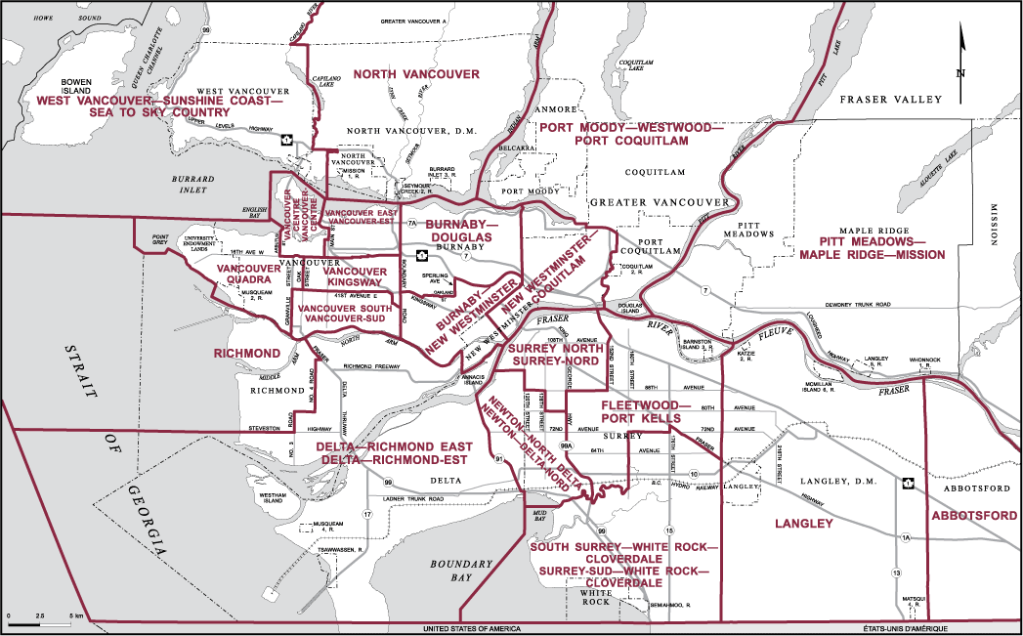
Example of electoral districts 2011

Slide 9
First Past the Post System

Slide 10
Definitions
First past the post
Popular vote
Proportional representation
The person with the most votes in a riding wins the seat in the House of Commons
The party with the most seats forms the government
The number of actual votes for a party (not # of seats won)
When the number of seats in the House of Commons matches the % of votes

Slide 11
Definitions
Minority Government
Majority government
Coalition Government
When the party with the most seats does not have 50% of the seats in the house of commons (the opposition can join together and out-vote them)
When the party with the most seats has over 50% of the total seats in the House of Commons (have the majority)
When a minority government joins forces with another party to create a majority government

Slide 12
Definitions
Non-confidence vote
A vote in the House of Commons to decide if the present government still has the support of the parliament. If the majority vote for non-confidence, the Governor General will dissolve the parliament and call a new election.

Slide 13
Party | Seats won | % of total seats
Conservatives | 95 | 31%
Liberals | 157 | 51%
NDP | 56 | 18%
Green | 0 | 0%
What type of government formed here?

Slide 14
Party | Seats won | % of total seats
Conservatives | 95 | 31%
Liberals | 157 | 51%
NDP | 56 | 18%
Green | 0 | 0%
What type of government formed here?
Majority government

Slide 15
Party | Seats won | % of total seats
Conservatives | 110 | 36%
Liberals | 132 | 43%
NDP | 65 | 21%
Green | 1 | 0%
What type of government formed here?

Slide 16
Party | Seats won | % of total seats
Conservatives | 110 | 36%
Liberals | 132 | 43%
NDP | 65 | 21%
Green | 1 | 0%
What type of government formed here?
Minority government

Slide 17
Party | Seats won | % of total seats
Conservatives | 100 | 32%
Liberals | 152 | 49%
NDP | 56 | 18%
Green | 0 | 0%
What type of government formed here?

Slide 18
Party | Seats won | % of total seats
Conservatives | 100 | 32%
Liberals | 152 | 49%
NDP | 56 | 18%
Green | 0 | 0%
What type of government formed here?
Minority government

Slide 19
Party | Seats won | % of total seats
Conservatives | 39 | 13%
Liberals | 80 | 26%
NDP | 186 | 60%
Green | 3 | 0%
What type of government formed here?

Slide 20
Party | Seats won | % of total seats
Conservatives | 39 | 13%
Liberals | 80 | 26%
NDP | 186 | 60%
Green | 3 | 0%
What type of government formed here?
Majority government

