Slide 1
Reading Political Cartoons
History Review

Slide 2
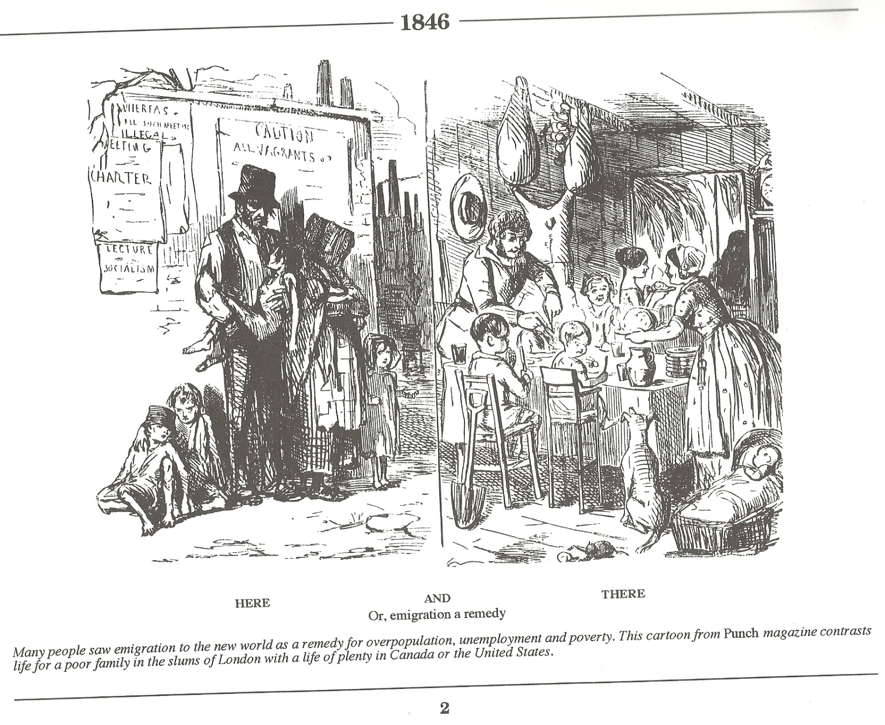
Immigration to the Canadas

Slide 3
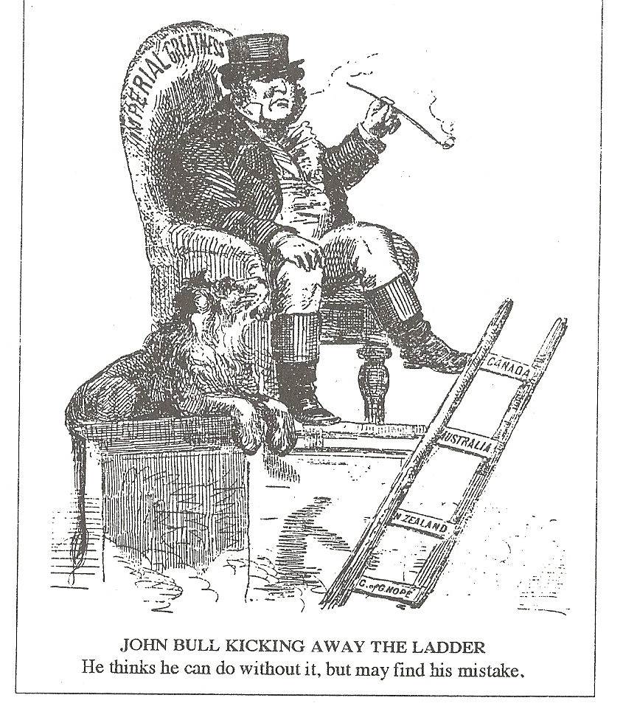
Confederation and Britain

Slide 4
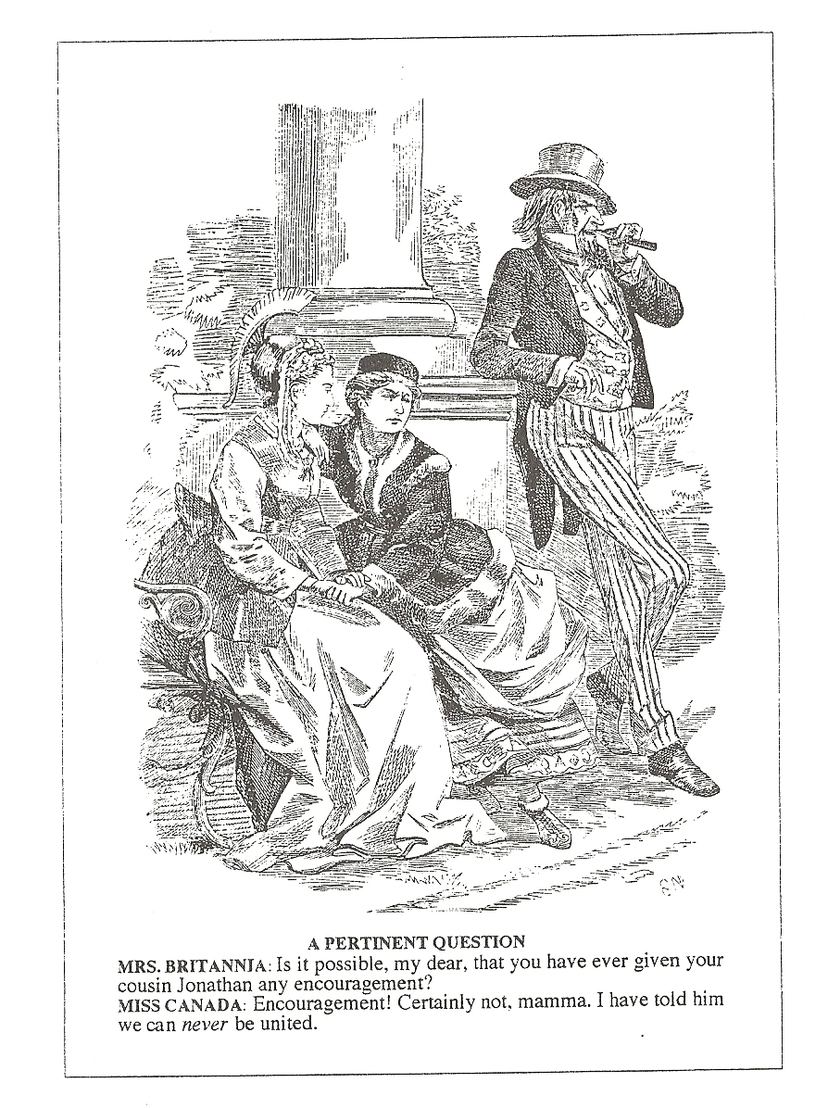
Confederation and USA annexation

Slide 5
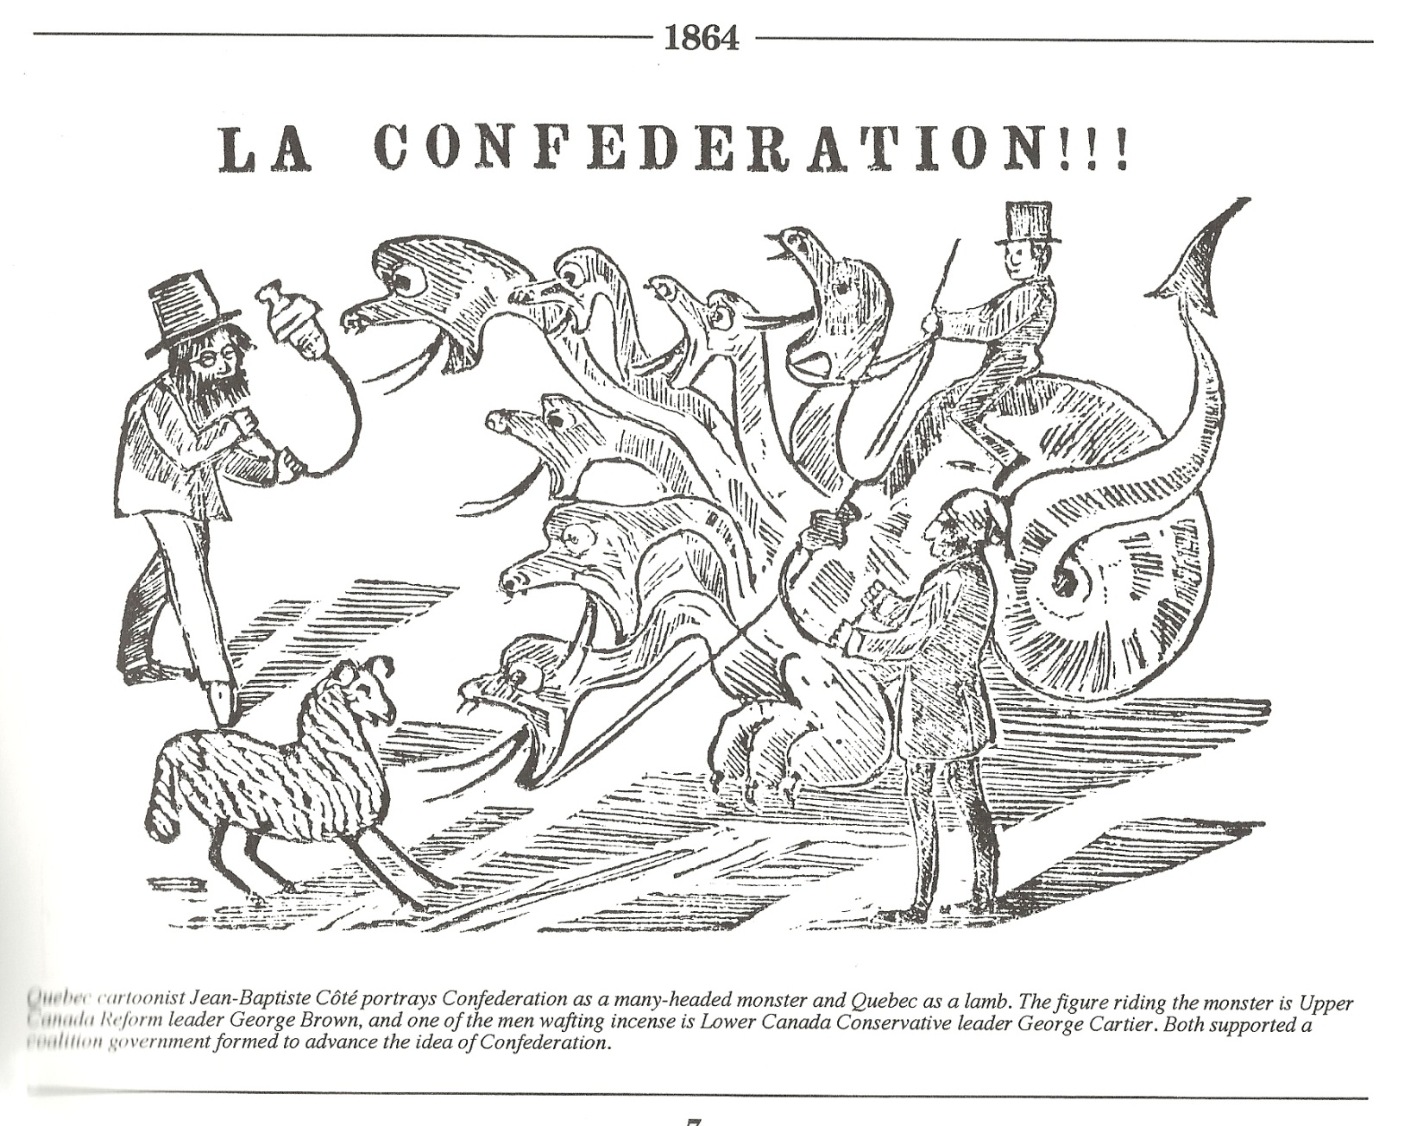
Confederation and Quebec

Slide 6
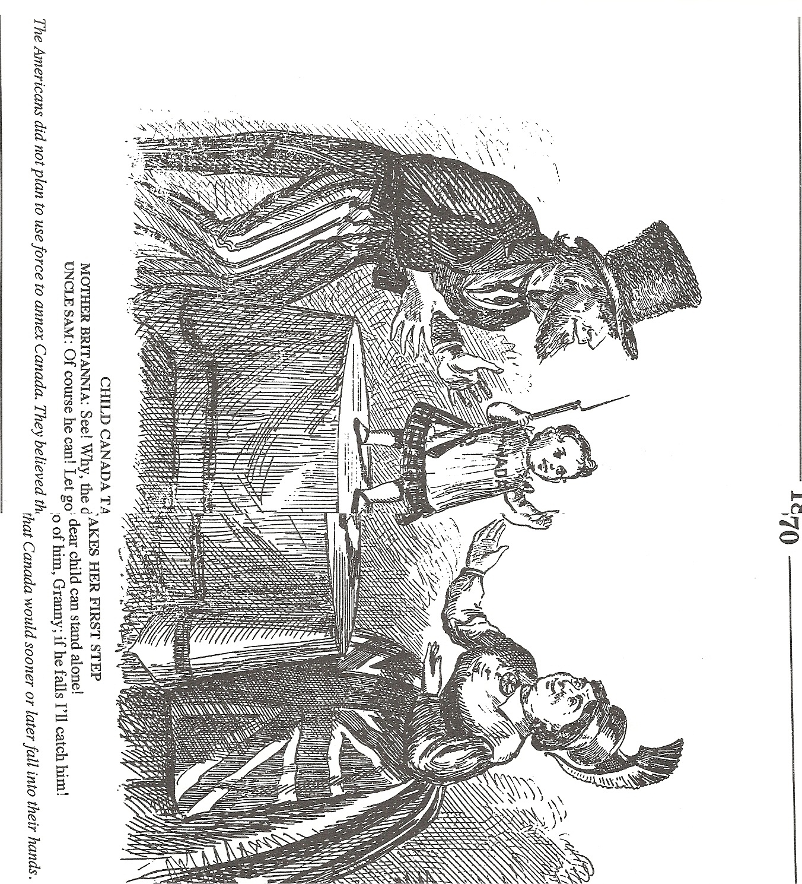
After Confederation

Slide 7
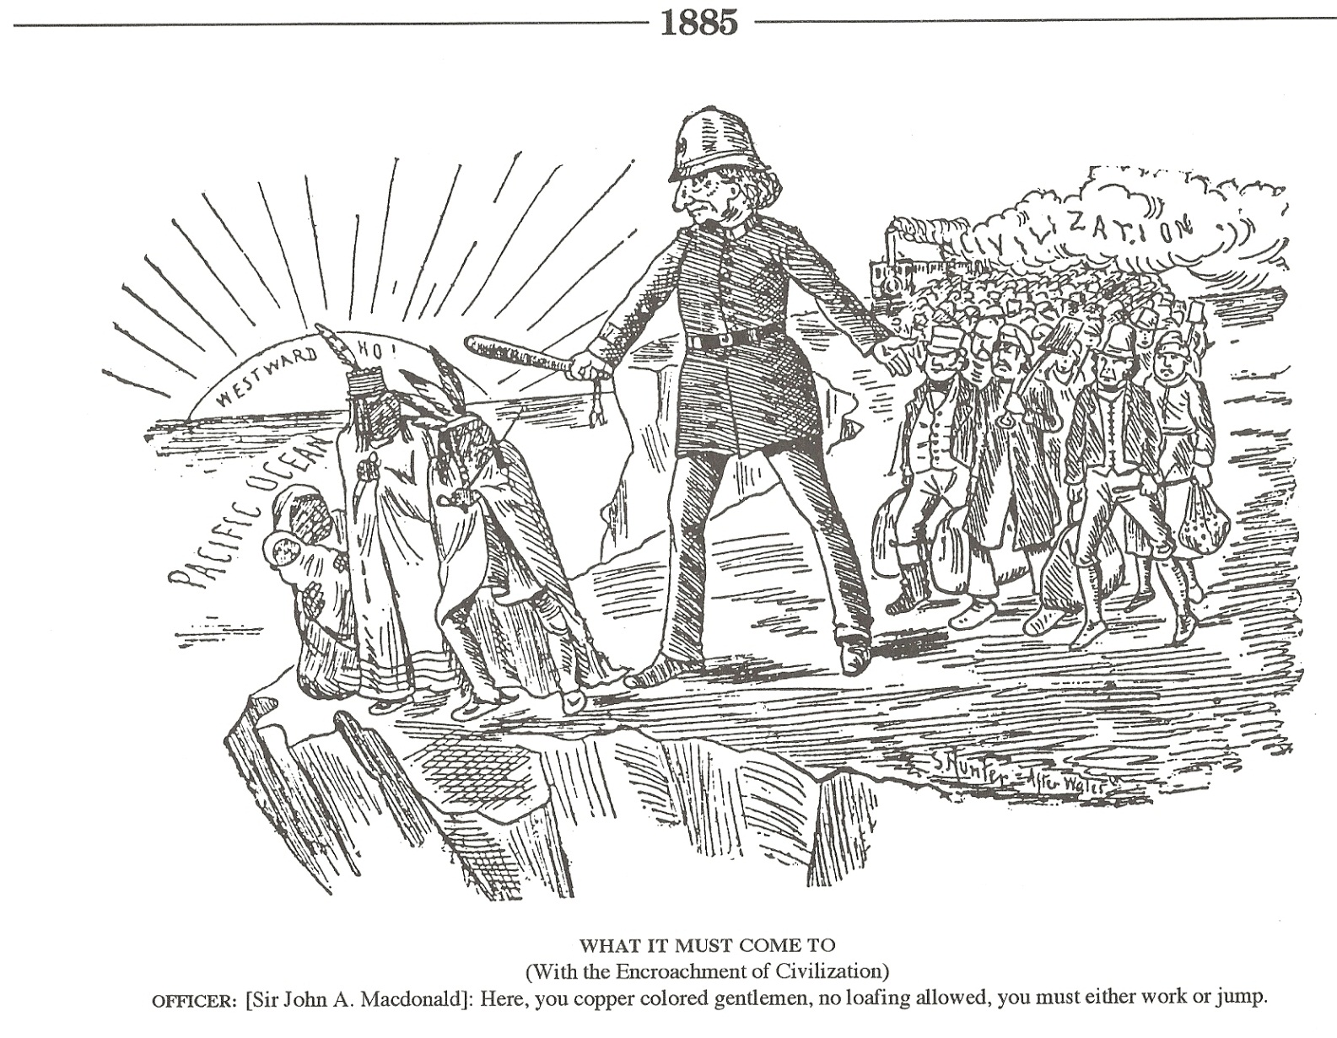
Settling the West vs. First Nations

Slide 8
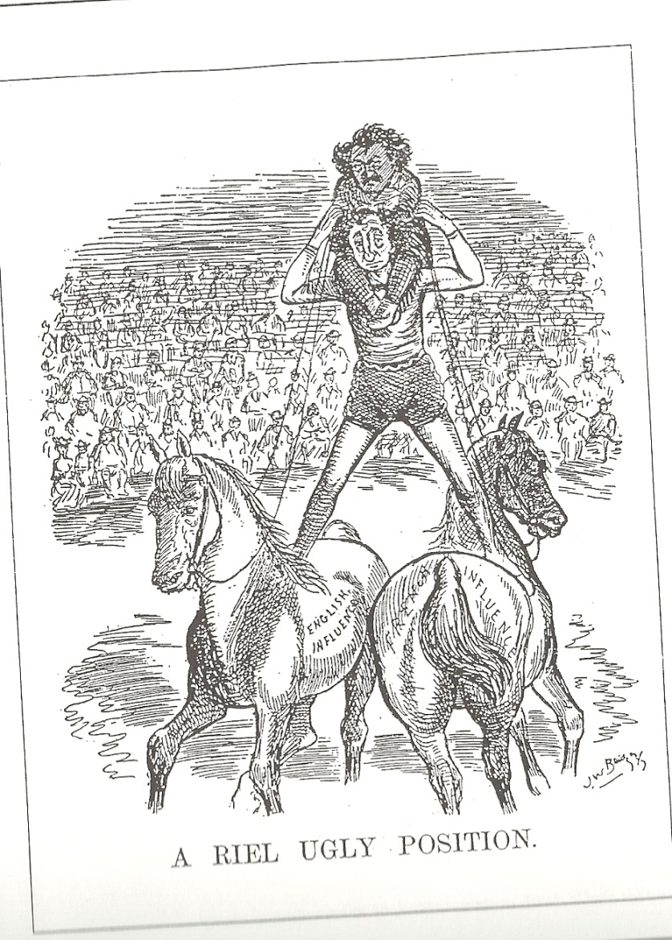
Trial of Louis Riel

Slide 9
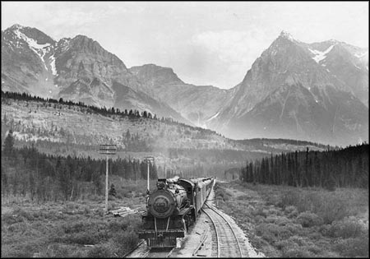
The Canadian Pacific Railroad
Macdonald’s National Policy and Immigration

Slide 10
The National Dream
What is the National Dream?
Why does British Columbia join Canada?
Who will build the Railroad?
Confederation: Dream of Country Sea to sea
Promise BC the Canadian Pacific Railroad (CPR) – connecting East and West Coast
Join Confederation in 1871
Jay Cooke (American) and Sir Hugh Allen (Canadian) form the Canadian Pacific Railway Company in 1871 to build the railway for John A. Macdonald
Secretly plan to make it an extension of American line

Slide 11
The Pacific Scandal
What is the Pacific Scandal?
Why did this upset the Canadian people?
What happens to Macdonald?
First Election: 1872
Conservatives (Macdonald) need money to campaign
Macdonald promises Sir Allen the Railroad contract for campaign $
After winning election, the memos leak out
Public outraged by American connection and government corruption
Afraid government controlled by Americans
Macdonald resigns – 1873 (new election called)

Slide 12
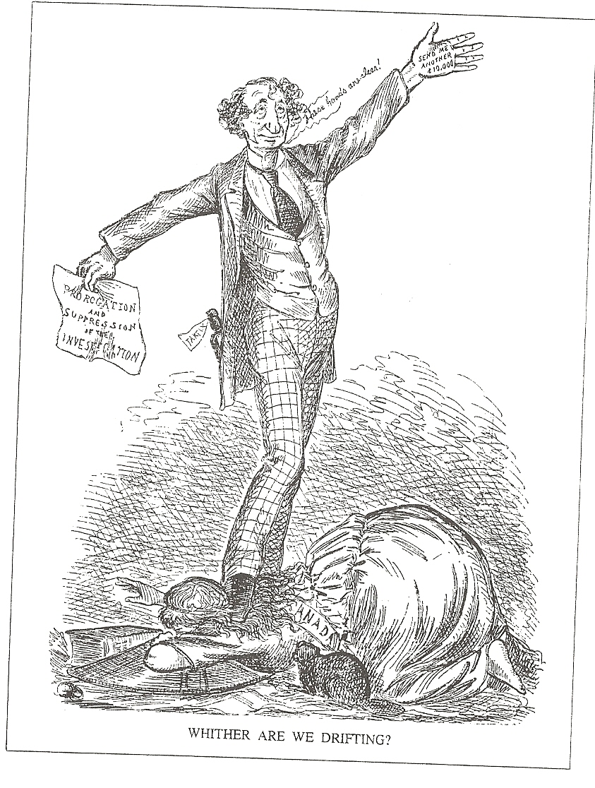
Pacific Scandal

Slide 13
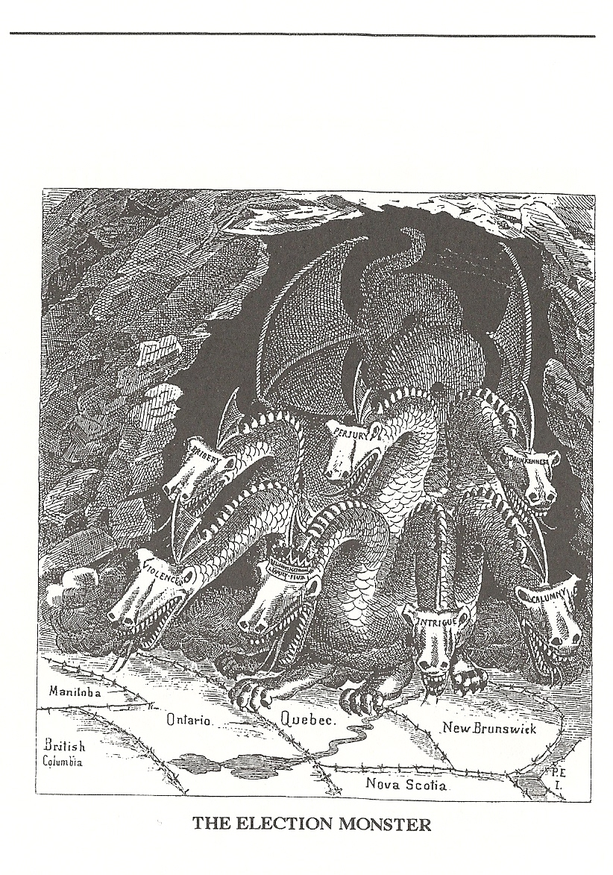
Election after Pacific Scandal

Slide 14
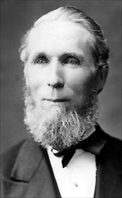
Prime Minister Alexander Mackenzie
Who is the new Prime Minister?
Does Mackenzie want the CPR?
Liberals win election
New Prime Minister: Alexander Mackenzie
Economy in Depression – Mackenzie is against spending $ on CPR
BC threatens to leave Canada if no Railroad
Mackenzie allows land surveyors to plot route of CPR

Slide 15
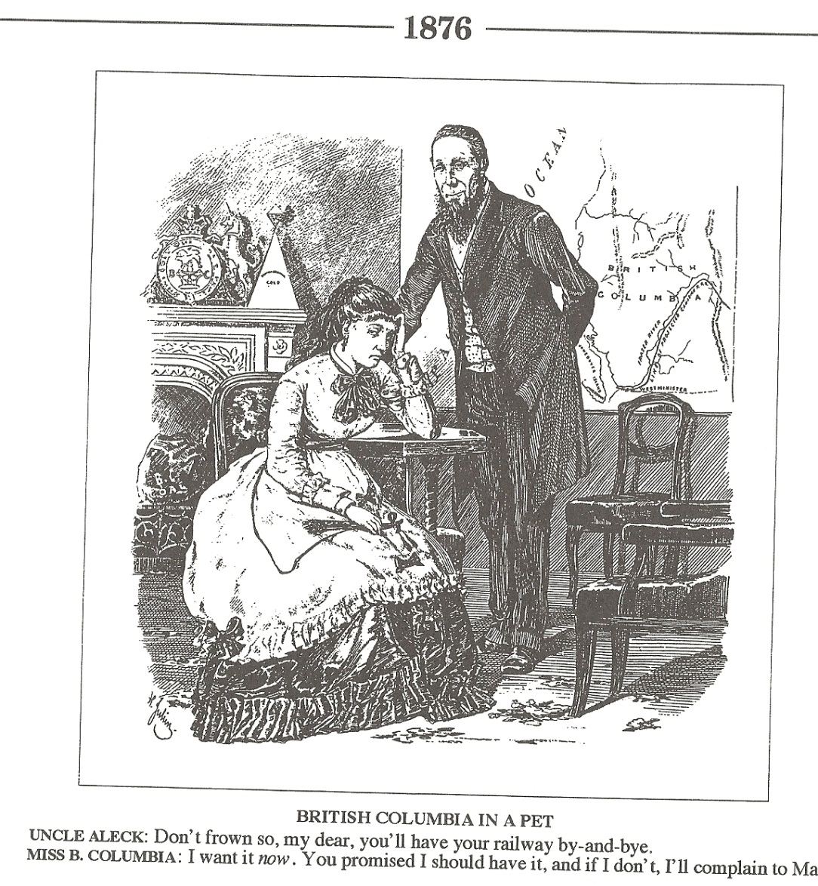
CPR and BC

Slide 16
“Battle of the Routes”
Who is in charge?
What are the favored routes?
Who else is interested in the choice of route?
Sanford Flemming in charge of surveying routes
Flemming and BC wanted the route through Edmonton, to Yellowhead pass, to New Westminster, Victoria wanted it to go to Bute inlet and across a bridge to the island
Land Speculators buy land hoping to make money if that route is chosen

Slide 17
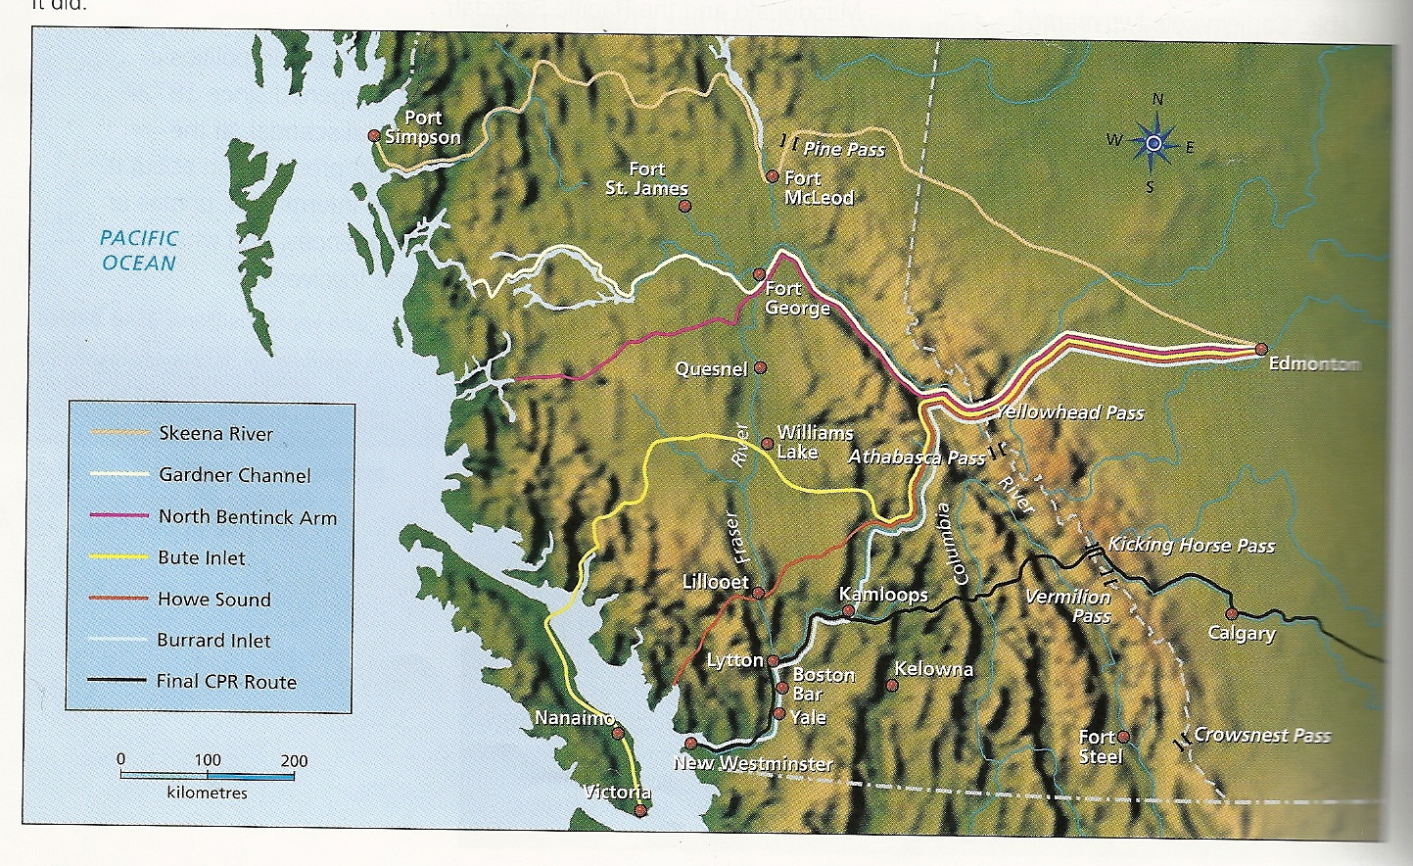
Map of possible routes p. 196

Slide 18
“Macdonald’s National Policy”
How does Macdonald win the next election?
What is the National Policy?
How is Macdonald going to finish the CPR?
Election 1878: Macdonald and Conservatives win based on his “National Policy”
National Policy
Protective tariffs
Increased immigration to West
Complete CPR
1880: Macdonald gives the “CPR syndicate” $25 mill, 25 mill acres of land, and monopoly west of Lake Superior for 20 years
CPR syndicate must build CPR in 10 years

Slide 19
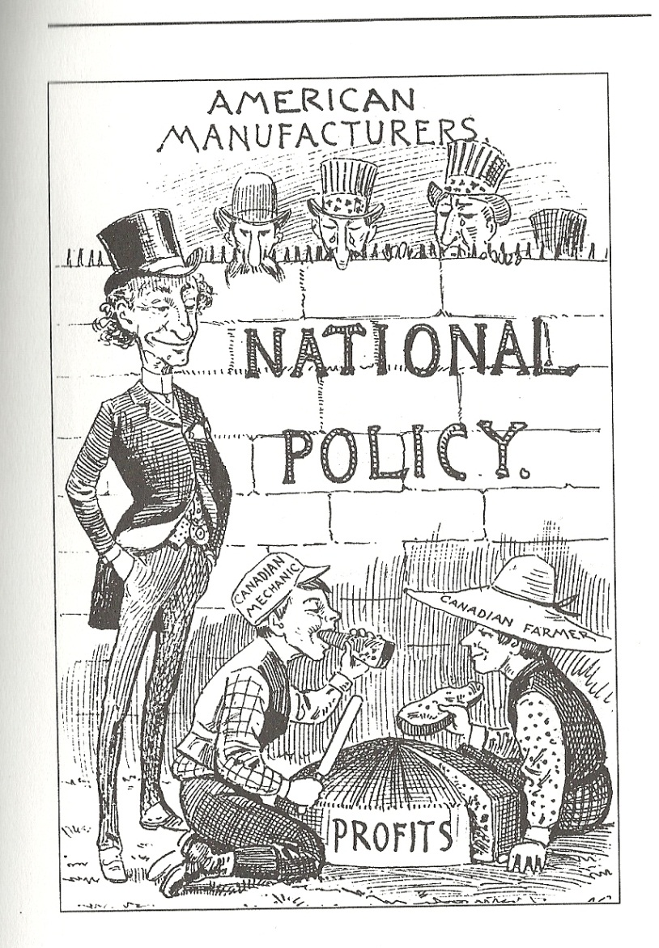
Protective tariffs

Slide 20
CPR Syndicate
Who is the CPR Syndicate?
Why do they change the prairie route?
CPR Syndicate: 3 Canadian Business men:
  George Stephen (Bank of Montreal)
  Donald Smith (HBC)
  James Hill (Pacific Railway)
Change route from Edmonton to Calgary to be able to buy all surrounding land (angry speculators)
Work is too slow, and route through BC unknown, so hire William Van Horne to run operations

Slide 21
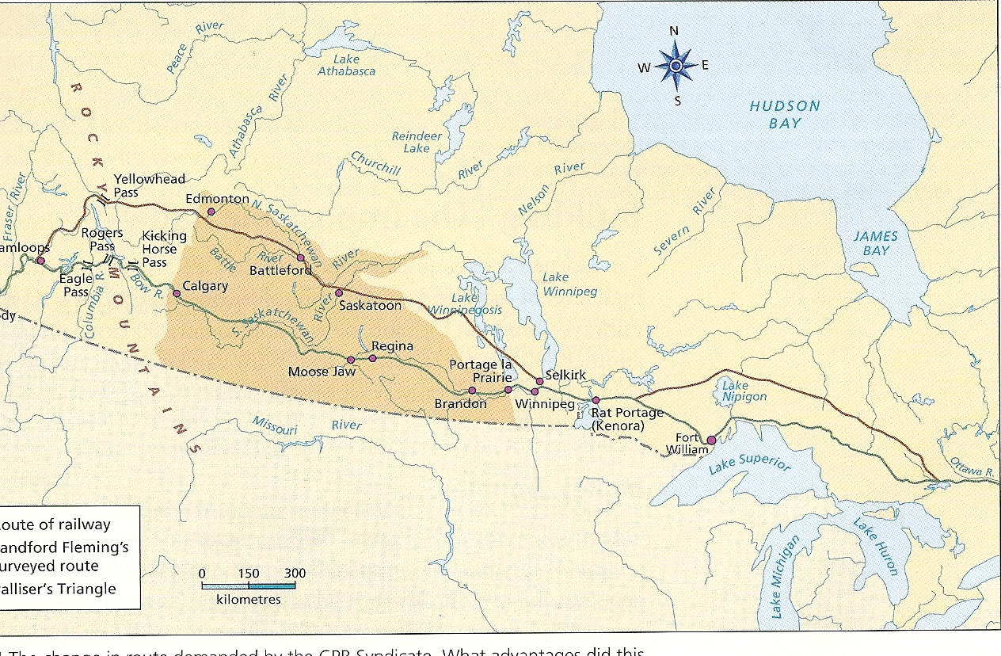
Changed CPR route, map p. 199

Slide 22
William Van Horne and the CPR
Was Van Horne more successful?
What money troubles did the CPR have?
How did Van Horne and Macdonald try to fix the problem?
230 km of track laid in 1881, under Van Horne he laid 800 km in 1882, and again in 1883
Gov. paid at completion of each section – company running out of money
1884: Can. Gov. gives extra $22.5 mill, and Van Hone makes cuts, and uses cheaper Chinese labour on BC difficult portion
Still not enough – fear bankruptcy before completion

Slide 23
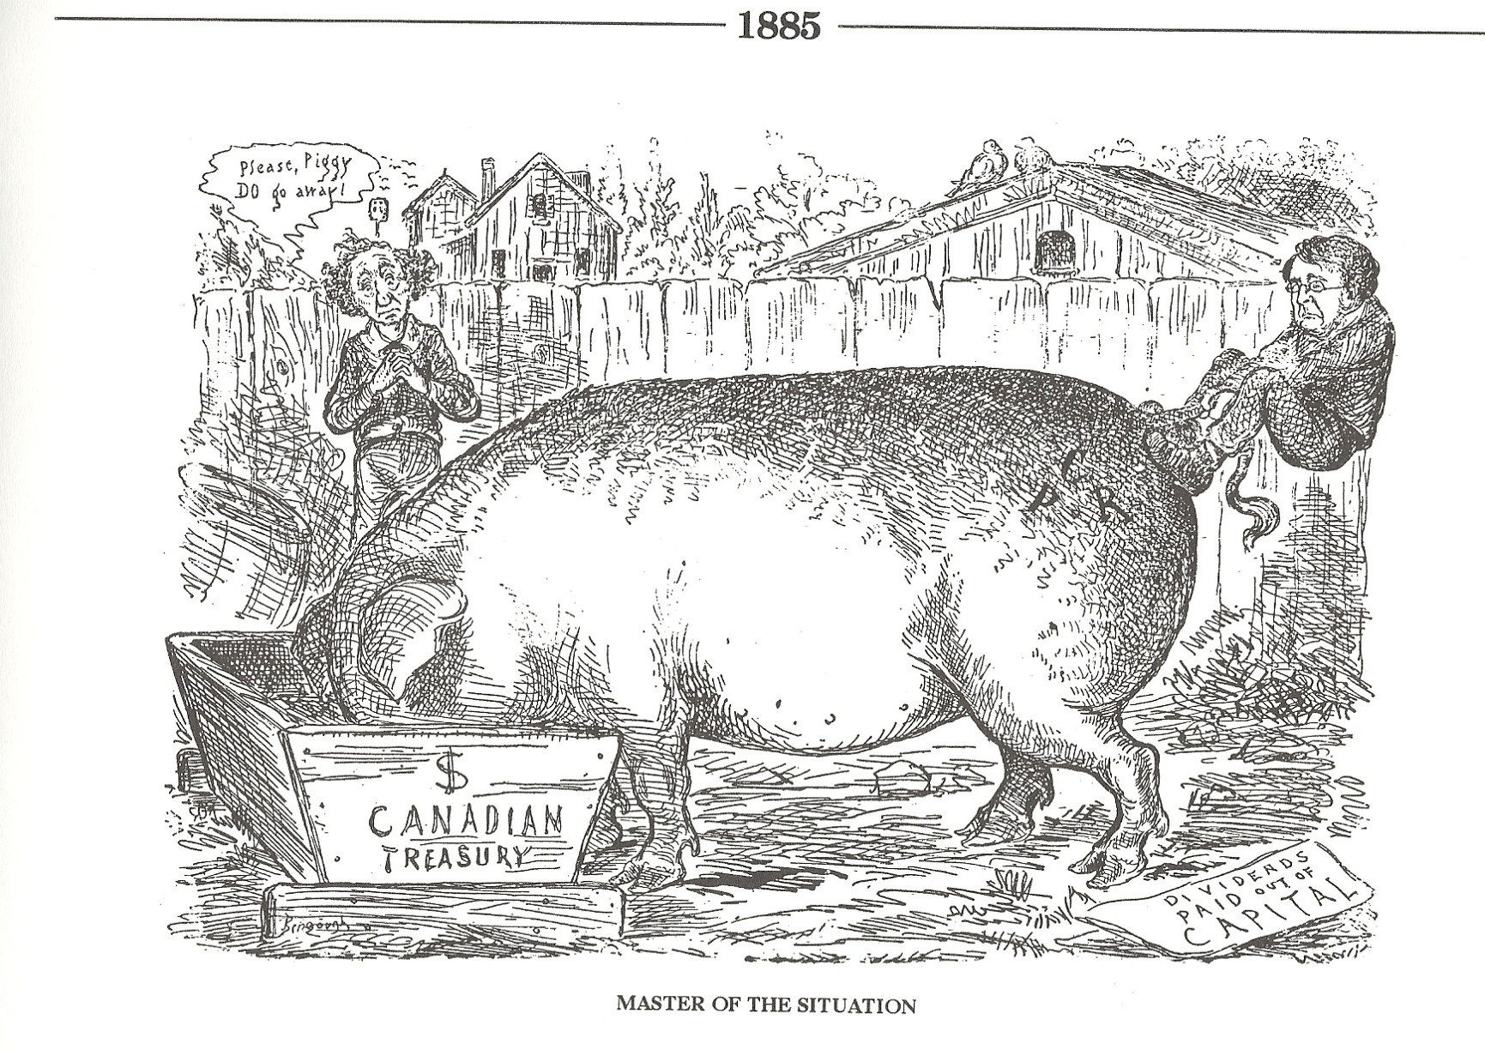
Price of CPR

Slide 24
CPR and NW Rebellion
How does the CPR help in the Rebellion?
How does this save the CPR?
1885: NW Rebellion (Metis)
Van Horne organizes troop movements and they arrive in Winnipeg in 5 days, despite incomplete sections of track
Public grateful for CPR and now supports the $ needed to finish it
CPR completed November 1885 (5 years early)

Slide 25
CPR Workforce
What were the working conditions on the CPR?
How was it different for the Chinese?
35 000 workers, 17000 are Chinese
Horrible living conditions, dangerous work
  Filthy, crowded bunkhouses
  Little food (beans, porridge, bacon)
  Fired if injured, little medical care
  Not paid if can’t work due to weather
  Dynamite blasts = constant danger
Chinese paid ½ wages (or less) which was approximately $1 per day, and forced to pay for lodging and food
Given most dangerous jobs
1 Chinese death for every km of track in BC
When done – most can’t afford to go home (settle in Vancouver and Victoria)

Slide 26
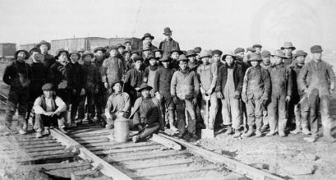
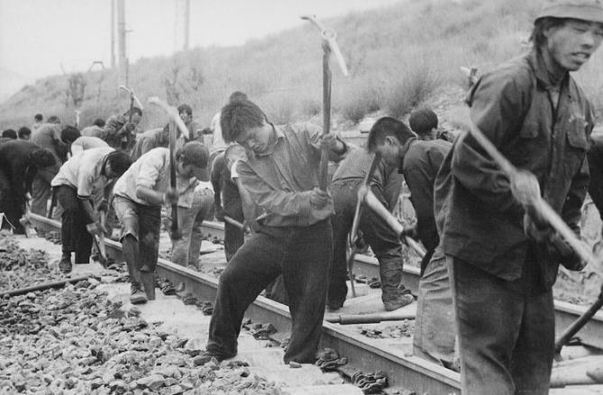
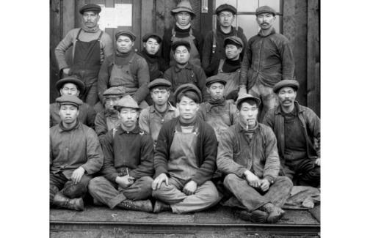
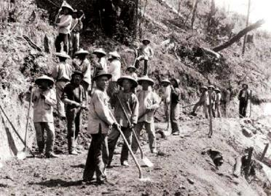
Chinese Workforce

Slide 27
Impact of CPR
What are some impacts of the CPR?
Strengthens Canada
  Nationalism/ identity
  form US Annexation
Increased Trade (east to west, with Europe and Asia)
BC population boom
Access to Prairies for immigrants

Slide 28
The Last Spike
Donald Smith drives the last spike at Craigellachie 1885
Pierre Berton (photographer) has made the "last spike" into a watershed in Canadian history, but in fact it was a rather anticlimactic gesture. The last spike was made of iron, not the customary gold. Moreover, the price of building the transcontinental railroad had been high: it cost the Canadian government 10.4 million hectares of the best Prairie land; an estimated $63.5 million in public funds and government loans of $35 million; not to mention the displacement of Canada's First Nations and the lost lives of many immigrant labourers.
Source: Library and Archives of Canada

Slide 29
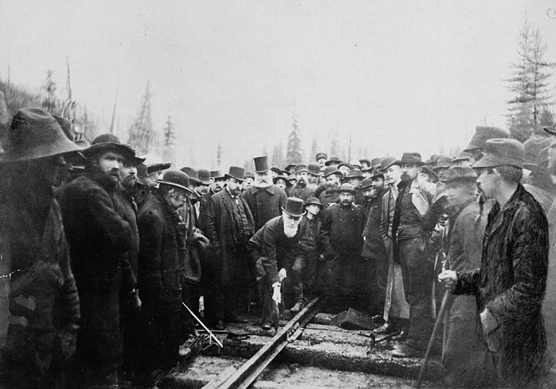
“What can we learn from the photo “The Last Spike”?
Donald Smith drives the last spike at Craigellachie 1885

