Slide 1

Path to Confederation

Slide 2
Life in Canada
Agriculture is the center of all life/economy/culture
Close communities/depend on neighbours
Church is social event
Barter economy (pay with goods)
Learn from First Nations (survival/farming)

Slide 3
Class Systems
Upper class (aristocracy), middle class (merchants) and lower class (farmers)
Oligarchy: Rule (governance) by a small, select group of people
Upper Canada: Family Compact are the ruling oligarchy
Lower Canada: Chateau Clique are the ruling oligarchy

Slide 4
Who owns the land?
Upper Canada
Family Compact owns most of the land (causing anger amongst lower classes)
2/7 of all land is crown reserve
  Underdeveloped (no roads)
  Prime land is wasted
Lower Canada
Chateau Clique owns most of the land (causing anger amongst lower classes
Chateau Clique are NOT French, but English

Slide 5
Types of Government
What is representative government?
What is Responsible Government?
What did the Colonies have?
Government is elected by voters – represents the people
Voters have the power to vote out/ remove a government that does not please them (responsible to the people)
Run by Britain/ Governor and small group of aristocrats (oligarchy)

Slide 6
Type of Government
Why is this colonial government not democratic?
Governor and his councils (Family Compact/ Chateau clique) could Veto all laws passed in Elected legislative assembly (and often did)

Slide 7
Why are the colonists angry?
Upper Canada
Lower Canada
No land
No roads (crown/ clergy land in the way)
Family Compact has all the power
Discrimination against the French by the English
No Representation in Government (French run by British)
High Taxes

Slide 8
Rebellions of 1837
Upper and Lower Canada colonists decided to work together to overthrow the oligarchies/governors
Britain did not have enough troops to fight rebels in both Upper and Lower Canada
Rebellions in both Upper and Lower Canada failed, in large part due to a lack of organization and a lack of support from the church
Some captured rebels were transported to Tasmania, an island off the coast of Australia
  The voyage was brutal, prisoners were shackled to the walls of the ships
  Many died on the voyage over
  Used as slave labour
  Many of Australia’s early colonists were transported convicts

Slide 9
Lord Durham
After the Rebellions of 1837, Britain realized that the old ways of governing the colonies had to change
  Appointed Lord Durham, John Lambton, as governor-in-chief of the Canadas (Upper and Lower)
In English Canada, he is heralded as one of the founders of Canadian democratic government
In French Canada he is seen as a racist who wanted to erase French culture
  “The language, the laws and the character of the North American continent are English, and every other race than the English race is in a state of inferiority. It is in order to release them from this inferiority that I wish to give to the Canadians our English character.” – Lord Durham, 1838

Slide 10
Lord Durham
He arrived in 1838 and upset the Family Compact and Chateau Clique when he told them things were going to change
Was lenient towards captured rebels and pardoned most of them
With the oligarchy now out of power and the legislative assembly having no more power, Durham was in a sense a dictator
Durham made enemies, mainly from those who lost property in the rebellions, which lead to little support
He resigned and went home to England to finish off his report of the colonies

Slide 11
Durham’s Report
Recommended that Upper and Lower Canada be joined together and given responsible government
Recommended that all the colonies of BNA be brought together as well (New Brunswick, Nova Scotia, PEI)
French were to assimilate into English: French were to lose their culture and language and become English
  Was VERY poorly received, as a similar thing was rejected in 1822 (Lower Canada’s governor James Craig proposed it)
Believed that peace could never be achieved in Canada without some form of democracy
While Canada would have a responsibly government, it would still be a colony of Britain, where Britain would control external affairs and the military

Slide 12
Benefits to Uniting
Larger markets
More industry
Better transportation systems
Develop economic policies that would serve Canada rather than Britain

Slide 13
British North America
What are the colonies of British North America?
Act of Union 1840: Canada is united as one colony with one government
Nova Scotia, Newfoundland, New Brunswick, Prince Edward Island are separate, independent British Colonies
USA getting stronger and belief in Manifest Destiny has them expanding rapidly westward

Slide 14
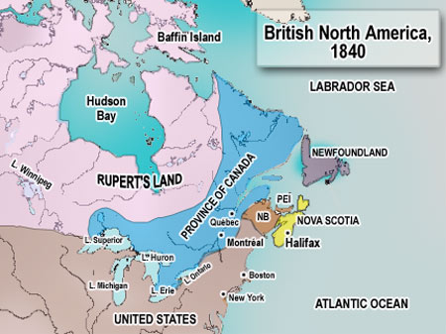

Slide 15
Confederation
What is Confederation?
Where does this idea begin?
Why here?
Confederation is the idea of joining the British Colonies under one central Federal Government, creating an independent country, separate from Britain
Canada (Canada East and West)
Government system in Canada is inefficient (nothing can get done!)

Slide 16
Government problems in
Canada West and Canada East
What makes the Canadian Government inefficient?
Need “Double Majority” – French and English representatives in Legislative Assembly must both pass a bill for it to be law
  Constant disagreement – nothing passes (not even location of parliament buildings)

Slide 17
Government problems in
Canada West and Canada East
What are the 4 political Parties?
4 political parties:
Parti Rouge: Louis-Joseph Papineau
  French farmers/businessmen and wants American Style Government
Parti Bleu: George-Etienne Cartier
  Focus on protecting French Culture, and economic development (support of Catholic Church)
3. Clear Grits: George Brown
  Defends English Canada and wants Representation by population (French be outnumbered)
  4. Tories: John A. Macdonald
  English, but for middle ground/ compromise

Slide 18
Government problems in
Canada West and Canada East
  John A. Macdonald joins forces with Georges-Etienne Cartier to form the Liberal-Conservative Government
    Coalition Government
    Tories and Party Blue
    George Brown of Clear Grits joins Cartier and Macdonald to form the Great Coalition Government
      Goal: Confederation of all the colonies
How does John A Macdonald get the Canadian Government working together?

Slide 19
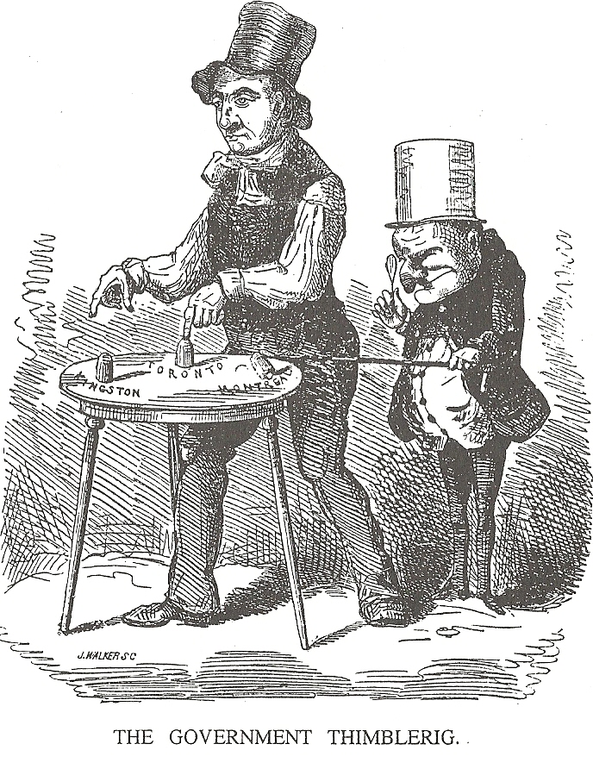
Capital of Canada moved from Montreal, to Toronto – can’t agree as French and English need a “Double Majority” to pass any law

Slide 20
Why is confederation an issue in the 1860s?
Need for government reform
(as stated above)
British support of confederation
Trade
Railroads
Joint Defense

Slide 21
Confederation Debate
How was British support a reason for confederation?
Britain doesn’t want to pay for defense of Colonies, and they aren’t very profitable anymore – wants them to be independent
Colonists are Loyalists and Britain supporting Confederation is a reason to also support it
Means more Responsible Government

Slide 22
Confederation Debate
How was Trade a reason for confederation?
1846 Britain repealed the Corn Laws
  Before Britain bought Canadian resources without tariffs (high Canadian profits)
  Now Canadians have to compete with rest of world prices to sell to Britain
  1854: Reciprocity between British Colonies and USA
    Could trade in USA without tariffs - happy again
    1865: USA decides to end reciprocity (free trade) agreement
    If all colonies Unite, they could have free trade with each other

Slide 23
Confederation Debate
How was a Railroad a reason for confederation?
Railway = allow crops/ manufactured goods/ etc. to get from colonies to USA market (and to each other)
Canada is currently isolated from Atlantic Maritime colonies
    Mountains
    Ice on St. Lawrence in winter
Canadian railways: Grand Trunk and Great Western going bankrupt
United Colonies could finance an intercontinental railway
    Possibility it could eventually run “sea to sea” – Atlantic to Pacific

Slide 24
Confederation Debate
How was Joint Defense a reason for confederation?
USA is expanding quickly Westward
  Manifest Destiny
  Fear will try to buy land from Britain from colonies, or invade colonies
  Fear Red River (present day Manitoba) would voluntarily join USA
  Fear USA will try to take unsettled West (present day Sask., Alberta, BC), and Canada needs more land
  Fenians (American Irish Catholics) attack colonies (raids) to lash out against British occupied Ireland
  United Colonies could stop Fenian raids, US annexation/ invasion, and take the Land in the West

Slide 25
Concerns against Confederation
Why were People in the Colonies skeptical about confederation?
Loss of independence:
  fear a central government (controls $, defence, law, etc.)
No Cultural/ Economic connection
  French fear an even greater English Majority
  Maritimes felt no connection to Canada – closer trade to USA
Hard to convince the general Public
  Very expensive
  Politicians often go back on promises
  4. Competing idea of Maritime Union (excluding the Canadas)

Slide 26
The Charlottetown Conference Sept. 1, 1864
Why was there a meeting in Charlottetown?
What does Canada promise?
Nova Scotia, PEI, and New Brunswick meet to discuss a Maritime Union
Canada decides to crash the meeting to pitch the idea of Confederation
  John A Macdonald, George Brown, George-Etienne Cartier, Alexander Galt, Thomas D’Arcy McGee
  Canada Promises:
    Railroad connecting Canada and Maritimes
    Free Trade
    Result: All Agree to have Confederation Meeting in Quebec in October

Slide 27
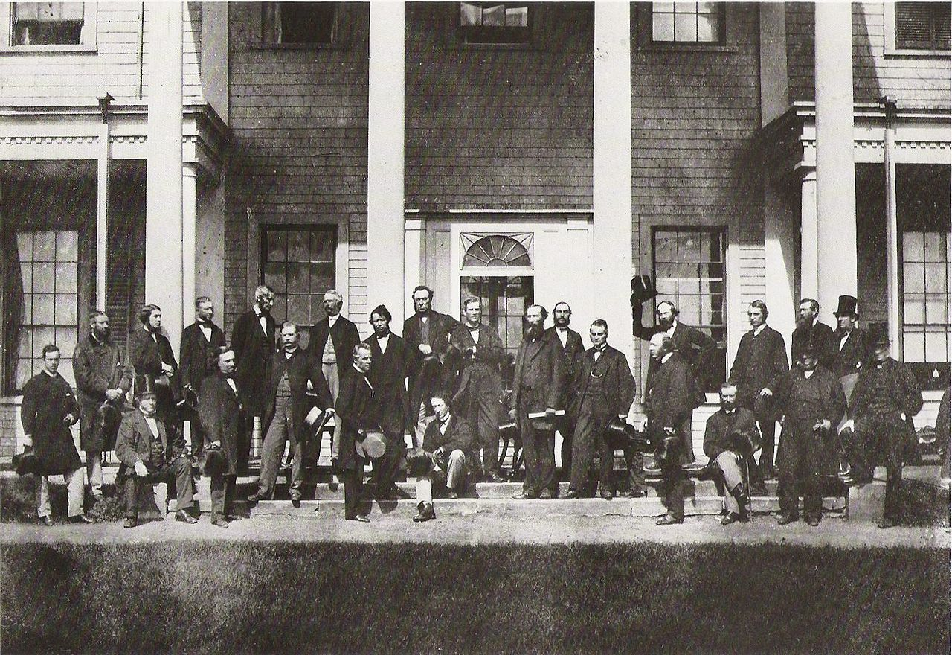

Slide 28
The Quebec Conference October 1864
What was the Quebec Conference?
What was discussed?
Planning of a new nation
Operation and powers of the new federal government
Powers of the new provinces
Protecting French language and culture
No thought towards the Aboriginal peoples

Slide 29
The Quebec Conference October 1864
It took nearly three years, but the Quebec Conference produced 72 Resolutions and a blueprint for Canada
Lots of opposition to certain proposals throughout the conference
July 1st, 1867: British Parliament passed the British North America Act, which created the Dominion of Canada
  Canada is now a country!
Plans to bring the Northwest and British Columbia into Confederation
Newfoundland and PEI needed to join, too
What happened?
What was left?

Slide 30
Quebec conference
We will be re-inacting the Quebec Conference.
You will each be a character from one of the colonies. You will have to decide if you support or oppose confederation, and will take part in the conference.

