Slide 1
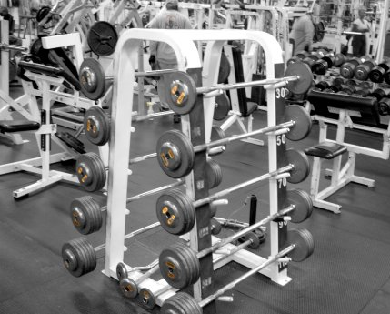
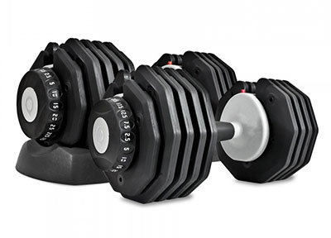
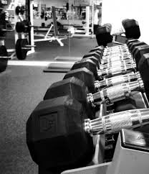
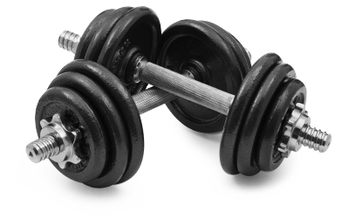
Fitness Reflection

Slide 2
Goalsetting
My goals were met over the course of this year. I strived to gain weight, and gained a total muscle mass of 12 pounds.
Some barriers I faced throughout the year was job confliction. I often spent time in the gym but on occasion was too tired to participate in class and instead did productive school work during that time.
Over the period of this year I had many external and internal influences. Much of which was my drive to excel in my fitness testing.

Slide 3
Pull Up Test
Over all I am very happy with how I have excelled. I started with 26 pull ups and by term 3 I reached my goal of 30 chin ups. Training required or this was mainly core and back which was required to accelerate up on the bar.
Terms

Slide 4
Plank Test
Over all I am confident with my consistency in this test. I pushed myself every term to reach 5 minutes and by term 3 had maintained my goal to outlast exhaustion. Training required or this was particularly core and arms which was required to maintain a steady balance when in plank position.
Terms

Slide 5
Push Up Test
I am proud with my performance in this test. I strived every term to increase my push up max and concluding term 3 had achieved 74 push ups well past my original goal to push out two or three more than the previous time. Training required for this was particularly core and arms which was required to maintain efficiency and speed throughout the test.
Terms

Slide 6
Bench Press Test
I am Satisfied with my performance in this test. I pushed myself to increase my reps and strived to gain muscle mass. Concluding term 3 maxed out at 16 over five times my original reps in the first term. Training required for this was particularly chest, biceps, and triceps which was required to exert enough force to complete each rep.
Terms

Slide 7
12 Minute Run
I am confident with my performance in this test. I slowed down by ½ a lap in the finial term due to poor cardio. to increase my cardio for next year and my next set of fitness testing I plan too run and produce cardio workouts to increase my speed and time. Training required for this test was particularly cardio and legs which was required to efficiently complete the laps.
Terms

Slide 8
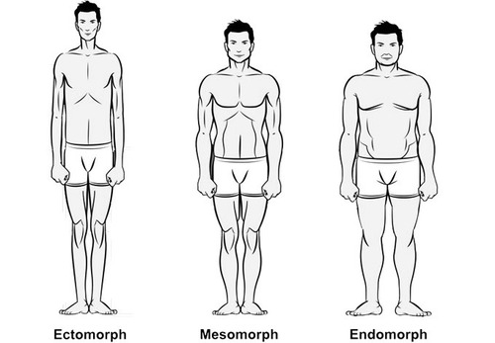
Somatotypes
Ectomorphic: characterized as linear, thin, tall, often fragile, light muscle mass. desire isolation, solitude and concealment, normally tense, anxious, and have restrained in posture and movement.
Mesomorphic: characterized as rugged, triangular, athletically built with well developed muscle. Thick skinned with good posture. Found to be inclined towards physical adventure and risk taking also found to be vigorous, courageous, assertive, direct and dominant.
Endomorphic: characterized as round, normally short and soft skinned, under-developed muscle mass and normally have difficulty losing weight. Known to over enjoy food, and love people and affection. May have slow reactions in physical situations.

Slide 9
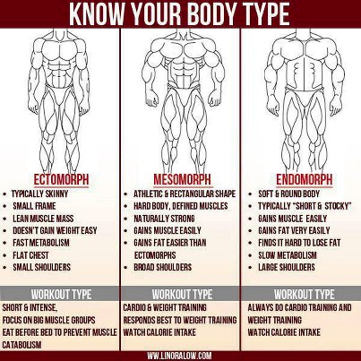
Finding Somatotypes
“You have a naturally fit body but, to maintain or improve it, you should adopt an exercise and diet regimen that compliments your build. You can strength train more often and for longer periods of time, but be careful not to overdo it. Train with moderate to heavy weighs and keep a moderate pace, making sure not to rest too long between sets. You'll find you gain muscle quite easily. Don't fear; you won't get "bulky." When you're happy with your muscle size, simply train to maintain. Stick to a good, healthy diet to stay lean and muscular, and watch for any slow-creeping fat gains. Engage in and enjoy aerobic activities, but be careful not to.” -www.bodybuilding.com
Traits:
Endomorph: 13%
Mesomorph: 63%
Ectomorph: 25%

Slide 10
Why did I take this course
To get bigger
Get better endurance
Build muscle mass
To keep myself in shape
To use and burn off energy
To socially communicate with my peers using something I personally enjoy

Slide 11
Personal fitness and Strengths
4.5/5
Strengths
Weaknesses
Core
Back
Triceps
Chest Strength
Long Distance
Bicep Strength
Legs
Short Distance
Chest Image
Bicep Image

Slide 12
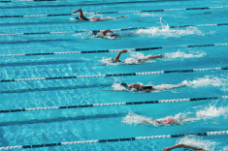
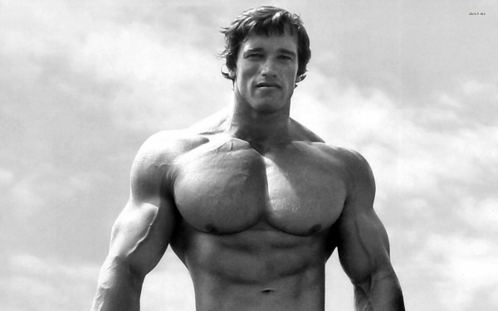
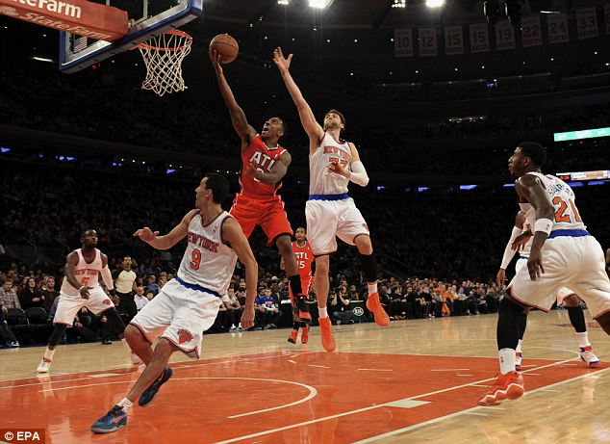
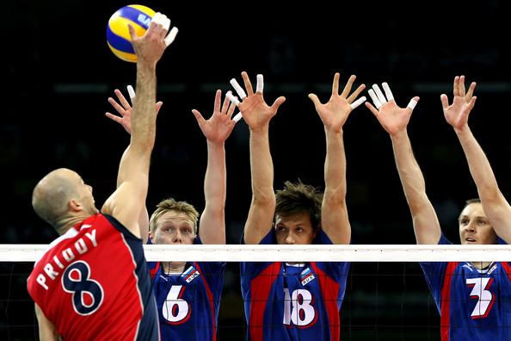
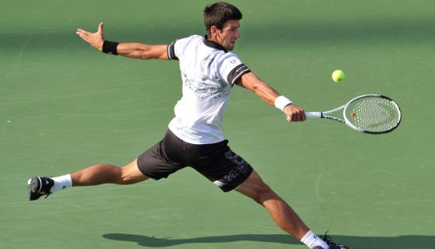
Sports that fit my body type

Slide 13
Outside/Inside Recourses
Community rec center at Walnut Grove once a week.
Swim workouts at walnut grove pool.
MMA gym by the bypass.
School gym and Courts.

Slide 14
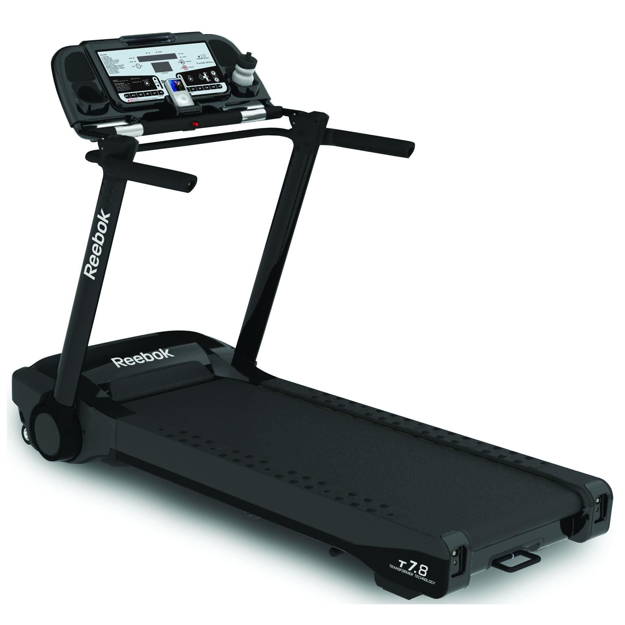
To Maintain a healthy lifestyle.
Lower stress levels
sleep
take time for myself
vitamins
drink more water
less caffeine
less sugar

Slide 15
Course Reflection
Before this course I had frequent weight and strength training experiences and participated in many sporting events.
No this course was not what I expected, we did not have the freedom I thought we would have until we approached third term and had a witch of teaching.
I believe I improved as soon as I was given my own time to chose my workouts, before this my workouts wee controlled and I was unable to work heavily in the places I lacked strength.
There were multiple things that could've made this program but I believe they all happened in the third term. Our new teacher Mr. Salter provided outdoor time so we could still compete in other sports, gave us time to accomplish our goals through free workouts, additionally also gave us pointers on technique and even worked out with us. Those three things were exactly what I expected in this course and I believe we did not receive them in the first two terms so creds to salter for turning my view of weight training around for me.
In this course I would simply change the ability to be controlled during workout time unless completely necessary or for an outdoor activity. I believe its extremely important to have proper time to efficiently workout and achieve your goals. Over the last term Mr. Salter has provided this experience for our class he has been lenient respectful and helpful in assisting us to reach our physical and emotional goals as high school influences. Unlike Tupper he has never held us up for 40 minutes talking about how much ice cream he ate the day before but has us getting right into our workouts with an efficient warm-up. Overall I am very pleased on how this course has turned out in the last term and I am excited to see where it goes next year thanks to Mr. Salter.

